Slide 1
TerraNNI: Natural Neighbor Interpolation on a 3D Grid Using a GPU
Alex Beutel
Carnegie Mellon University
Joint work with Pankaj Agarwal, Thomas Mølhave, Arnold Boedihardjo, James Shine

Slide 2
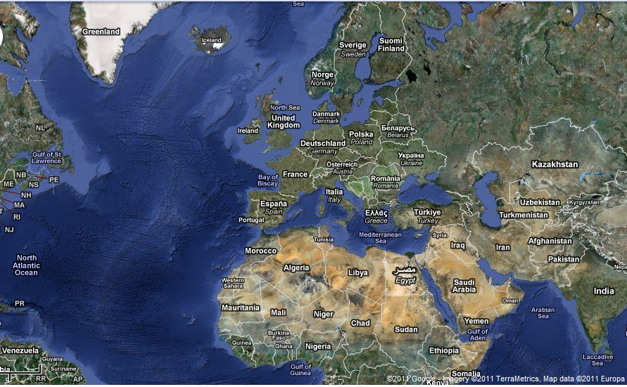
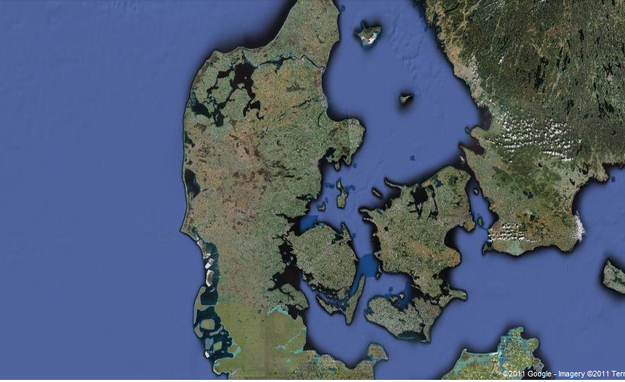
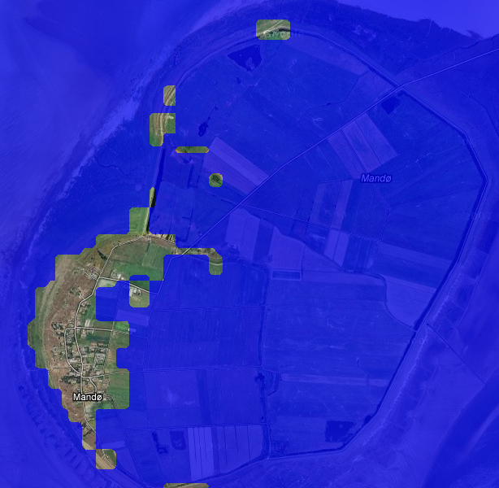
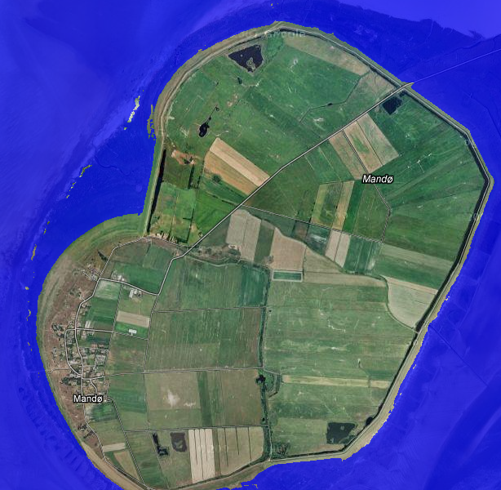
Flood mapping – Mandø, Denmark
90 meter grid resolution
2 meter grid resolution
Notes:
Explain importance of high-res and scalablility

Slide 3
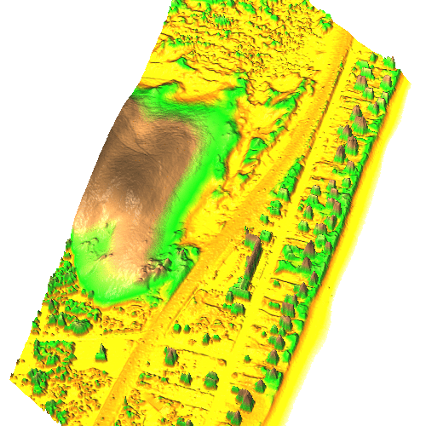
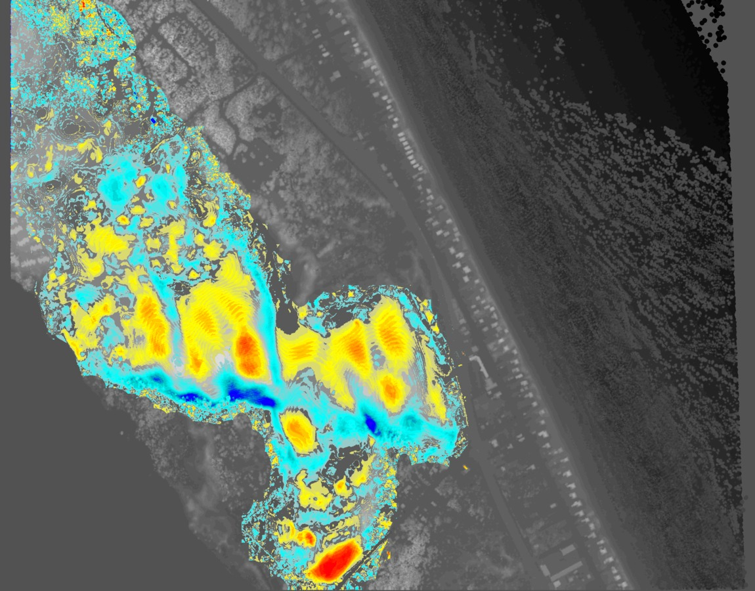
Change Detection – Nags Head, NC
http://skagit.meas.ncsu.edu/~helena/grasswork/NH9908p_anim.gif
Notes:
Why is this important? Explain easier to obtain spatio-temporal data, change detection one possible application

Slide 4
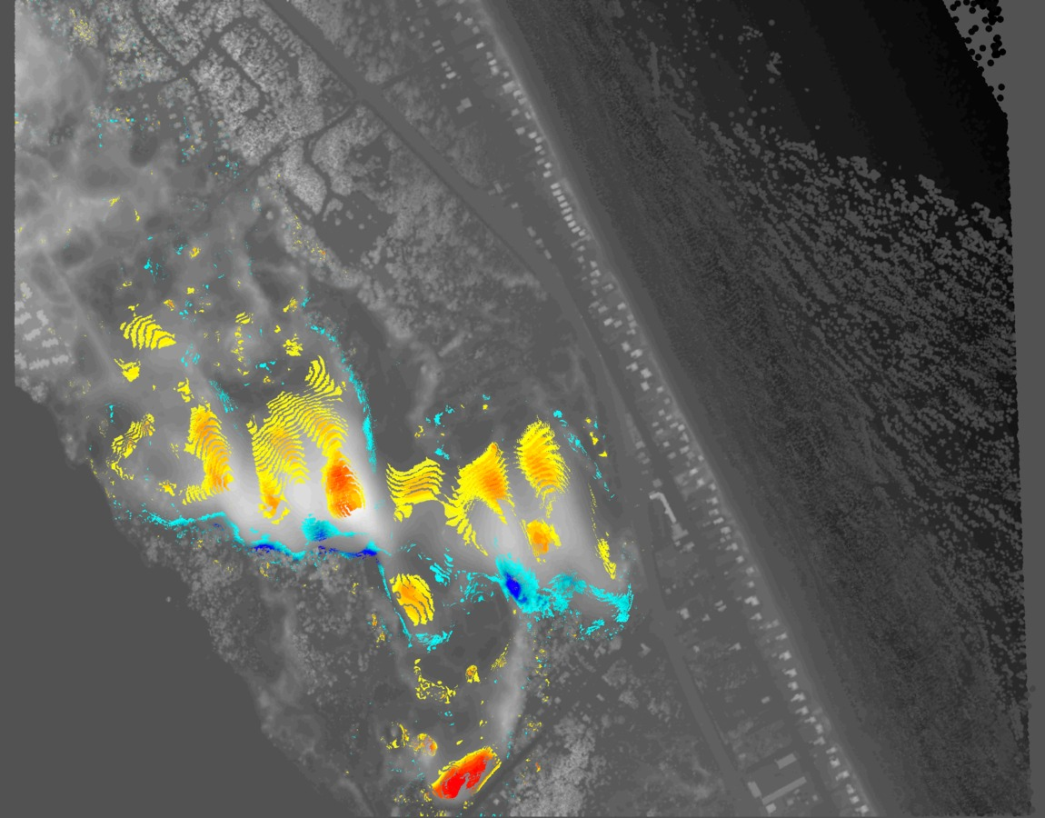

Change Detection – Nags Head, NC
2002-2003
2003-2004
Notes:
Why is this important? Explain easier to obtain spatio-temporal data, change detection one possible application

Slide 5
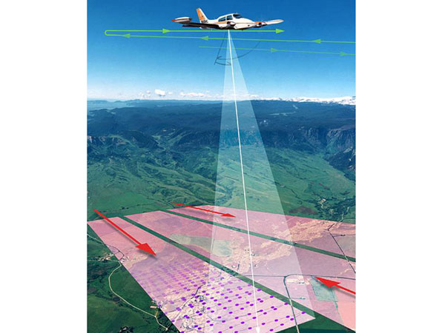
LIDAR – Light Detection and Ranging
Source: http://minnesota.publicradio.org/display/web/2008/07/09/digitalmap/

Slide 6
Digital Elevation Model (DEM)
Geographic Information Systems need models
Enables many applications
  Hydrology, contouring, noise computations, line-of-sight, city planning

Slide 7
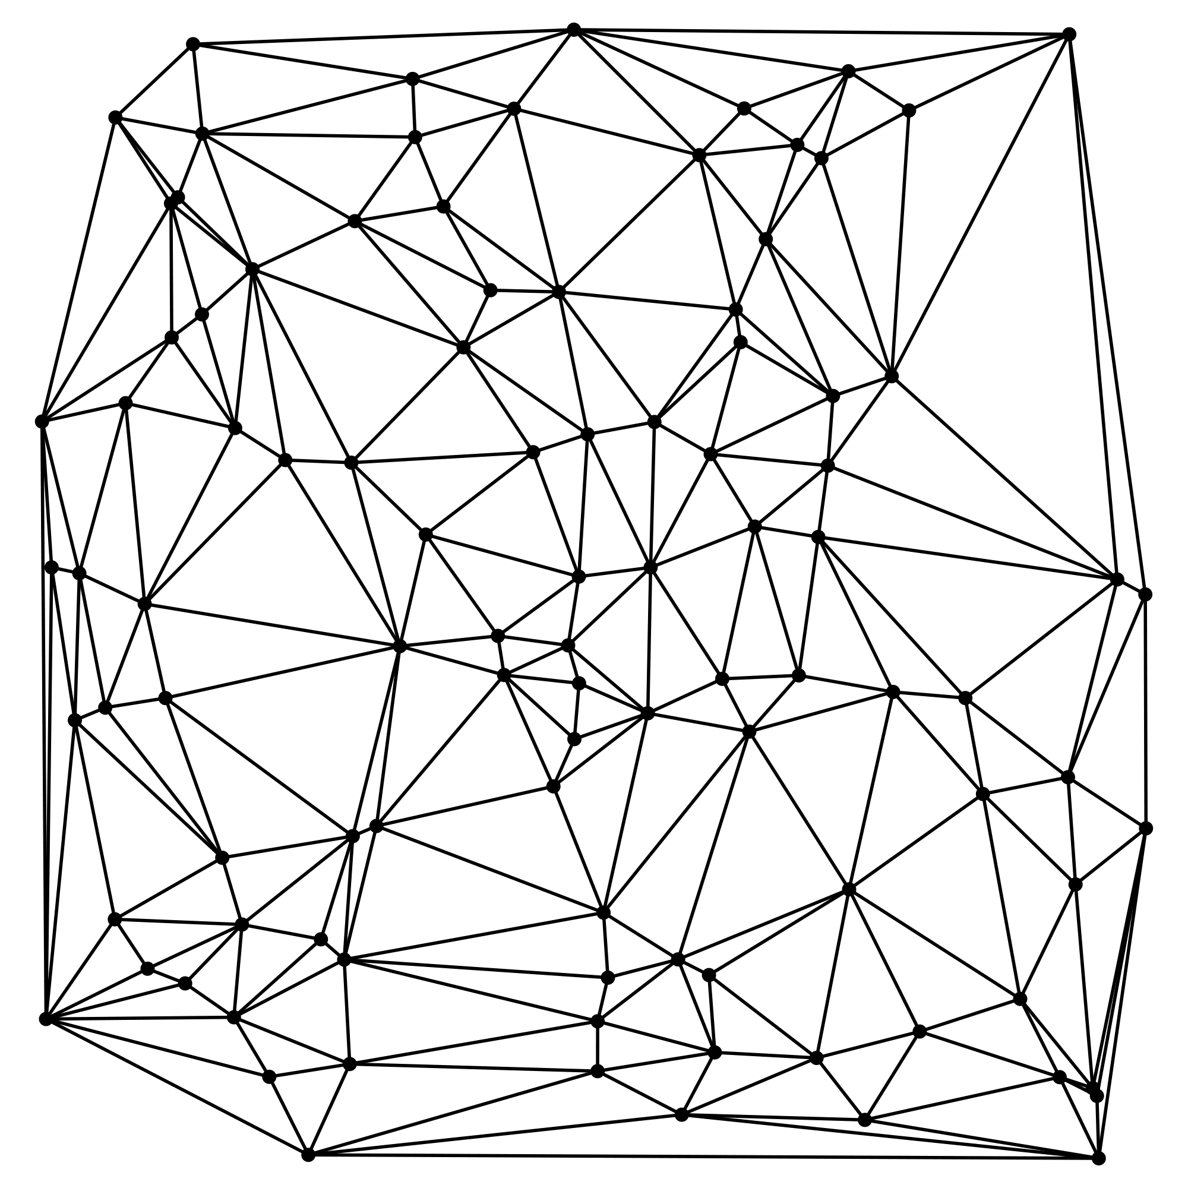
GRID Terrain Models
Linear interpolation based on Delaunay triangulation [Agarwal et al. ‘05]
  Simple but not smooth
  Relatively fast
Regularized spline with tension (RST) [Mitasova et al. ‘93]
  Uses high-order polynomials
  Better with sparse data
  Slow
Natural Neighbor Interpolation (NNI) [Beutel et al. ‘10]
  Smooth, fast, and scalable
  Discretized on the GPU

Slide 8
Voronoi Diagram in 2D
A Voronoi cell Vor(p_{i}) is the region in space for which p_{i} is the closest point (the nearest neighbor) from the set of input points S

Slide 9
2D Natural Neighbor Interpolation
Vor(q) takes area from neighboring cells (natural neighbors)
Interpolate h(q) based on weighted average of heights of natural neighbors h(p_{i})
Weights are based on:

Slide 10
3D Interpolation
For spatial-temporal data must use a volumetric grid
CPU algorithms have trouble scaling to higher dimensions
Efficiency and scalability become more important
Used in geostatistics, environmental sciences, GIS, biomedical engineering, and other disciplines
9
Notes:
CRUCIAL
Multiple years of LIDAR data
Volumetric grid of form (x,y,t) with elevation z at each grid point

Slide 11
3D Natural Neighbor Interpolation
NNI extends to higher dimensions and a wide class of distance metrics
Our Contributions:
  TerraNNI: GPU algorithms for 3D NNI
  trade-offs in time and GPU memory
  Implementation is fast, scalable and robust

Slide 12
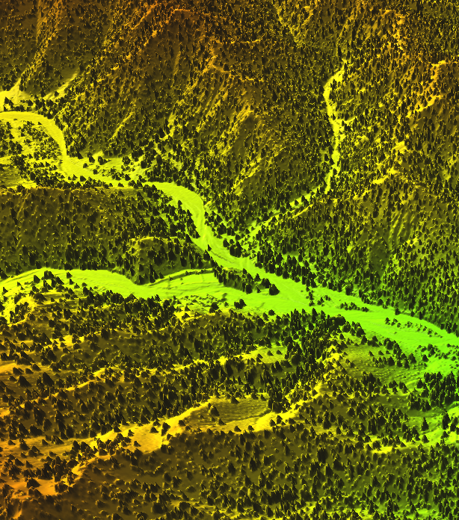
Outline
GPU background
Voronoi diagrams
  Triangulation
  Lifting Transform
Fast batch NNI in 2D
NNI algorithms for 3D grids
  Slow, little memory usage
  Faster, medium memory usage
  Fastest, high memory usage
Evaluation
Notes:
Remove image? Too distracting?

Slide 13
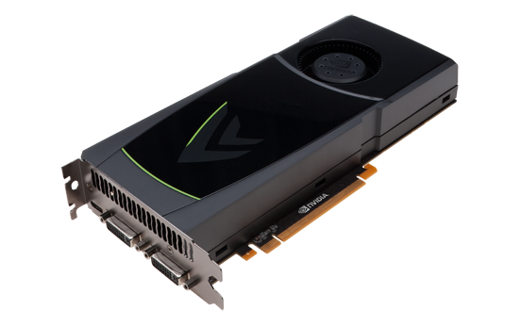
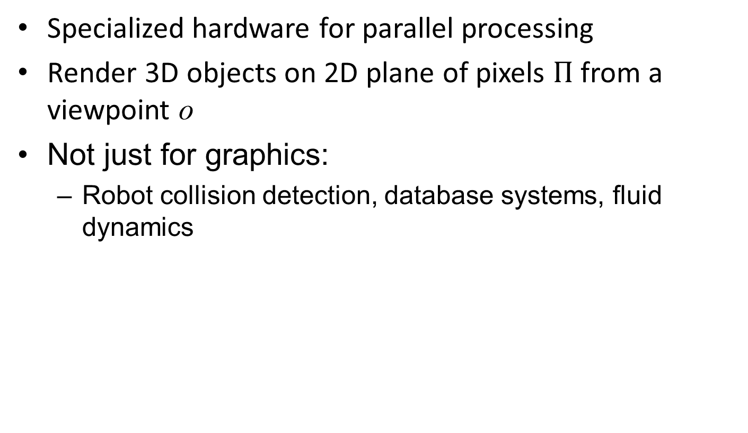
Graphics Processing Unit (GPU)
Specialized hardware for parallel processing
Render 3D objects on 2D plane of pixels $Π$ from a viewpoint o
Not just for graphics:
  Robot collision detection, database systems, fluid dynamics

Slide 14
Computing the 3D Voronoi Diagram
[Hoff, et al. 1999]

Slide 15
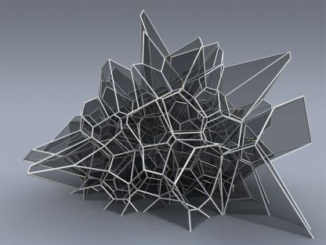
3D Voronoi Diagram
http://www.qhull.org/html/normal_voronoi_knauss_oesterle.jpg

Slide 16
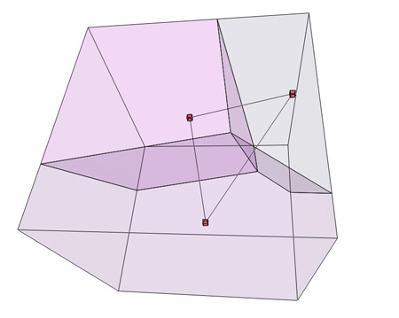
3D Voronoi Diagram
As before – A Voronoi cell Vor(p_{i}) is the region in space for which p_{i} is the near neighbor from the set of input points S
http://www.wblut.com/blog/wp-content/2009/04/voronoi3db2.jpg

Slide 17
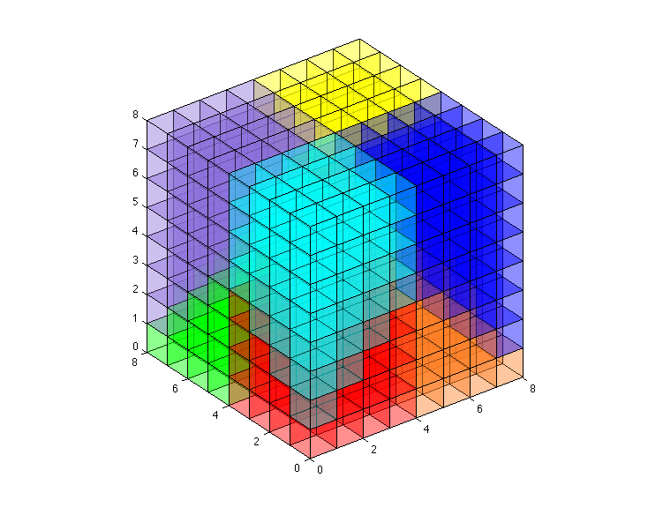
Pixelized 3D Voronoi Diagram
Can discretize 3D space into voxels
  Cubes of space
  Sample from center of each voxel
Define PVor_{S}(p_{i}) to be the set of voxels for which, from the set S, p_{i} is closest to the center of that voxel

Slide 18
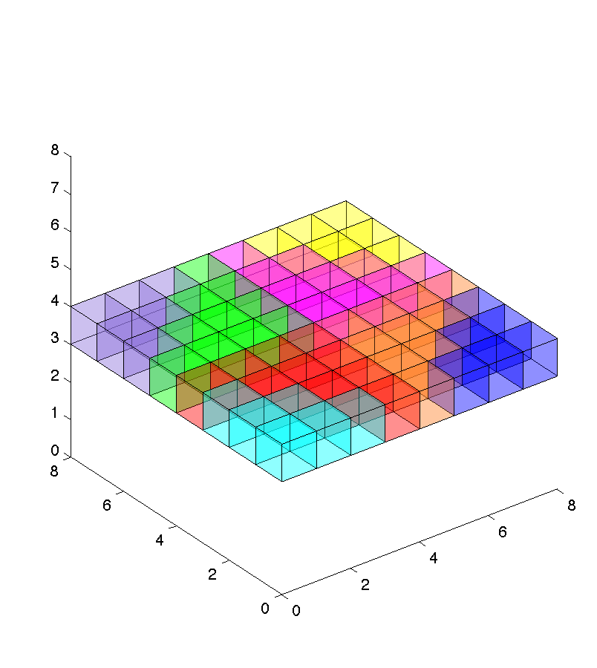
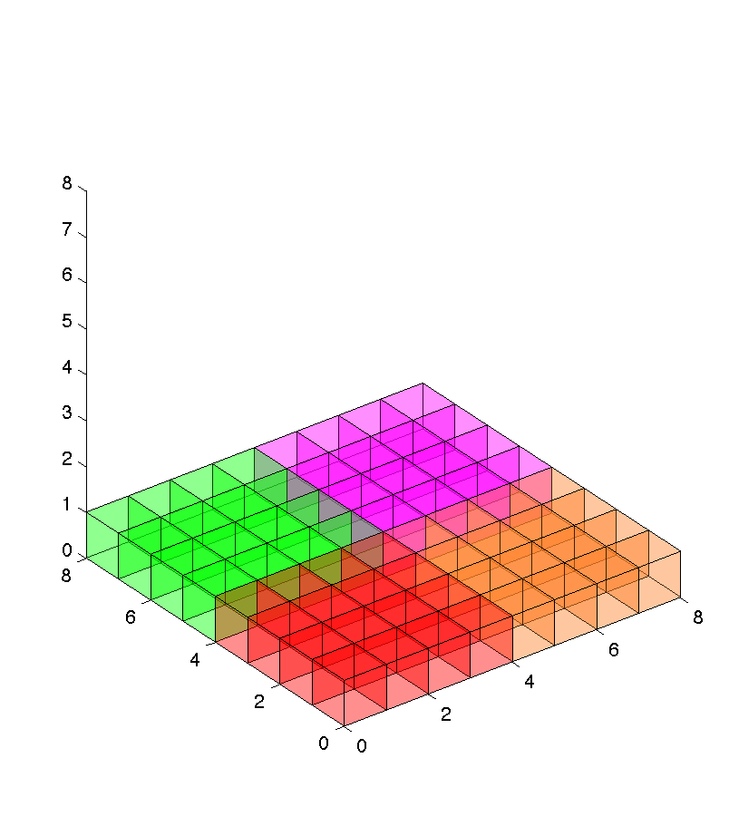
Pixelized Voronoi Diagram
Can look at just one plane of voxels
  Time is constant in each plane
Generate each time slice separately

Slide 19
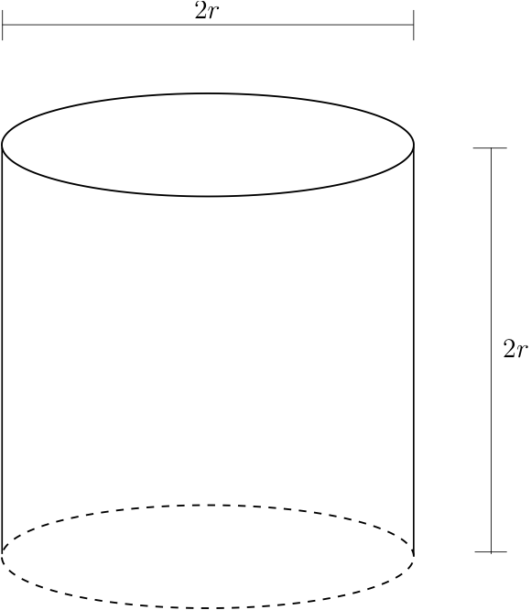
Cylindrical Region of Influence
Notes:
Is abrupt, lead in softly
Add bullet points?

Slide 20
Truncated Pixelized Voronoi Diagram
Define TPVor(S,τ)
  Only consider points p in S for which
  |t_{p}-τ| ≤ r
  For pixel v and point p,
  d((x_{v},y_{v}),(x_{p},y_{p})) ≤ r for v to be in TPVor_{S}(p)
    Only draw cone (or other shape representing the metric) up to radius r

Slide 21
Voronoi Diagram and Lower Envelopes
For each point p_{i} define function
Lower envelope of {f₁,f₂…f_{n}} is
Lower envelope is distance from x to its nearest neighbor

Slide 22
Weighted Euclidean Lower Envelope
When evaluating for only one time slice, time is constant for all points in that time slice

Slide 23
Lower Envelope

Slide 24
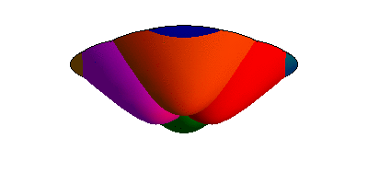
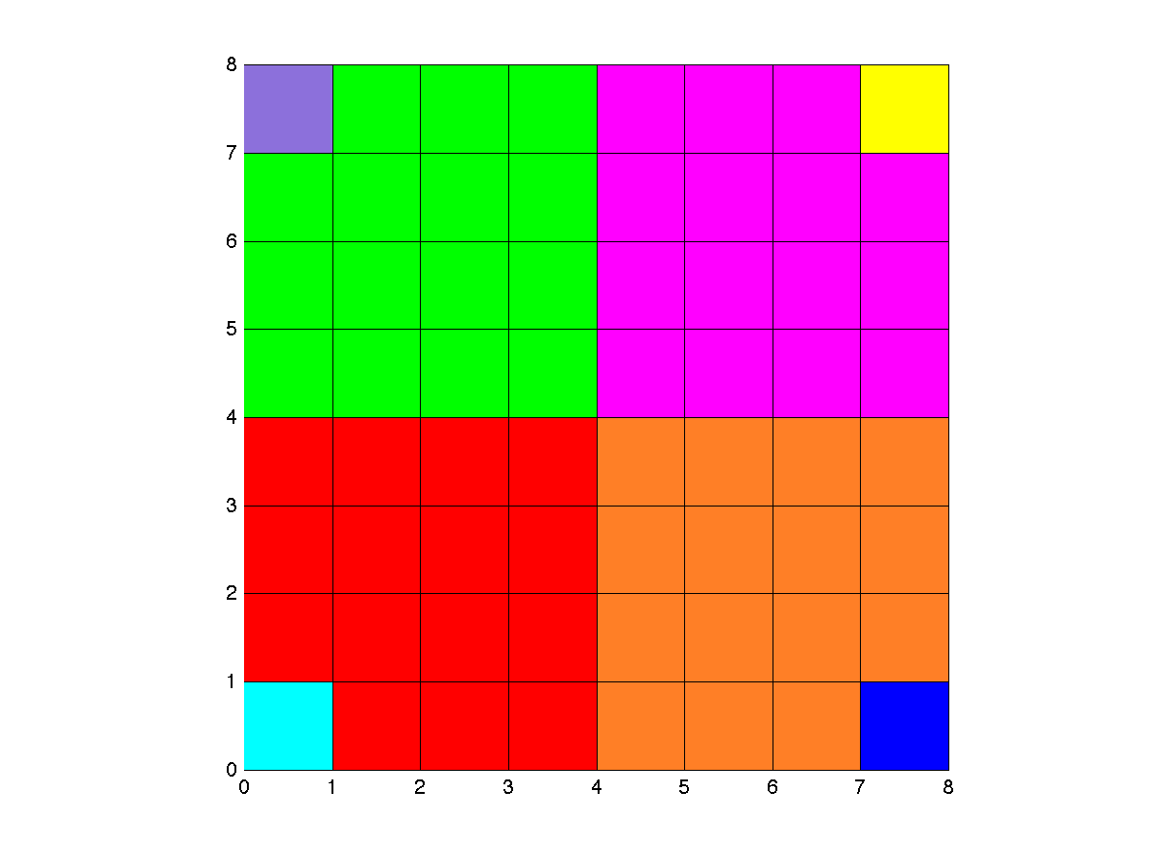
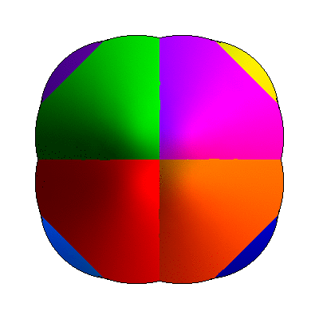
Lower Envelope – Discretized in Time & Space

Slide 25
Triangulation of the Lower Envelope
Find height for which
d(p,x)=r
Intersect shape with m equally spaced planes
Approximate intersection of each plane with the curve by a convex k-gon
Create triangles between adjacent k-gons using 2k triangles
2km triangles required per object rendered

Slide 26
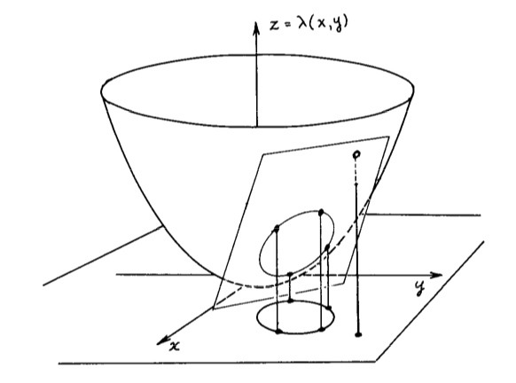
Lifting Transform for Weighed Euclidean Metric
Drawing curved surfaces requires many triangles
More efficient if we can just draw a plane
Lower envelope of g is that same as that for f
[Guibas et al. ‘85]

Slide 27
Lifting Transform for Weighed Euclidean Metric
Only need to draw plane for each point
Can use many less triangles
Still approximate by
k-gon

Slide 28
Computing TPVor(S,τ)
Reset framebuffer
Get P={points within “r” from t=4}
Render metric for points in P
Depth and color buffers now stores TPVor(S,τ)
Call this process
GVor(S,τ)

Slide 29
Natural Neighbor Interpolation
[Fan, et al. ‘05]
[Beutel, et al. ‘10]

Slide 30
Natural Neighbor Interpolation
Vor(q) takes area from neighboring cells (natural neighbors)
Interpolate h(q) based on weighted average of heights of natural neighbors h(p_{i})
Weights are based on:

Slide 31
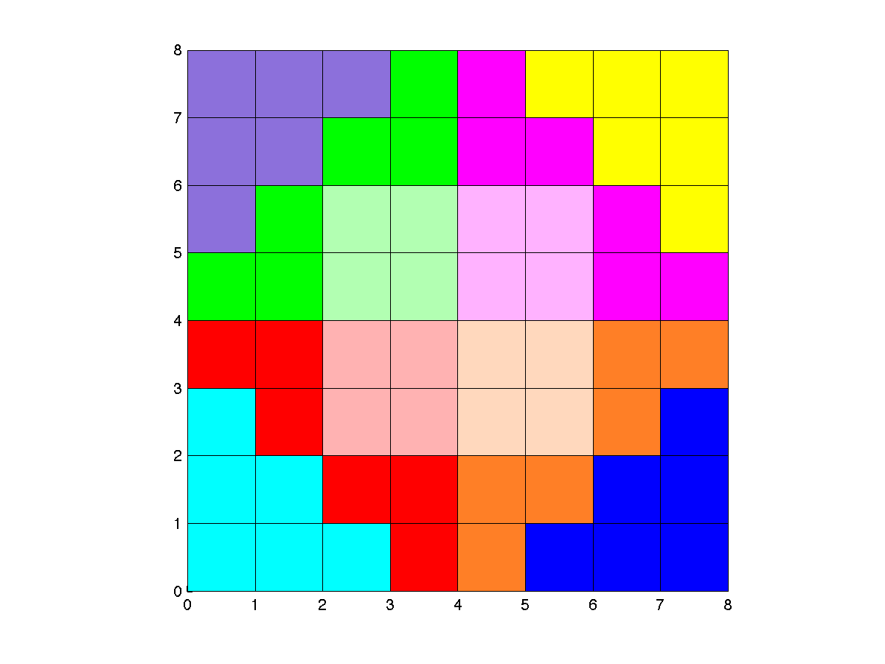
BufferAnalysis
4
4
4
4

Slide 32
NNI Query Processing
GVor(S)
Save and clear color buffer
Draw Voronoi cell for query q
Save color buffer
BufferAnalysis
Notes:
Remove animation, collapse subsequent slides

Slide 33
Answering Multiple Queries
[Fan et al. ‘05]
[Beutel et al ’10]

Slide 34
NNI Batch Query Processing
GVor(S)
Save and clear color buffer
Draw Voronoi cell for query q
Save color buffer
BufferAnalysis
SLOW

Slide 35
Using Bit Tricks while Exploiting Region of Influence and Grid Structure ….
[Fan, et al. ’05]
[Beutel, et al. ‘10]

Slide 36
NNI Grid Query Processing
GVor(S)
Save and clear color buffer
Draw Voronoi cell for ~10⁶ queries
Save color buffer
BufferAnalysis

Slide 37
NNI Batch Query Processing
GVor(S)
BufferAnalysis
Draw Voronoi cell for ~10⁶ queries
Save interpolated heights
GVor(S)
Save and clear color buffer
Draw Voronoi cell for ~10⁶ queries
Save color buffer
BufferAnalysis
SLOW
CUDA
SLOW
Notes:
Explain what cuda is

Slide 38
NNI in 3D

Slide 39
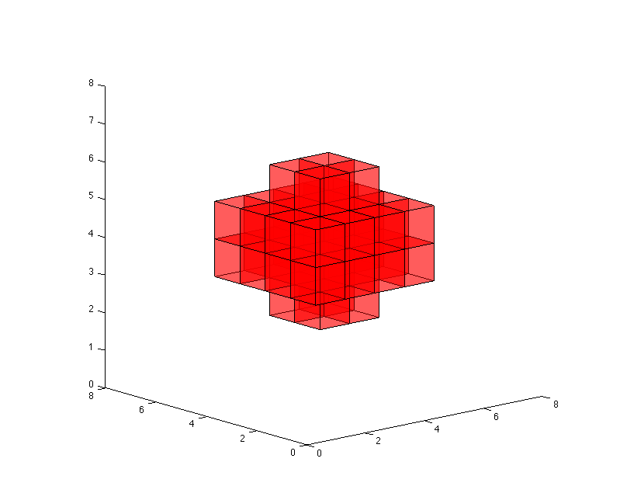
Natural Neighbor Interpolation
Largely the same:
Each time slice: use 2D method

Slide 40
NNI on N x N Grid at t_{o}
GVor(S,τ)
BufferAnalysis
Draw Voronoi cell for ~10⁶ queries
Save interpolated heights
Loop
over τ
for
t_{o}-r ≤ τ ≤ t_{o}+r
Interpolate(F_{τ},t₀τ)

Slide 41
NNI on N x N Grid at t_{o}
GVor(S,τ)
Save interpolated heights
Interpolate(F_{τ},t_{o},τ)
Loop
over τ
for
t_{o}-r ≤ τ ≤ t_{o}+r

Slide 42
Handling N x N x N Grids

Slide 43
r²-pass Algorithm
GVor(S,τ)
Interpolate(F_{τ},t_{o},τ)
Save interpolated heights
GVor(S,τ)
Interpolate(F_{τ},t₁,τ)
Save interpolated heights
t_{o}-r ≤ τ ≤ t_{o}+r
t₁-r ≤ τ ≤ t₁+r
…
Interpolate N x N x {t_{o}}
Interpolate N x N x {t₁}

Slide 44
Voronoi Generation Redundancy
F_{τ} – Framebuffer with Voronoi at time τ
r = 1.5
F₀ F₁ F₂ F₃ F₄ F₅ F₆ F₇ F₈
F₀ F₁ F₂ F₃ F₄ F₅ F₆ F₇ F₈
F₀ F₁ F₂ F₃ F₄ F₅ F₆ F₇ F₈
F₀ F₁ F₂ F₃ F₄ F₅ F₆ F₇ F₈
But regenerating is F₂ F₃ unnecessary
Interpolate grid for τ = 3
Interpolate grid for τ = 2

Slide 45
r-pass Algorithm
GVor(S,t_{i}+r)
Interpolate(F_{τ},t_{i},τ)
Save interpolated heights
GVor(S,t_{i+1}+r)
Interp (F_{τ},t_{i+1},τ)
Save interpolated heights
t_{i+1}-r ≤ τ ≤ t_{i+1}+r
t_{i}-r ≤ τ ≤ t_{i}+r
…
…
Interpolate N x N x {t_{i}}
Interpolate N x N x {t_{i+1}}

Slide 46
1-pass Algorithm
Can be used if data is time series data and d(•,•) is the weighted Euclidean metric
Recall
Run GVor(S^{τi},τ_{i}), here:
Use CUDA to shift slice times by adding appropriate ω²(τ-t_{i})² term
Combine shifted slices to get TPVor(S,τ)
Perform BufferAnalysis
Notes:
Expand if time

Slide 47
Review Algorithm Trade-offs
Algorithm Number of Passes | Number of copies of Framebuffer | Triangles rendered per point | Triangles rendered per point: Euclidean metric
r² | 1 | ~(2r)²kmn | ~(2r)²kn
r | 2r+1 | ~2rkmn | ~2rkn
1 | 2(2r+1) | ~kmn | ~kn
Algorithm Number of Passes | Number of copies of Framebuffer | Triangles rendered per point | Triangles rendered per point: Euclidean metric
r² | 1 | ~2000n | ~16n
r | 5 | ~500n | ~4n
1 | 10 | ~250n | ~2n
Notes:
Update for k=4 in the lifting transform

Slide 48
Experiments

Slide 49
Implementation
Hardware
  Intel Core2 Duo CPU running Ubuntu 10.4
  NVIDIA GeForce GTX 470 with CUDA 3.0
OpenGL
  Templated Portable I/O Environment (TPIE) for interacting with disk efficiently

Slide 50
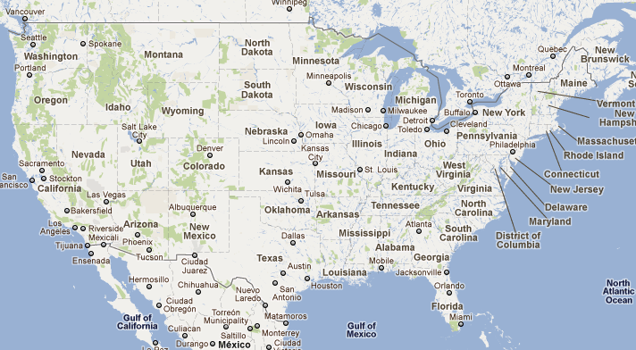
Tests
Nags Head, NC (Coastal):
  382 MB
  20 million data points
  Data sets from 1997-1999, 2001, 2004, 2005, 2007, 2008
Fort Leonard Wood (Missouri)
  8.8 GB
  450 million data points
  80.5 km² region
  Data sets from 2009, 2010

Slide 51
Implementation Comparison
Precision
  Our implementation is an approximation of natural neighbor interpolation
    Error introduced by region of influence, discretization, and in some cases tessellation
  Other implementations are precise
    Computationally more expensive
Degeneracies
  Many precise implementations have trouble with degenerate data (co-planar points)
  By discretizing NNI, this is not a problem in our implementation
Notes:
Is co-planar data clear?

Slide 52
Implementation Comparison
TerraNNI:
  6 minutes 32 seconds on NC Coastal (20 million input, 48 million voxels)
  26 minutes on Ft. Wood (450 million input, 4 million voxels)
Interpolate3d
  Exhausted memory and crashed after 2 hours, about halfway through constructing the Voronoi diagram
  Completes interpolating 50,000 voxels using 10 million input points in 3 hours
Cgal (Delaunay triangulation)
  NC Coastal data set in 11 minutes
  Ran out of memory and crashed on Ft. Wood data
Qhull (Delaunay triangulation)
  Ran out of memory within a couple of minutes
  Could complete 3 million points in about 3.5 minutes
Notes:
Ours took 35.8 sconds to construct the voronoi diagram

Slide 53
Performance
Algorithm | r² |  | r
Shape Rendered | Hyperboloid | Plane | Hyperboloid | Plane
Binning Time | 17.89s | 17.53s | 13.98s | 17.2s
GVor | 8m 15s | 3m 16s | 1m 24s | 35.8s
Draw Queries | 4m 1s | 2m 26s | 3m 44s | 2m 28s
BufferAnalysis | 3m 45s | 4m 18s | 2m 45s | 3m 5s
Write output | 5.2s | 4.54s | 3.47s | 4.53s
Total time | 16m 26s | 10m 23s | 8m 11s | 6m 32s
Faster
Tests performed on NC coastal data set
Notes:
Note increased time for buffer analysis for planes

Slide 54
Performance
Algorithm | r² |  | r
Shape Rendered | Hyperboloid | Plane | Hyperboloid | Plane
Binning Time | 17.89s | 17.53s | 13.98s | 17.2s
GVor | 8m 15s | 3m 16s | 1m 24s | 35.8s
Draw Queries | 4m 1s | 2m 26s | 3m 44s | 2m 28s
BufferAnalysis | 3m 45s | 4m 18s | 2m 45s | 3m 5s
Write output | 5.2s | 4.54s | 3.47s | 4.53s
Total time | 16m 26s | 10m 23s | 8m 11s | 6m 32s
Tests performed on NC coastal data set
Notes:
Note increased time for buffer analysis for planes

Slide 55
Performance
Algorithm | r² |  | r
Shape Rendered | Hyperboloid | Plane | Hyperboloid | Plane
Binning Time | 17.89s | 17.53s | 13.98s | 17.2s
GVor | 8m 15s | 3m 16s | 1m 24s | 35.8s
Draw Queries | 4m 1s | 2m 26s | 3m 44s | 2m 28s
BufferAnalysis | 3m 45s | 4m 18s | 2m 45s | 3m 5s
Write output | 5.2s | 4.54s | 3.47s | 4.53s
Total time | 16m 26s | 10m 23s | 8m 11s | 6m 32s
Tests performed on NC coastal data set
Notes:
Note increased time for buffer analysis for planes

Slide 56
Future Work
Explore relationship between memory and time trade-offs in d-dimensions
We are open-sourcing TerraNNI for others to use
  Download it on Github:
bit.ly/TerraNNI

Slide 57
Thanks!
Thanks to the Army Research Office for access to data

Slide 58
NNI Query Processing
Main Memory
GVor(S)
Save and clear color buffer
Draw Voronoi cell for query q
Save color buffer
BufferAnalysis
GPU Memory
Notes:
Remove animation, collapse subsequent slides

Slide 59
Natural Neighbor Interpolation
Discrete version:
Area of new Voronoi Cell:
Interpolated value:
|TPVor(q₁)| = 73
h(q₁)=(33/73)h(p₁)+(12/73)h(p₂)+(28/73)h(p₃)
Call this process BufferAnalysis
Notes:
Maybe make numbers big? Not sure how to not spend too much time on this
DELETE

Slide 60
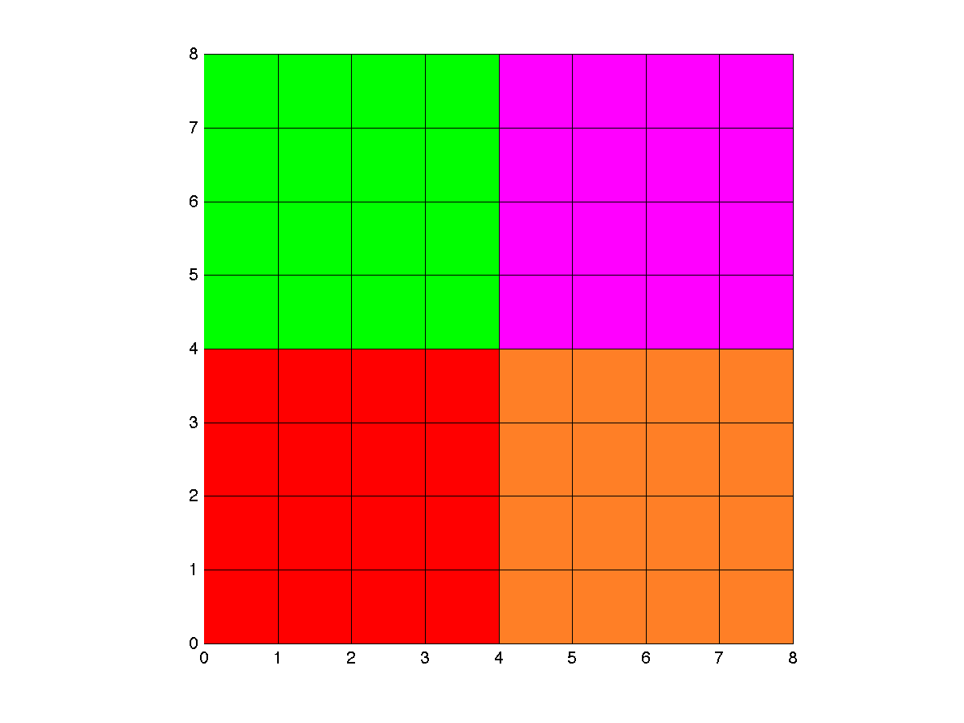
BufferAnalysis
0
0
0
0
Total
0

Slide 61
BufferAnalysis
0
0
0
0
Total
0

Slide 62
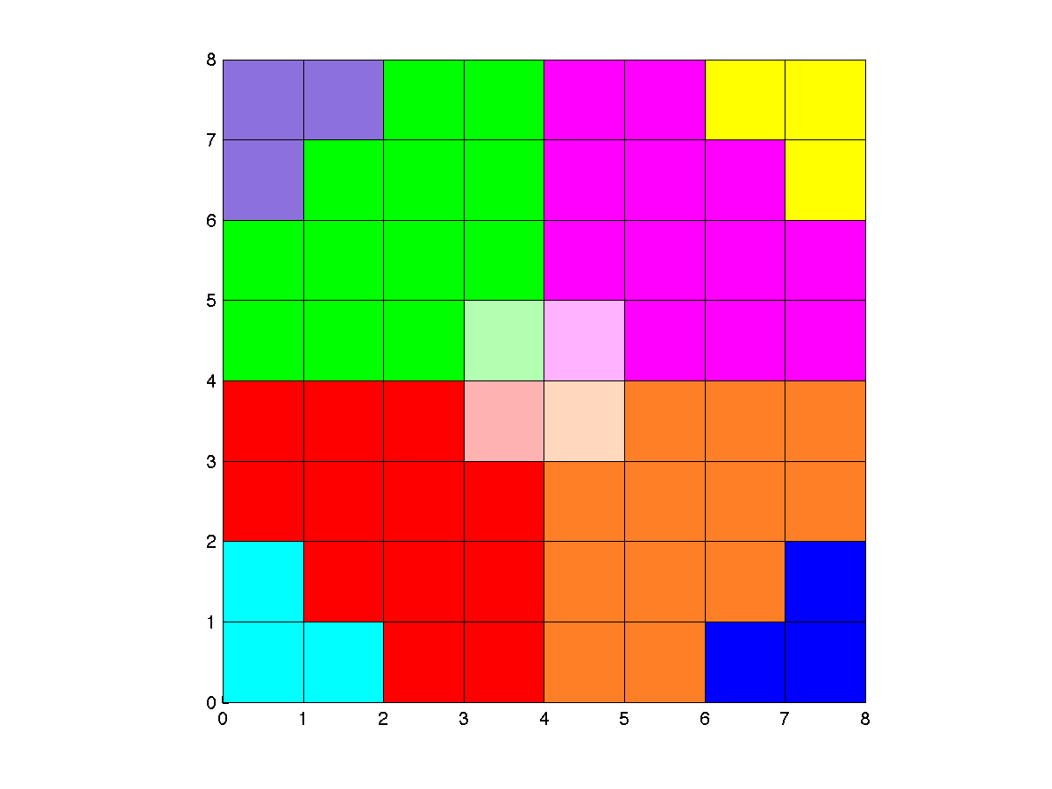
BufferAnalysis
1
1
1
1
Total
4

Slide 63
BufferAnalysis
5
5
5
5
Total
20

Slide 64
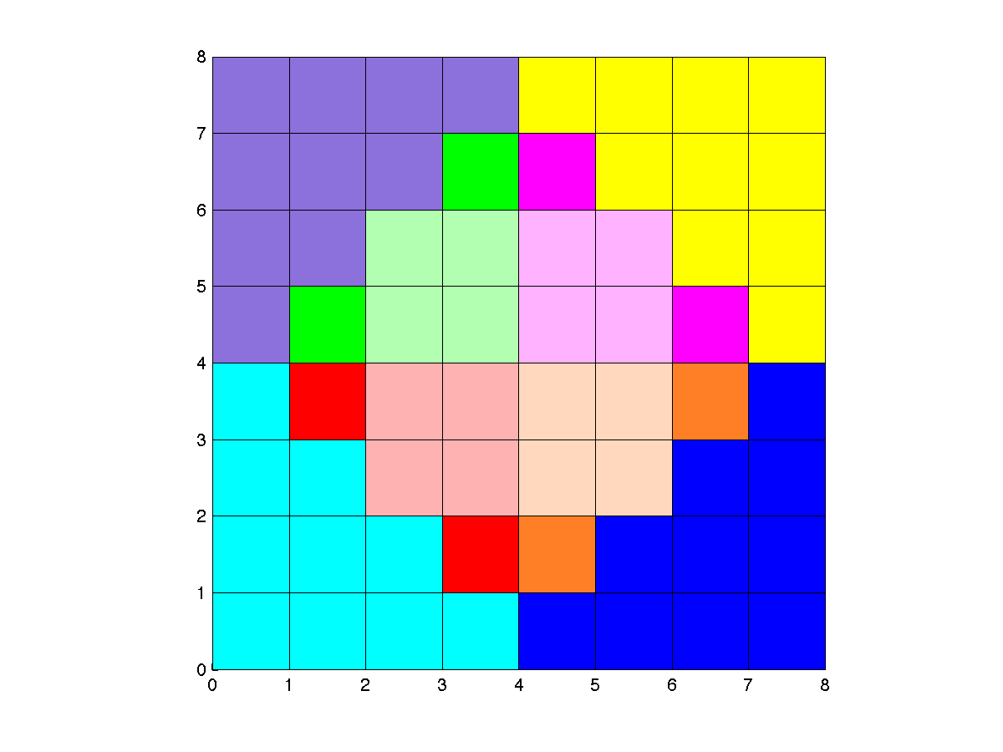
BufferAnalysis
9
9
9
9
Total
36

Slide 65
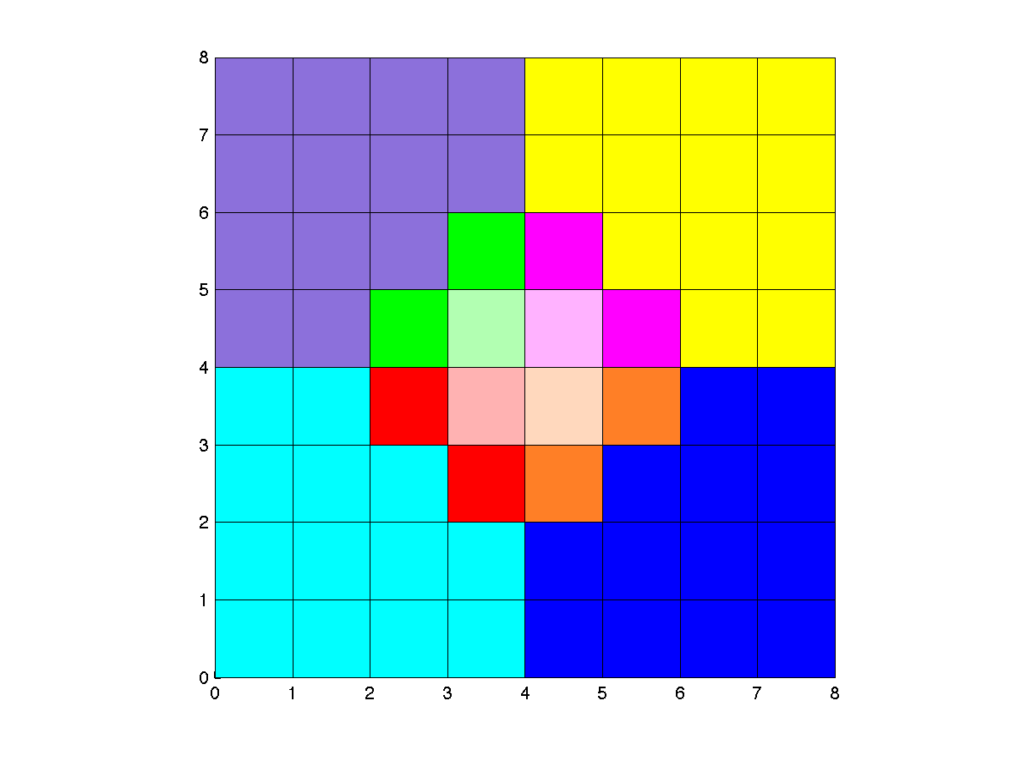
BufferAnalysis
10
10
10
10
Total
40

Slide 66
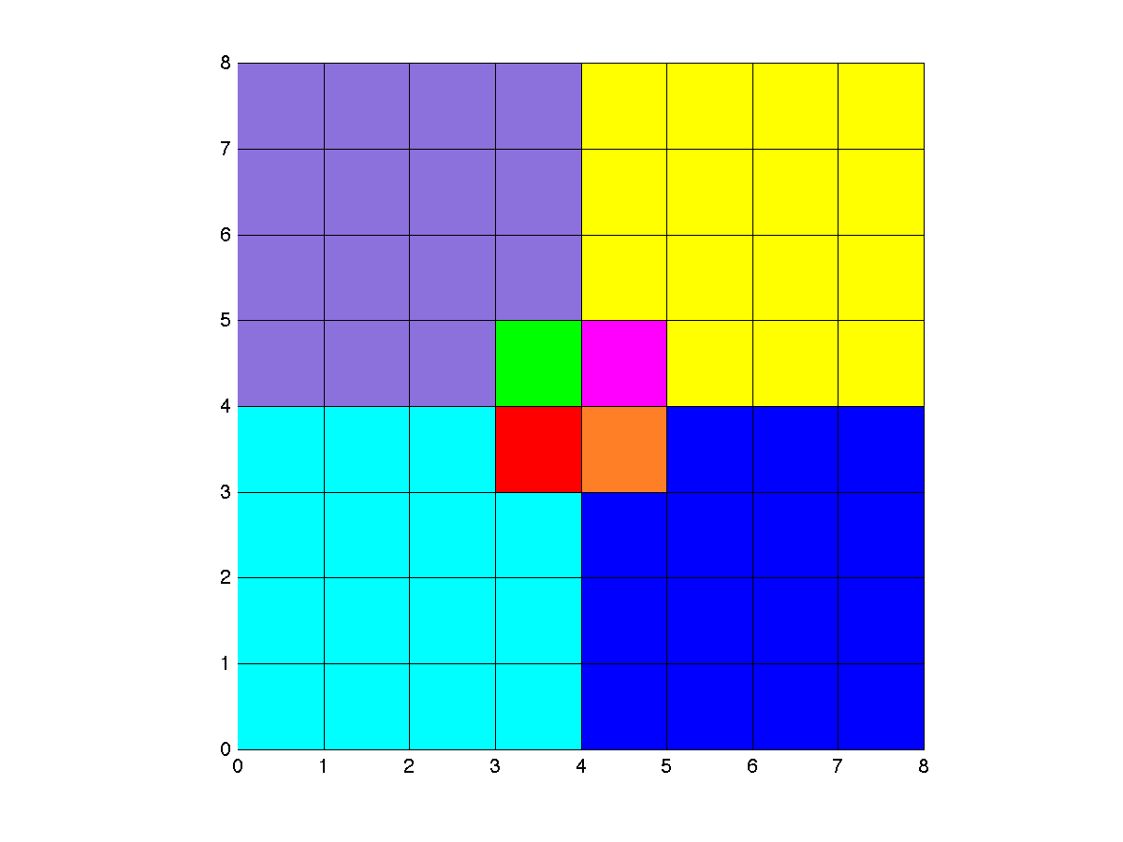
BufferAnalysis
10
10
10
10
Total
40

Slide 67
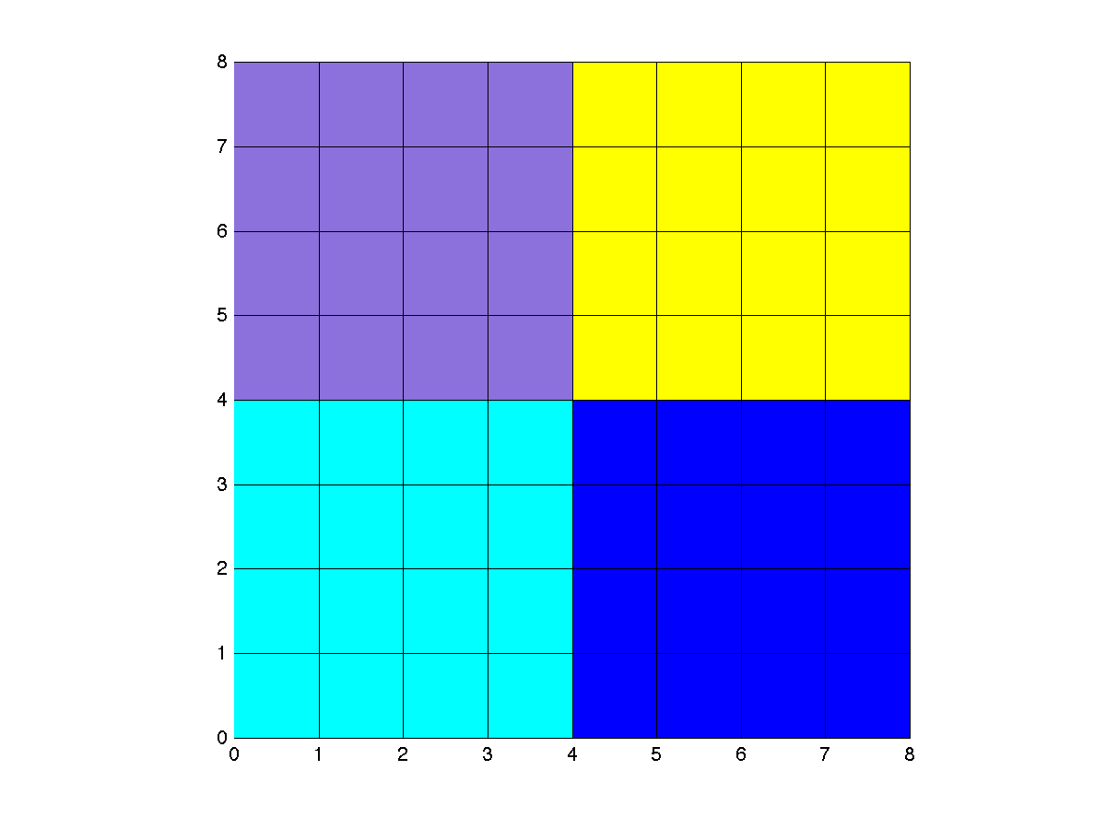
BufferAnalysis
10
10
10
10
Total
40
h(q) = (10/40)h(p₁) + (10/40)h(p₂) +(10/40)h(p₃) +(10/40)h(p₄)

Slide 68
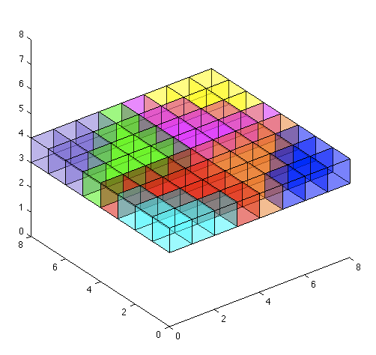
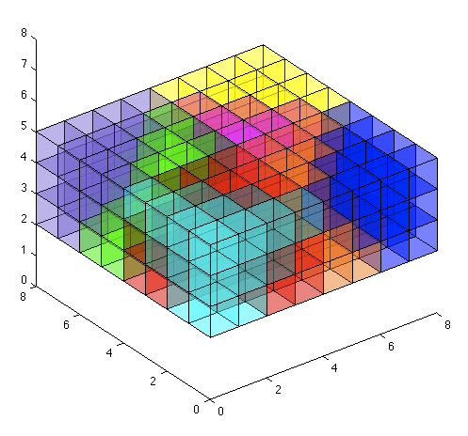
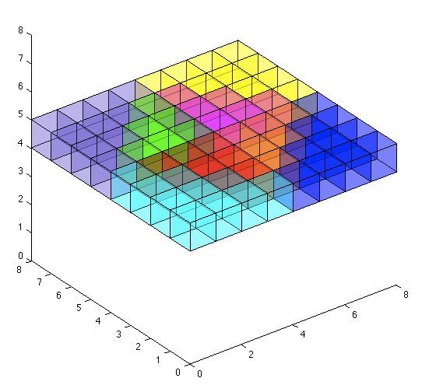
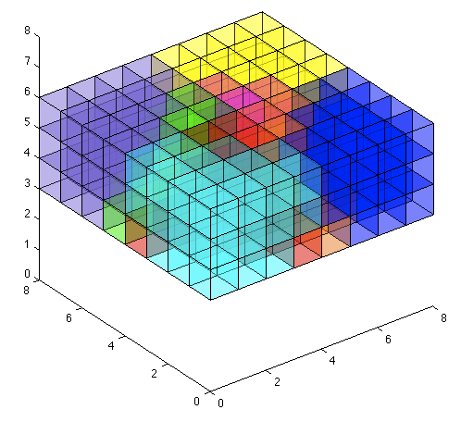
NNI on N x N x N Grids
GPUVoronoi(S)
NNI and BufferAnalysis

Slide 69
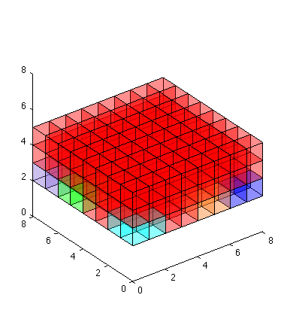
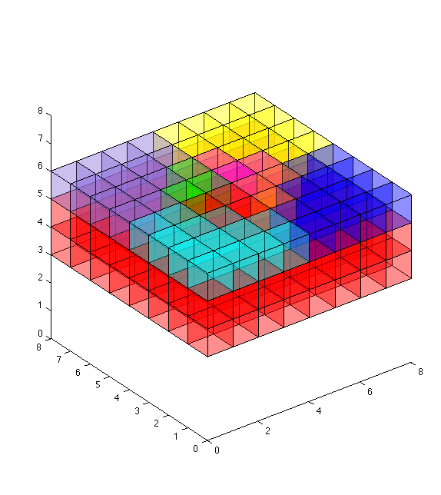
GPUVoronoi(S) Overlap

Slide 70
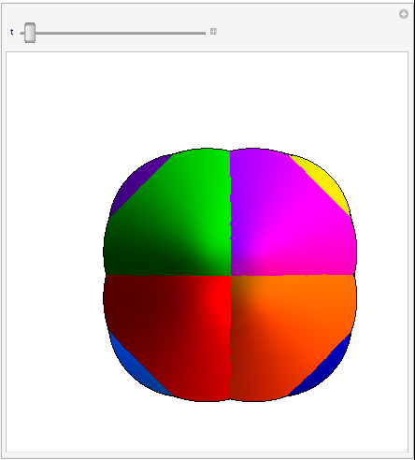
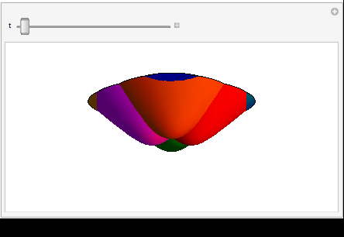
Lower Envelope – Continuous in Time

Slide 71
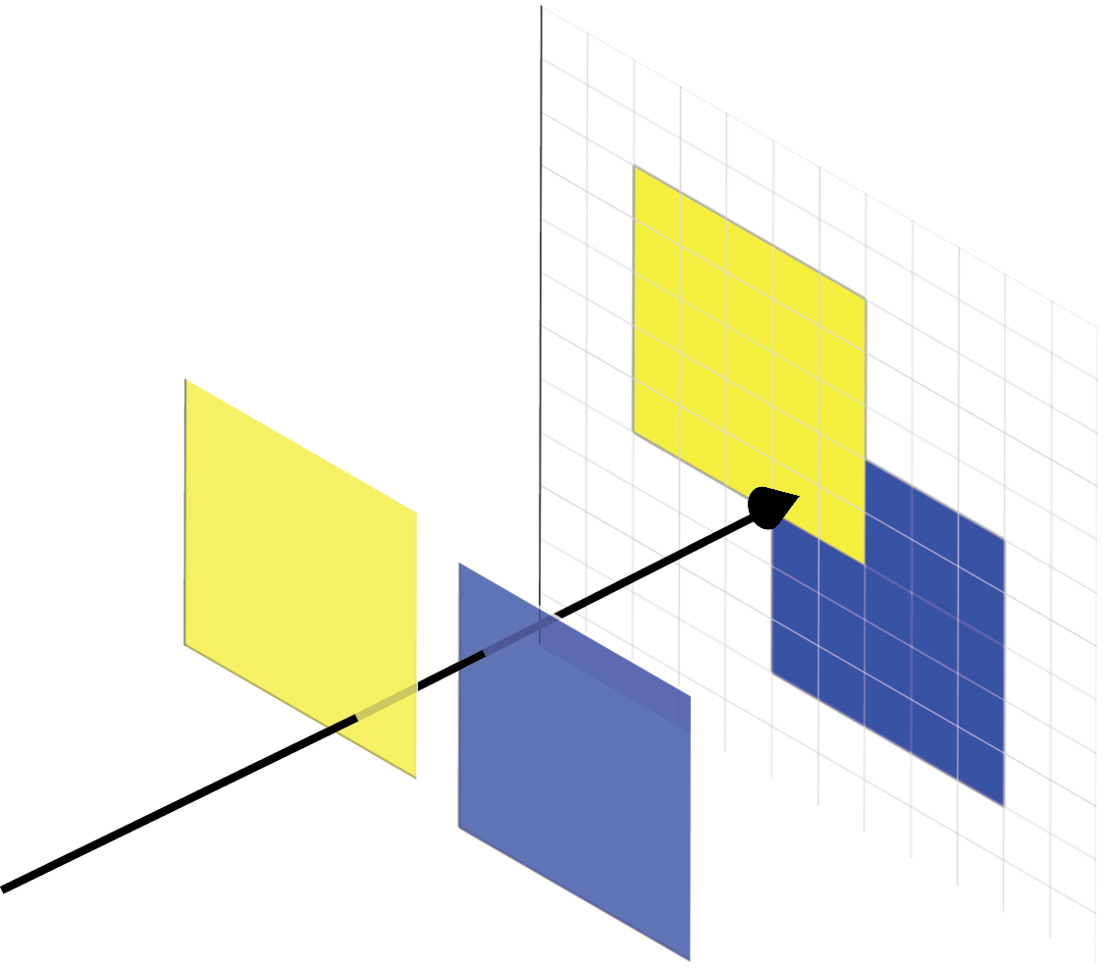
GPU Buffers
Color Buffer
Buffers are 2D array of pixels.
Color Buffer
  Stores information about color as seen from viewpoint
Depth buffer
  Stores distance to closest object from viewpoint
Notes:
Keep just last part of animation

Slide 72
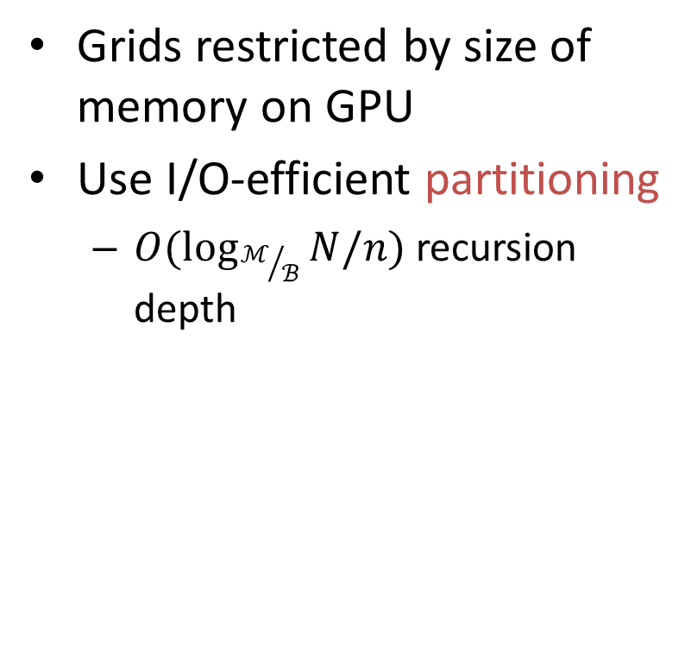
Larger Grids
Grids restricted by size of memory on GPU
Use I/O-efficient partitioning
  $O(\log_{ℳ/ℬ}{N/n)}$ recursion depth

Slide 73
Performance - Efficiency
 | Afghanistan | Fort Leonard Wood
Size of input (10⁶) | 186 | 2180
Size of output (10⁶) | 9.5 | 151
RST | 95m | 34h
Linear Interpolation | 16m | 338m
Times in seconds

Slide 74
Performance - Efficiency
 | Afghanistan | Fort Leonard Wood
Size of input (10⁶) | 186 | 2180
Size of output (10⁶) | 9.5 | 151
RST | 95m | 34h
Linear Interpolation | 16m | 338m
NNI without CUDA | 21m | 186m
NNI with CUDA | 2m 40s | 36m
Binning Time | 1m 10s | 17m
Interpolation Time | 1m 30s | 19m
Times in seconds

Slide 75
Performance - Quality
Afghanistan
all ground points
Afghanistan
sparse ground points
NNI
Linear Interpolation

Slide 76
Batching NNI Queries
For a given pixel, only need to know if Voronoi cell for q covers it (Y/N)
Only use one bit in color buffer for each query
Color buffer performs bitwise-OR

Slide 77
NNI for Grid DEM Construction
Grid of queries, M x M grid

Slide 78
Batched NNI on Grids
w is number of bits in color buffer (and number of queries we can handle by previous algorithm)
Break grid into query blocks of size B x B
Could handle each in one pass with previous algorithm

Slide 79
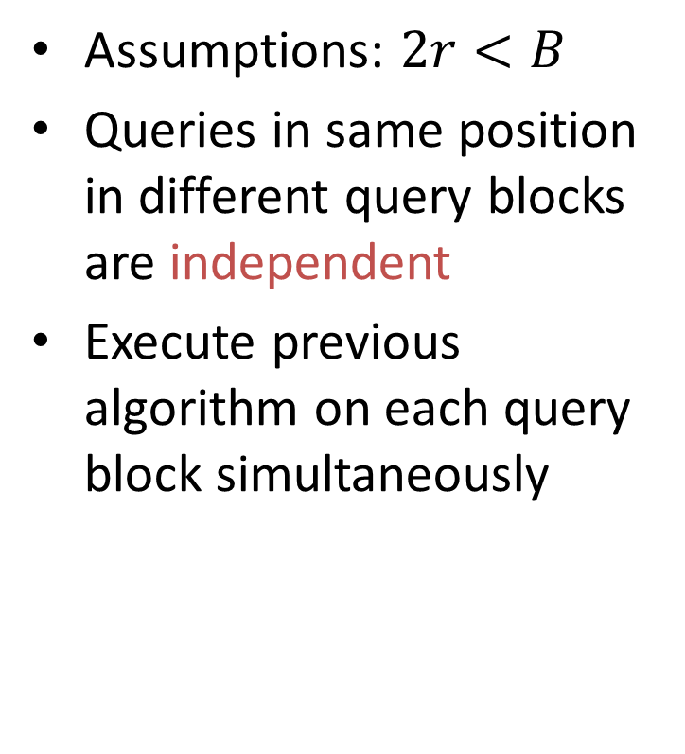
Batched NNI on Grids
Assumptions: $2r<B$
Queries in same position in different query blocks are independent
Execute previous algorithm on each query block simultaneously

Slide 80
Putting it together

Slide 81
Performance - Efficiency
 | Afghanistan | Fort Leonard Wood
Size of input (10⁶) | 186 | 2180
Size of output (10⁶) | 9.5 | 151
RST | 95m | 34h
Linear Interpolation | 16m | 338m
NNI without CUDA | 21m | 186m
Binning Time | 1m 30s | 17m
Interpolation Time | 19m 30s | 169m
Times in seconds

Slide 82
Voronoi Generation Redundancy
F_{τ} – Framebuffer with Voronoi at time τ
Δ = 3
F₀ F₁ F₂ F₃ F₄ F₅ F₆ F₇ F₈
F₀ F₁ F₂ F₃ F₄ F₅ F₆ F₇ F₈
F₀ F₁ F₂ F₃ F₄ F₅ F₆ F₇ F₈
F₀ F₁ F₂ F₃ F₄ F₅ F₆ F₇ F₈
But regenerating is F₂ F₃ unnecessary
Interpolate grid for τ = 3
Interpolate grid for τ = 2

Slide 83
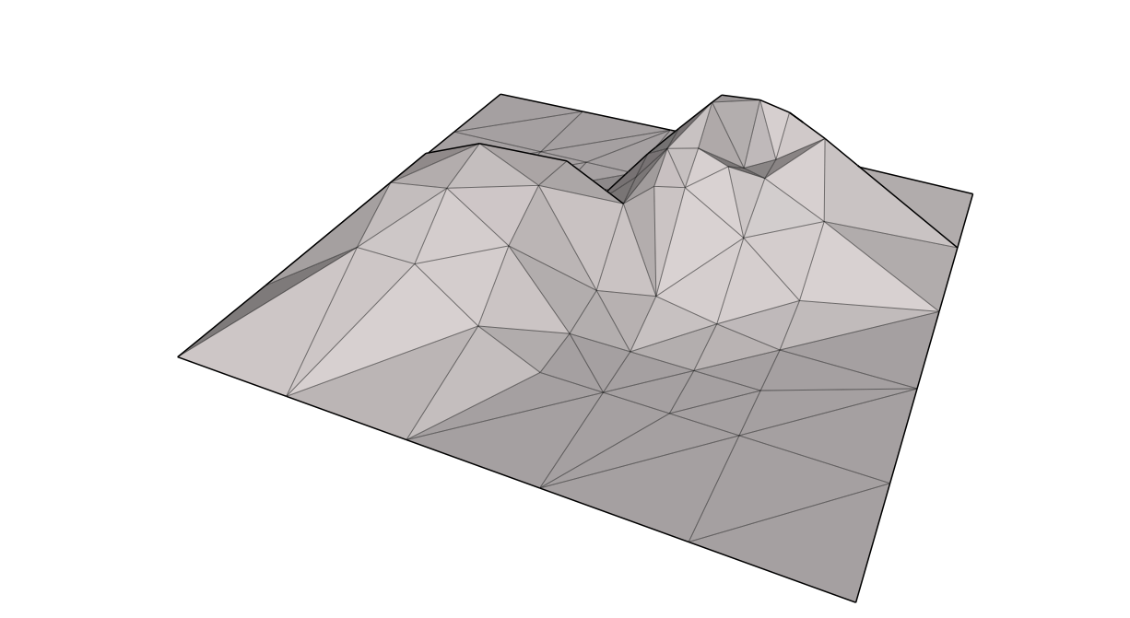
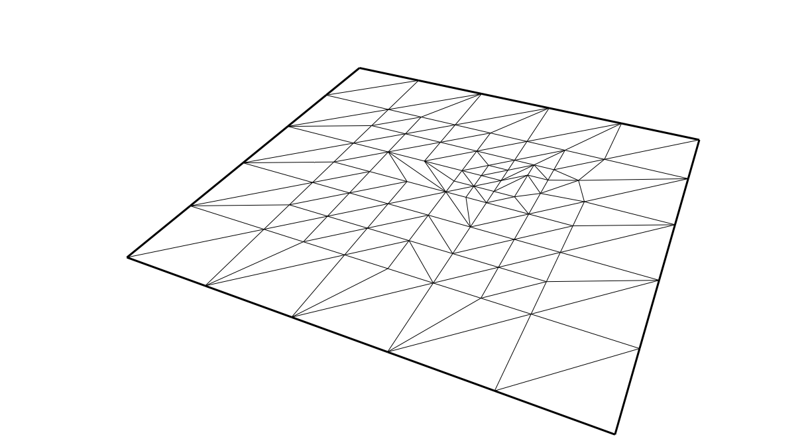

Digital Elevation Models
Triangular Irregular Network (TIN)

Slide 84
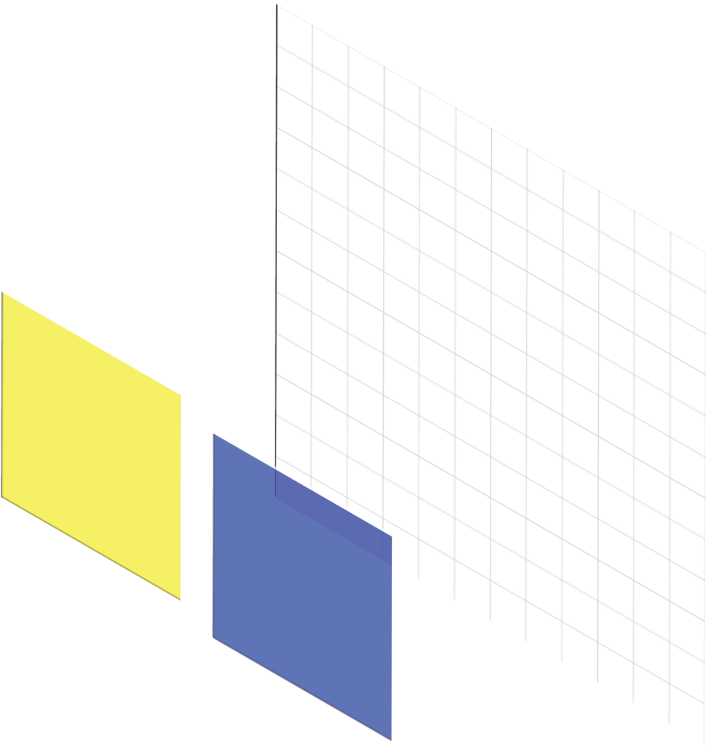
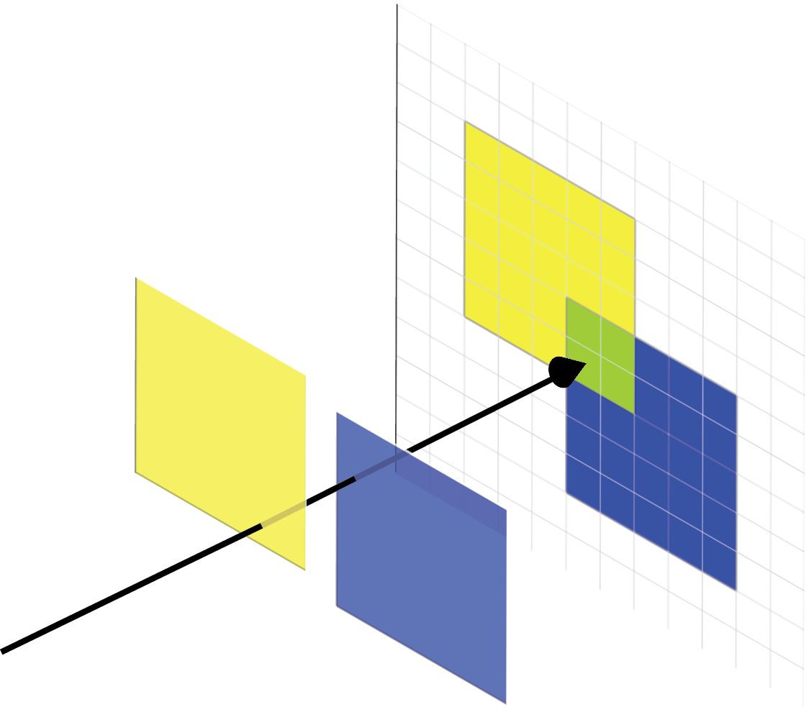
GPU Buffers
Color Buffer
Buffers are 2D array of pixels.
Color Buffer
  Stores information about color as seen from viewpoint
Depth buffer
  Stores distance to closest object from viewpoint
Notes:
Keep just last part of animation

Slide 85
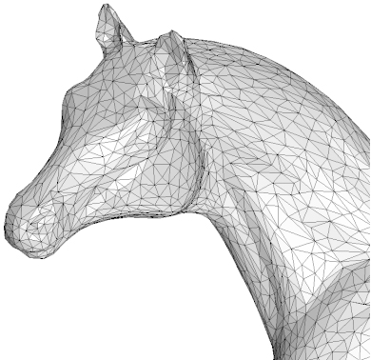
GPU Model of Computation
Speed of processing on GPU more heavily impacted by number of triangles rather than size of each
http://www.sciweavers.org/sourcecode/gts-triangulated-surface-library

Slide 86
Pixelized Voronoi Diagram

Slide 87
Lower Envelope – Discretized in Time

Slide 88
Lower Envelope – Discretized in Time & Space

Slide 89
Lifting Transform for Weighed Euclidean Metric
Drawing curved surfaces requires many triangles
More efficient if we can just draw a plane
Lower envelope of g is that same as that for f

Slide 90
Review Algorithm Trade-offs
Algorithm Number of Passes | Number of copies of Framebuffer | Triangles rendered per point | Triangles rendered per point: Euclidean metric
r² | 1 | O(r²kmn) | O(r²kn)
r | 2r+1 | O(rkmn) | O(rkn)
1 | 2(2r+1) | O(kmn) | O(kn)
For r=2, k=50, m=5, we get the following:
Algorithm Number of Passes | Number of copies of Framebuffer | Triangles rendered per point | Triangles rendered per point: Euclidean metric
r² | 1 | O(1000n) | O(200n)
r | 5 | O(500n) | O(100n)
1 | 10 | O(250n) | O(50n)
Notes:
Table with real values underneath

Slide 91
NNI Batch Query Processing
GVor(S)
Save and clear color buffer
Draw Voronoi cell for query q
Save color buffer
BufferAnalysis
SLOW

Slide 92
Using Bit-Tricks….
[Fan, et al. ‘05]

Slide 93
NNI Batch Query Processing
GVor(S)
Save and clear color buffer
Draw Voronoi cell for 32 queries
Save color buffer
BufferAnalysis
SLOW

Slide 94
Terrain Dynamics in North Carolina
What if we have spatial-temporal data?
  Planes scan same region different years
Want to accurately analyze terrain dynamics over time
http://skagit.meas.ncsu.edu/~helena/grasswork/NH9908p_anim.gif

Slide 95
Outline
NEW PIC?
GPU background
Voronoi diagrams
  Triangulation
  Lifting Transform
NNI optimization in 2D
NNI algorithms for 3D grids
  r²-pass
  r-pass
  1-pass
Evaluation

Slide 96
GPU Model of Computation
FAST
CPU
Main Memory
SLOW
FAST
GPU
Graphics Card Memory

Slide 97
Triangulation of the Lower Envelope
Assume that d() doesn’t have cross terms between x, y, and t
General method for triangulation distance function

Slide 98
Truncated Polygonal Hyperboloids

Slide 99
Lifting Transform for Weighed Euclidean Metric
Images? Don’t know how to explain without math. Can talk through it slowly

Slide 100
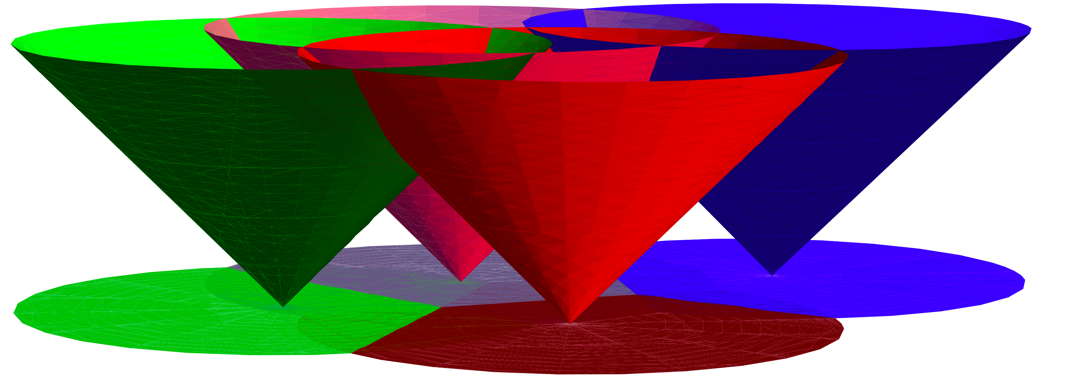
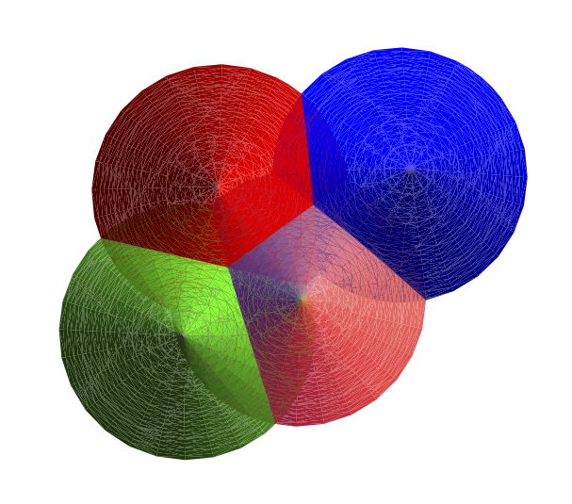
Rendering the Voronoi Diagram
Render on GPU with looking at cones from below
(viewpoint at -∞)

Slide 101
Pixelized Voronoi Diagram
Drawing on GPU discretizes Voronoi diagram. Call this PVor_{S}(p).
Render cone for each input point
Depth buffer stores distance from the pixel to the closest input point (structure of the Voronoi diagram)
Color buffer can store any information specific to the closest input point
Depth Buffer
Color buffer

Slide 102
Generating Pixelized Voronoi Diagrams
Render using truncated polyhedralcones

Slide 103
Truncated Pixelized Voronoi Diagram
TPVor(S)
Radius of cone r defines region of influence
If two points are >2r apart their cones can not overlap and they can not effect each other.

Slide 104
NNI Batch Query Processing
GVor(S)
BufferAnalysis
Draw Voronoi cell for ~10⁶ queries
Save interpolated heights
Optimize GPU to CPU communication
  Transferring color buffers between GPU and CPU memory is slow
  For each query we have a multiple pixels
  Transferring extra data
  Perform BufferAnalysis with CUDA directly on GPU
  Only transfer one value for each query point
GVor(S)
Save and clear color buffer
Draw Voronoi cell for ~10⁶ queries
Save color buffer
BufferAnalysis
SLOW
SLOW
Notes:
Greatly Simplify

Slide 105
Batching N x N Grids
Each time slice: use 2D method
Because radius is limited, we can again do entire grid at once
Handle each time slice separately

Slide 106
Interpolate
Consider this process as a subroutine
Interpolate(F_{τ},t_{i},τ) defined as
  Given frambuffer F_{τ} containing TPVor(S,τ)
  Draw hypeboloid for each query and count necessary pixels

Slide 107
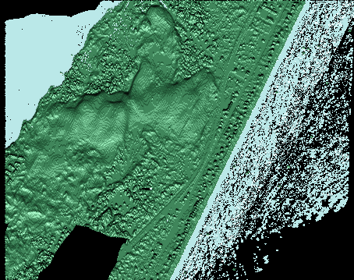

Slide 108
Performance
 | O(r²) | O(r) | O(r²) | O(r)
Points/Year (10⁶) | 10 | 10 | 50 | 50
Binning Time | 2m 40s | 3m 2s | 15m 55s | 16m 17s
GPUVoronoi(S) | 18m 28s | 4m 58s | 2h 7m | 33m 18s
Draw Query Cones | 1.128s | 1.02s | 1.2s | 0.98s
BufferAnalysis | 8m 36s | 2m 11s | 8m 23s | 2m 21s
Write Points | 0.71s | 0.01s | 1.68s | 1.63 s
Total | 29m 54s | 10m 19s | 2h 31m | 52m 6s
Output grid: 200 by 200 x 8
Radius in time: 2 (each Voronoi diagram generally required 50 million or 250 million cones to be drawn)
Notes:
50 million – 11GB of data in LAS format
10 million – 2.1GB

