Slide 1
Natural Neighbor Based Grid DEM Construction Using a GPU
Alex Beutel
Duke University
Joint work with Pankaj K. Agarwal and Thomas Mølhave

Slide 2
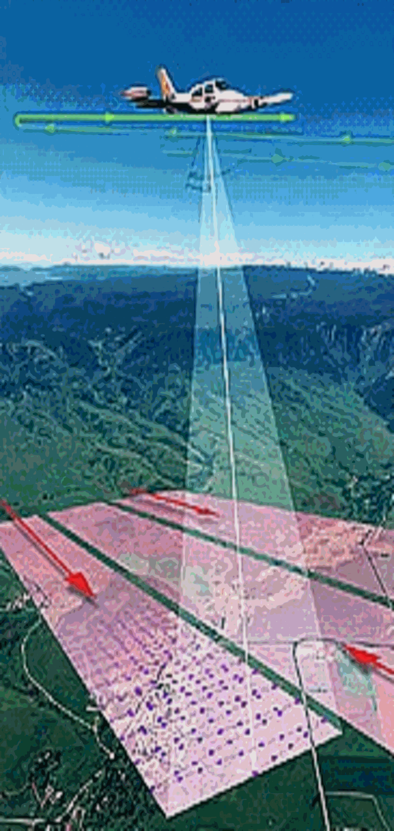
Light Detection and Ranging
(LiDAR)
Planes collect data with lasers
Each point recorded (x,y,z)
Image from USDA

Slide 3
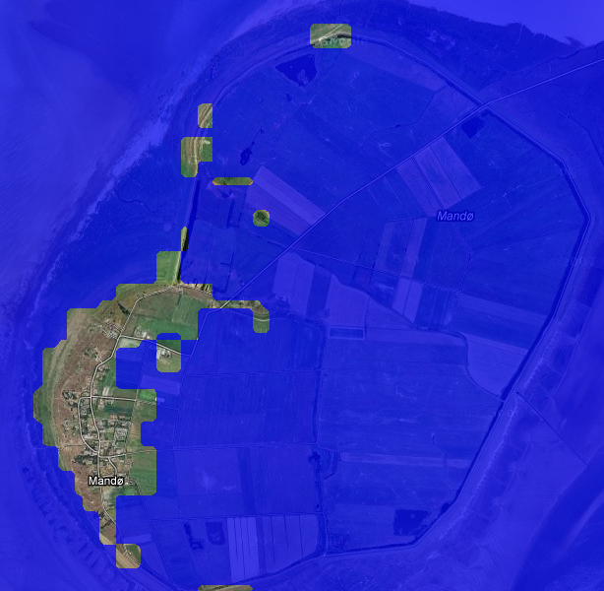
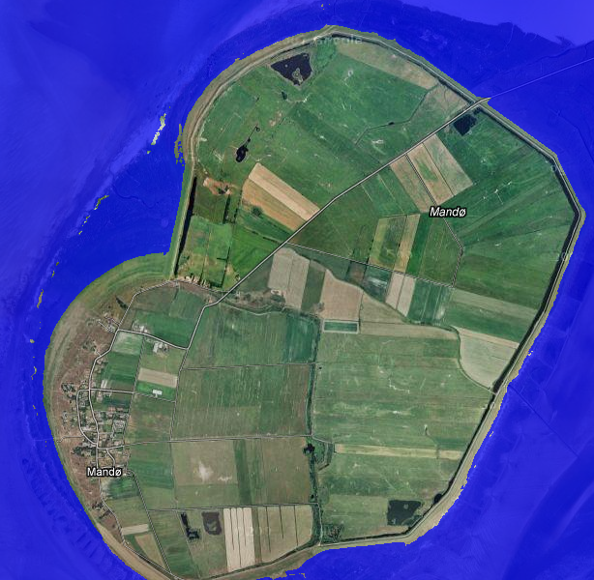
Flood mapping – Mandø, Denmark
90 meter grid resolution
2 meter grid resolution

Slide 4
Digital Elevation Model (DEM)
LiDAR data is just a point cloud
Create simpler models that are easier to process
Modeled as a grid DEM
Grid requires interpolation at grid points
Used in many GIS applications
  Hydrology, contouring, noise computations, line-of sight, city planning

Slide 5
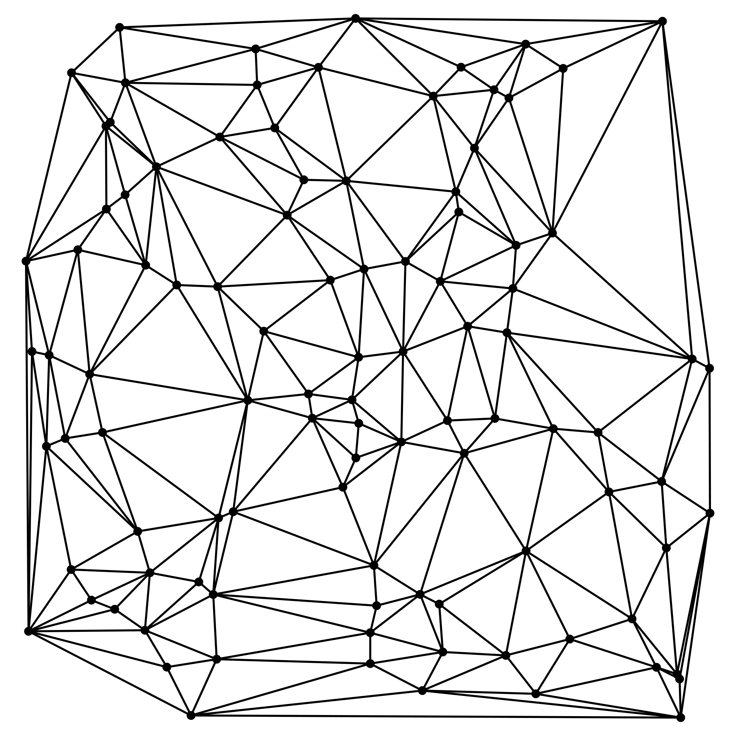
DEM Construction
Must interpolate value at each grid point
Linear interpolation based on Delaunay triangulation [Agarwal et al. 2005]
  Simple but not smooth
  Relatively fast
Regularized spline with tension (RST) [Mitasova et al. 1993]
  Uses high-order polynomials
  Better with sparse data
  Slow

Slide 6
Natural Neighbor Interpolation (NNI)
Voronoi diagram based
Has been used but too slow
Take advantage of general purpose graphics processing unit (GPGPU)
NNI
Linear Interpolation

Slide 7
Our Contributions
Build high-quality, large-scale grid DEMs with a natural neighbor based interpolation scheme using the GPU
  Handle gaps in data by introducing the idea of region of influence
  Exploit the fact that we only interpolate at grid points using clever blocking. Handle 10⁶ NNI queries in one pass. Previous maximum of ~32 [Fan et al. SIAM, 2005]
  Use CUDA to improve performance of our implementation

Slide 8
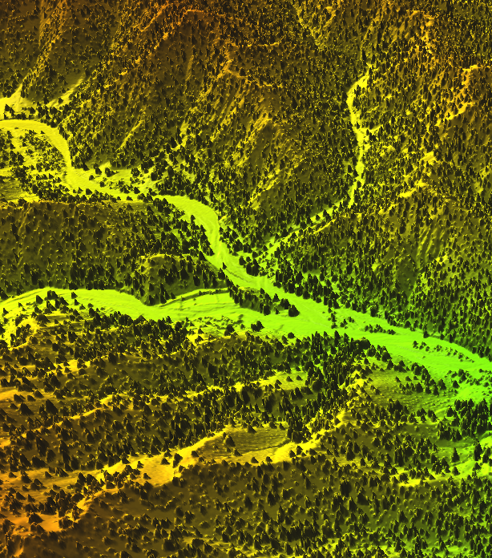
Outline
GPU background
Voronoi diagrams on the GPU
Natural neighbor interpolation (NNI)
Batched NNI
  On grids
Implementation
Evaluation

Slide 9
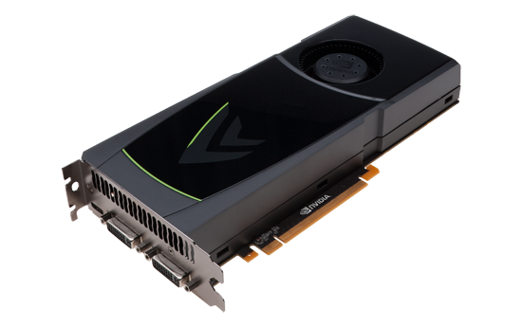
Graphics Processing Unit (GPU)
Specialized hardware for parallel processing
Render 3D objects
on 2D plane of pixels Π from a viewpoint o
Used generically in other applications
  Robot collision detection, database systems, fluid dynamics

Slide 10
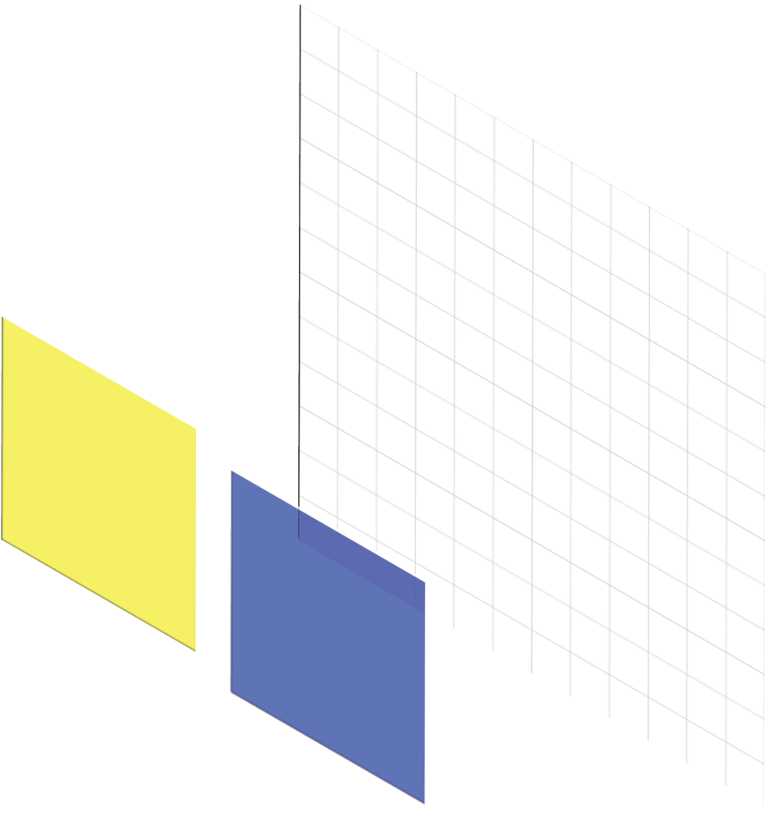
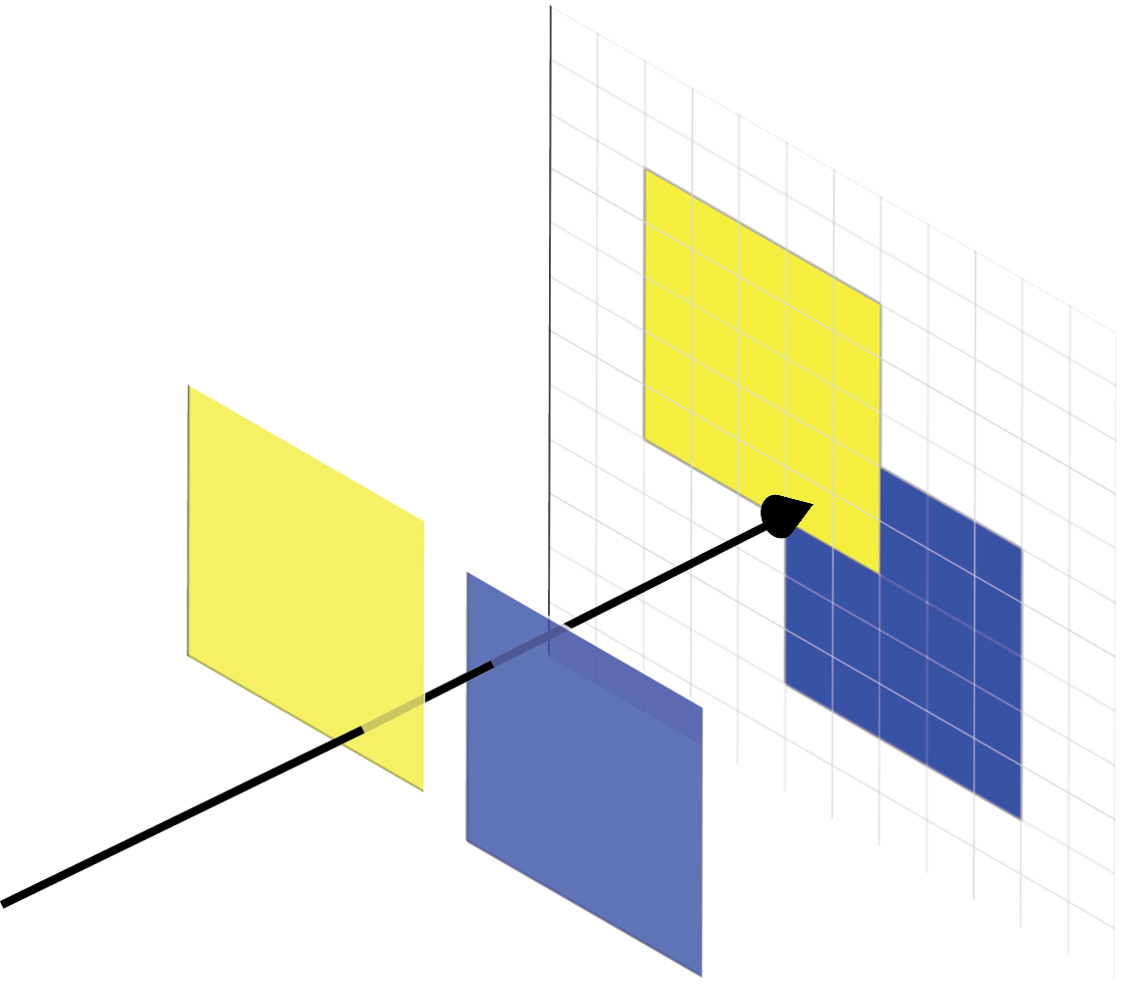
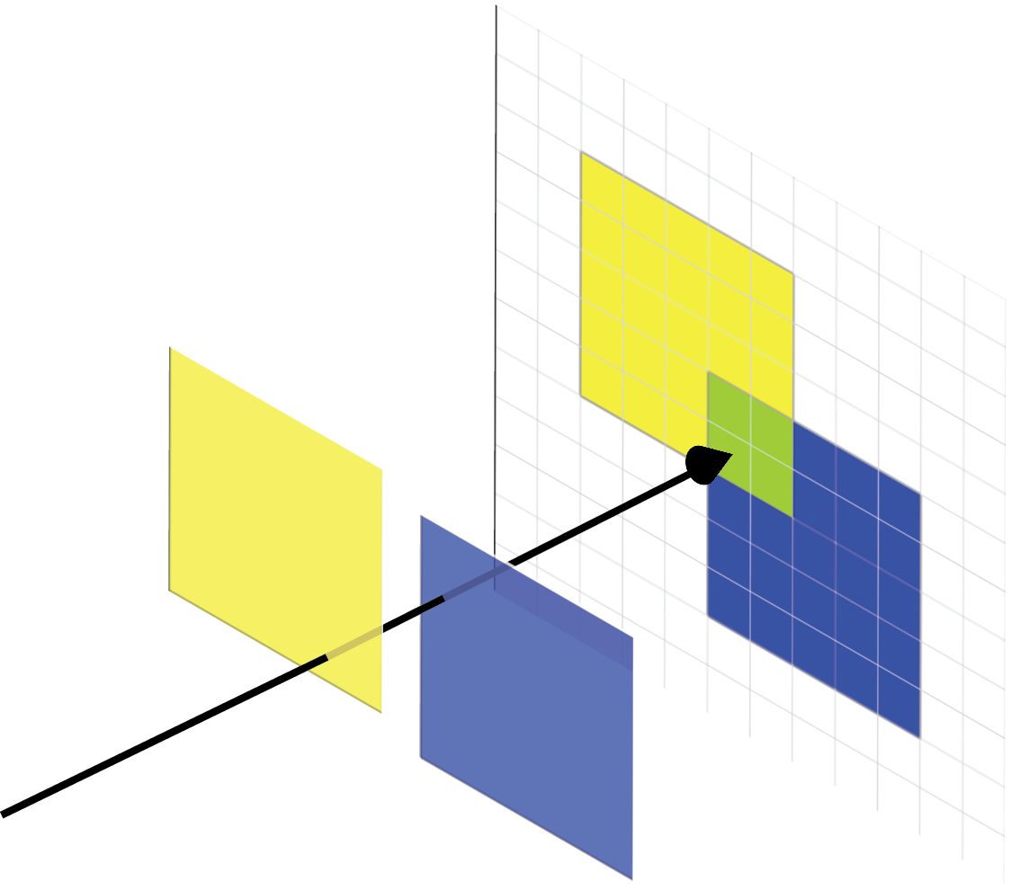
GPU Buffers
Color Buffer
Buffers are 2D array of pixels.
Store unique piece of information about each pixel
Color Buffer
  Stores information about color as seen from a given viewpoint at each pixel
  Can blend objects in line of sight
  Binary options such as bitwise-OR
Depth buffer
  Stores distance to closest object from viewpoint
  Can be set to read-only

Slide 11
GPU Model of Computation
FAST
On card memory for buffers
  Slow read-back to main CPU memory
  Fast, parallel access on card
CUDA for general purpose parallel processing
CPU
Main Memory
SLOW
FAST
GPU
Graphics Card Memory

Slide 12
Computing the Voronoi Diagram
[Hoff, et al. 1999]

Slide 13
Voronoi Diagram
A Voronoi cell Vor(p_{i}) is the region in space for which p_{i} is the closest point (the nearest neighbor) from the set of input points S
Voronoi diagram, Vor(S), is the planar subdivision induced by the Voronoi cells of S
Notes:
As discussed yesterday by sarana nutanong

Slide 14
Voronoi Diagram and Lower Envelopes
For each point p_{i} define function
Lower envelope of {f₁,f₂…f_{n}} is
Lower envelope is distance from x to its nearest neighbor

Slide 15
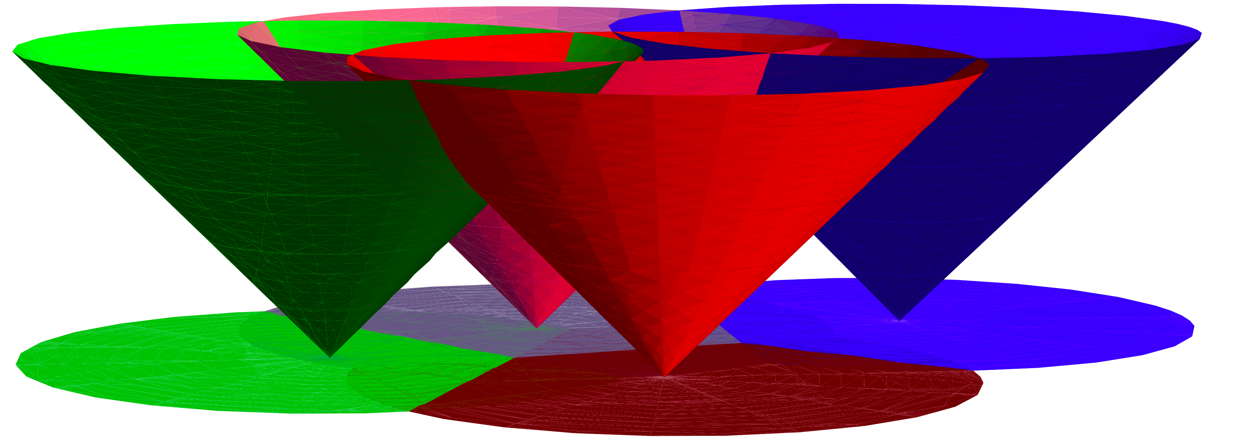
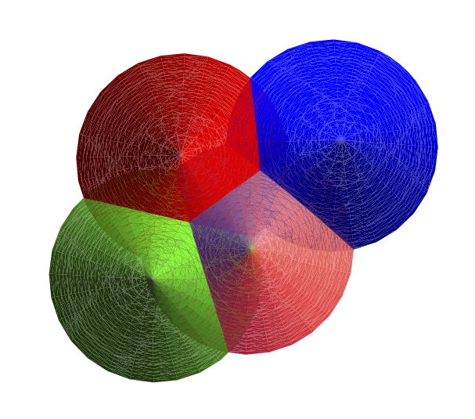
Rendering the Voronoi Diagram
Render on GPU with looking at cones from below
(viewpoint at -∞)

Slide 16
Pixelized Voronoi Diagram
Drawing on GPU discretizes Voronoi diagram. Call this PVor_{S}(p).
Render cone for each input point
Depth buffer stores distance from the pixel to the closest input point (structure of the Voronoi diagrmam)
Color buffer can store any information specific to the closest input point
Depth Buffer
Color buffer

Slide 17
Generating Pixelized Voronoi Diagrams
Render using truncated polyhedralcones

Slide 18
Truncated Pixelized Voronoi Diagram
TPVor(S)
Radius of cone r defines region of influence
If two points are >2r apart their cones can not overlap and they can not effect each other.

Slide 19
Natural Neighbor Interpolation

Slide 20
Natural Neighbor Interpolation
Vor(q) takes area from neighboring cells (natural neighbors)
Interpolate h(q) based on weighted average of heights of natural neighbors h(p_{i})
Weights are based on:

Slide 21
Natural Neighbor Interpolation
|TPVor(q₁)| = 73
h(q₁)=(33/73)h(p₁)+(12/73)h(p₂)+(28/73)h(p₃)
Call this process BufferAnalysis

Slide 22
NNI Query Processing
Main Memory
Draw TPVor(S)
Save and clear color buffer
Draw Voronoi cell for query q
Save color buffer
BufferAnalysis
GPU Memory

Slide 23
Batching NNI Queries
[Fan, et al. SIAM 2005]

Slide 24
NNI Batch Query Processing
Draw TPVor(S)
Save and clear color buffer
Draw Voronoi cell for query q
Save color buffer
BufferAnalysis
SLOW

Slide 25
Batching NNI Queries
For a given pixel, only need to know if Voronoi cell for q covers it (Y/N)
Only use one bit in color buffer for each query
Color buffer performs bitwise-OR

Slide 26
NNI Batch Query Processing
Draw TPVor(S)
Save and clear color buffer
Draw Voronoi cell for 32 queries
Save color buffer
BufferAnalysis
SLOW

Slide 27
Batching Grids of NNI Queries

Slide 28
NNI for Grid DEM Construction
Grid of queries, M x M grid

Slide 29
Batched NNI on Grids
w is number of bits in color buffer (and number of queries we can handle by previous algorithm)
Break grid into query blocks of size B x B
Could handle each in one pass with previous algorithm
Notes:
Previous algorithm can handle up to w simultaneous queries so we break into query blocks of size <=w

Slide 30
Batched NNI on Grids
Make assumption that cone radius is less than half the width of one query block
Queries in same position in different query blocks are independent
Execute previous algorithm on each query block simultaneously

Slide 31
NNI Grid Query Processing
Draw TPVor(S)
Save and clear color buffer
Draw Voronoi cell for ~10⁶ queries
Save color buffer
BufferAnalysis

Slide 32
Larger Grids
Grids restricted by size of memory on GPU
Developed a binning procedure
  Sub-grids that can be handled by GPU
  Separate input data

Slide 33
Putting it together

Slide 34
Implementation
Ran on
  Intel Core2 Duo CPU running Ubuntu 10.4
  NVIDIA GeForce GTX 470 with CUDA 3.0
OpenGL
  Templated Portable I/O Environment (TPIE) for interacting with disk efficiently

Slide 35
NNI Batch Query Processing
Draw TPVor(S)
BufferAnalysis
Draw Voronoi cell for ~10⁶ queries
Save interpolated heights
Optimize GPU to CPU communication
  Transferring color buffers between GPU and CPU memory is slow
  For each query we have a multiple pixels
  Transferring extra data
  Perform BufferAnalysis with CUDA directly on GPU
  Only transfer one value for each query point
Draw TPVor(S)
Save and clear color buffer
Draw Voronoi cell for ~10⁶ queries
Save color buffer
BufferAnalysis
SLOW
SLOW

Slide 36
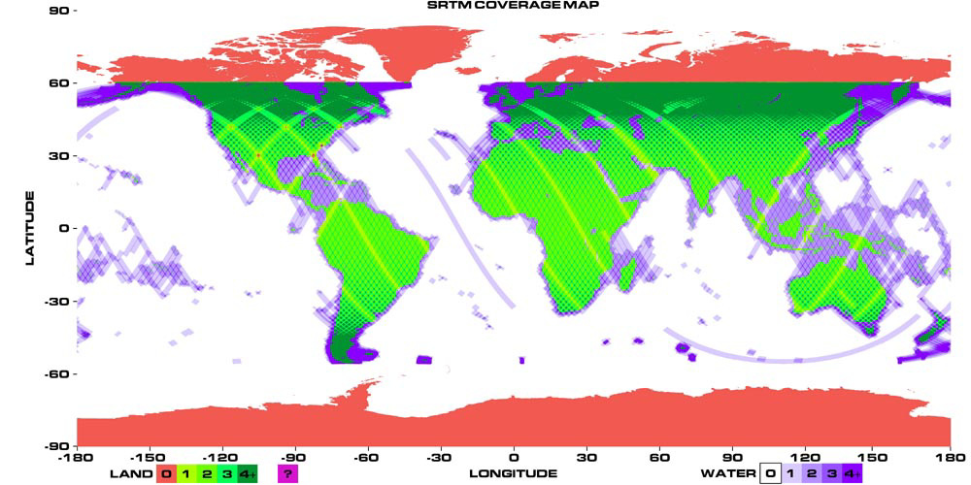
Tests
Denmark (DKPART):
  27 GB
  1 billion data points
  900 km² region
Afghanistan:
  3.5 gigabytes
  186 million data points
  4 km² region
Fort Leonard Wood (Missouri)
  57 GB
  2.2 billion data points
  600 km² region
Source: NASA
Data from COWI A/S and the Army Research Office
Notes:
LiDAR = Light Detection and Ranging

Slide 37
Performance - Efficiency
 | Afghanistan | DKPART | Fort Leonard Wood
Size of input (10⁶) | 186 | 1038 | 2180
Size of output (10⁶) | 9.5 | 213 | 151
RST | 5698 | 66729 | 122305
Times in seconds

Slide 38
Performance - Efficiency
 | Afghanistan | DKPART | Fort Leonard Wood
Size of input (10⁶) | 186 | 1038 | 2180
Size of output (10⁶) | 9.5 | 213 | 151
RST | 5698 | 66729 | 122305
Linear Interpolation | 962 | 7377 | 20307
Times in seconds

Slide 39
Performance - Efficiency
 | Afghanistan | DKPART | Fort Leonard Wood
Size of input (10⁶) | 186 | 1038 | 2180
Size of output (10⁶) | 9.5 | 213 | 151
RST | 5698 | 66729 | 122305
Linear Interpolation | 962 | 7377 | 20307
NNI without CUDA | 1252 | 14323 | 11164
Binning Time | 91 | 569 | 1036
Interpolation Time | 1161 | 13754 | 10128
Times in seconds

Slide 40
Performance - Efficiency
 | Afghanistan | DKPART | Fort Leonard Wood
Size of input (10⁶) | 186 | 1038 | 2180
Size of output (10⁶) | 9.5 | 213 | 151
RST | 5698 | 66729 | 122305
Linear Interpolation | 962 | 7377 | 20307
NNI without CUDA | 1252 | 14323 | 11164
NNI with CUDA | 163 | 1238 | 2190
Binning Time | 67 | 558 | 1030
Interpolation Time | 96 | 680 | 1160
Times in seconds

Slide 41
Performance - Efficiency
 | Afghanistan | DKPART | Fort Leonard Wood
Size of input (10⁶) | 186 | 1038 | 2180
Size of output (10⁶) | 9.5 | 213 | 151
RST | 5698 | 66729 | 122305
Linear Interpolation | 962 | 7377 | 20307
NNI without CUDA | 1252 | 14323 | 11164
NNI with CUDA | 163 | 1238 | 2190
Binning Time | 67 | 558 | 1030
Interpolation Time | 96 | 680 | 1160
Times in seconds

Slide 42
Performance - Quality
Afghanistan
all ground points
Afghanistan
sparse ground points
NNI
Linear Interpolation

Slide 43
Future Work
NNI for grid DEMs on GPU
  Scalable
  Much faster
Make region of influence more flexible
Extend algorithm to 3D
  Spatial-temporal data

Slide 44
Questions?
alex.beutel@cs.duke.edu
http://alexbeutel.com
Special thanks to Pankaj Agarwal and Thomas Mølhave for all their help
Thanks to COWI A/S and the Army Research Office for access to data

Slide 45
Performance - Efficiency
 | Afghanistan | DKPART | Fort Leonard Wood
Size of input (10⁶) | 186 | 1038 | 2180
Size of output (10⁶) | 9.5 | 213 | 151
NNI with CUDA | 163 | 1238 | 2190
Binning Time | 67 | 558 | 1030
Interpolation Time | 96 | 680 | 1160
NNI without CUDA | 1252 | 14323 | 11164
Binning Time | 91 | 569 | 1036
Interpolation Time | 1161 | 13754 | 10128
Linear Interpolation | 962 | 7377 | 20307
RST | 5698 | 66729 | 122305
Times in seconds

Slide 46
Performance - Efficiency
 | Without CUDA |  | With CUDA
Grid Resolution (m.) | 0.8 | 2 | 0.8 | 2
GPUVoronoi(S) | 411 | 73 | 76 | 74
Read C¹ | 814 | 116 | N/A | N/A
Draw Query Cones | 51 | 5.84 | 39 | 6.96
Read C² | 875 | 135 | N/A | N/A
BufferAnalysis | 102 | 9.57 | 183 | 0.46
Write Points | 4.01 | 0.92 | 4.2 | 0.8
Total | 2289 | 371 | 337 | 105
Times in seconds

Slide 47
Performance - Efficiency
 | Without CUDA |  | With CUDA
Grid Resolution (m.) | 0.8 | 2 | 0.8 | 2
GPUVoronoi(S) | 411 | 73 | 76 | 74
Read C¹ | 814 | 116 | N/A | N/A
Draw Query Cones | 51 | 5.84 | 39 | 6.96
Read C² | 875 | 135 | N/A | N/A
BufferAnalysis | 102 | 9.57 | 183 | 0.46
Write Points | 4.01 | 0.92 | 4.2 | 0.8
Total | 2289 | 371 | 337 | 105
Times in seconds

Slide 48
Voronoi Diagram
Voronoi diagram, Vor(S), is the planar subdivision induced by the Voronoi cells of S

Slide 49
Natural Neighbor Interpolation

Slide 50
Natural Neighbor Interpolation

Slide 51
Truncated Pixelized Voronoi Diagram
TPVor(S)
Radius of cone r defines region of influence
If two points are >2r apart their cones can not overlap and they can not effect each other.

Slide 52
Tests
Compared against linear interpolation based on Delaunay triangulation and RST
Used w=32, 6-sided polyhedralcones, r=~20 m.
Data sets
  DKPART – 1 billion data points over 10 x 90 km of Denmark data set (courtesy of COWI A/S). 27GB
  Afghanistan – 186 million data points over 4 km² in Paktika province (provided by ARO). 3.5 GB
  Fort Leonard Wood – 2.2 billion points over 600 km² in Missouri (provided by ARO). 57 GB

Slide 53
Handling Larger Grids
Algorithm is limited by size of GPU memory
Maximum size grid in one pass is μ x μ
Divide grid into sub-grids of necessary size
Using binning procedure for optimal I/O efficiency

Slide 54
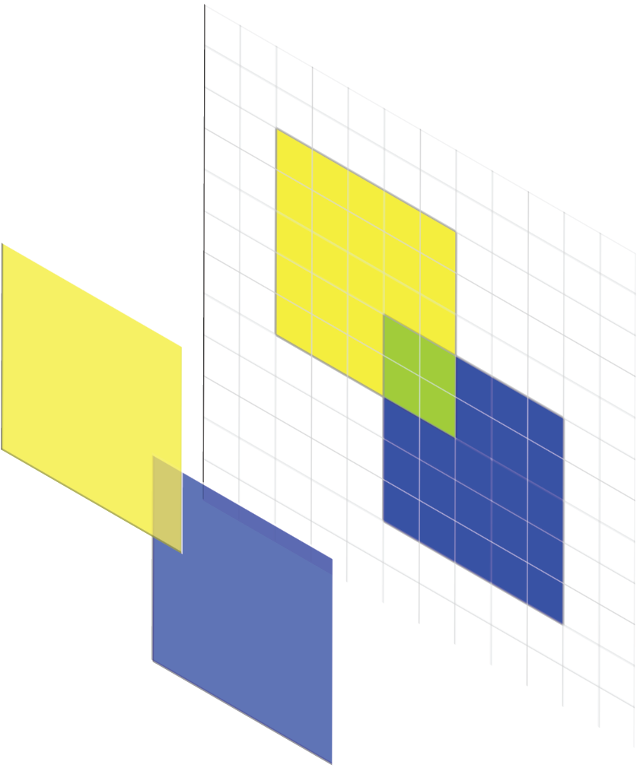
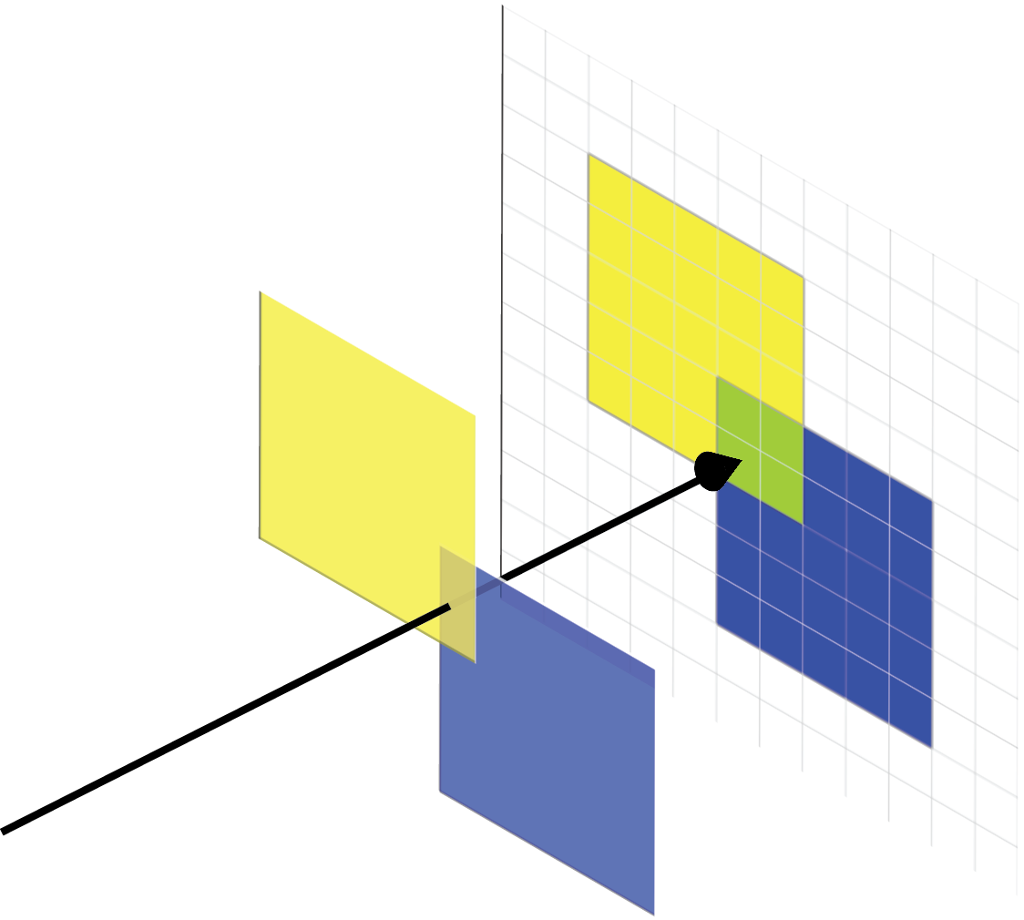

GPU Buffers
Color Buffer C
Depth buffer
  p_{j} is intersection of ray oπ and ω_{j}
  Can set to read-only
Color Buffer
  α_{j} is blending parameter
  χ_{j} is color of ω_{j}
  Binary options such as bitwise-OR

Slide 55
Handling Larger Grids
Algorithm is limited by size of GPU memory
Maximum sized grid in one pass is N x N
Divide grid into sub-grids Q of necessary size μ x μ with μ=(N-4r/ρ)/s
Using binning procedure for optimal I/O efficiency

Slide 56
I/O Efficient Binning
Have memory of size M and we write to disk with blocks of size B
If μ>M then m=M/μ and we need m² sub-grids
Can hold at most M/B streams in memory (holding B points per stream in memory at a time)
Partition into groups P of Q of size n=m/(M/B)^{1/2}
Recurse on P
Depth of recursion is
O(log_{M/B}M/μ)

Slide 57
Handling Larger Grids
Create point stream for each sub-grid
Iterate through points
Add points to each sub-grid which the point’s cone could effect
  Within r of the sub-grid
If necessary, recurse
Run algorithm on each sub-grid Q independently

Slide 58
BufferAnalysis
Iterate over pixels
Check if pixel is part of query point q’s Voronoi cell (color is set)
For each pixel reference C¹ for height of natural neighbor from which q stole area
Set of pixels Π

Slide 59
NNI Batch Query Processing
Save and clear color buffer C¹
Draw TPVor(S)
SLOW
Draw Voronoi cell for query
Save and clear color buffer C²
BufferAnalysis

Slide 60
NNI Query Processing
Draw TPVor(S)
Save and clear color buffer
Draw Voronoi cell for query q
Save color buffer
BufferAnalysis

Slide 61
Updated BufferAnalysis
Iterate over pixels
Check if pixel π is colored
  For each bit in C²[π] that is 1 find corresponding query point q_{i}
  Reference C¹ for height
  Update interpolated height

Slide 62
NNI Batch Query Processing
Save and clear color buffer C¹
Draw TPVor(S)
SLOW
Draw Voronoi cells for 32 queries
Save and clear color buffer C²
BufferAnalysis

Slide 63
NNI on Grids
M x M grid of query points
Spaced by ρs

Slide 64
Batched NNI on Grids
w is number of bits in color buffer (and number of queries we can handle by previous algorithm)
Break grid into query blocks of size B x B
Could handle each in one pass with previous algorithm
Notes:
Previous algorithm can handle up to w simultaneous queries so we break into query blocks of size <=w

Slide 65
Independence
Cones can only color pixels within a radius of r
If regions of influence are disjoint (independent) can use the same color for both cones
For a given red colored pixel must be able to determine which query colored it from set {q₁,q₂,q₃,q₄}
If the queries are independent then the closest query colored it

Slide 66
Batched NNI on Grids
Make assumption that cone radius is less than half the width of one query block
Queries in same position in different query blocks are independent
Execute previous algorithm on each query block simultaneously

Slide 67
Updated BufferAnalysis
Iterate over pixels
Check if pixel π is colored
  For each bit in C²[π] that is 1 find corresponding set of query points Q_{j} that used this bit as their color
  Find q_{i} in Q_{j} that is closest to π and update interpolated height for this query point
For red bit, Q_{j} = {q₁,q₂,q₃,…}
For blue bit, Q_{k} = {q₄,q₅,q₆,…}

Slide 68
Implementation Optimizations
Reduce disk-transfer
  I/O efficient binning of data for large grids
  Use Templated Portable I/O Environment (TPIE)

Slide 69
GPU Buffers
Buffers are 2D array of pixels.
Store unique piece of information about each pixel
Depth buffer
  Stores distance to closest object from viewpoint
  Can be set to read-only
Color Buffer
  Stores information about color as seen from a given viewpiont at each pixel
  Can blend objects in line of sight
  Binary options such as bitwise-OR
Color Buffer C

Slide 70
Performing an NNI query
|TPVor(q₁)| = 73
h(q₁)=(33/73)h(p₁)+(12/73)h(p₂)+(28/73)h(p₃)
Call this process BufferAnalysis

