Slide 1
From Point Cloud to 2D and 3D Grids:
A Natural Neighbor Interpolation Algorithm using the GPU
Alex Beutel
Duke University

Slide 2
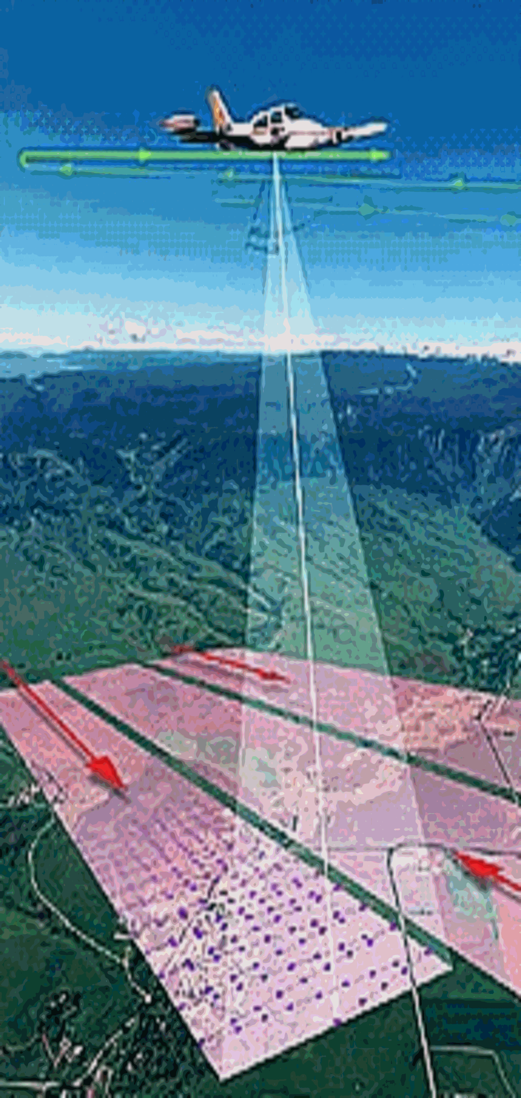
Light Detection and Ranging
(LiDAR)
Planes collect data with lasers
Each point recorded (x,y,z)
Image from USDA

Slide 3
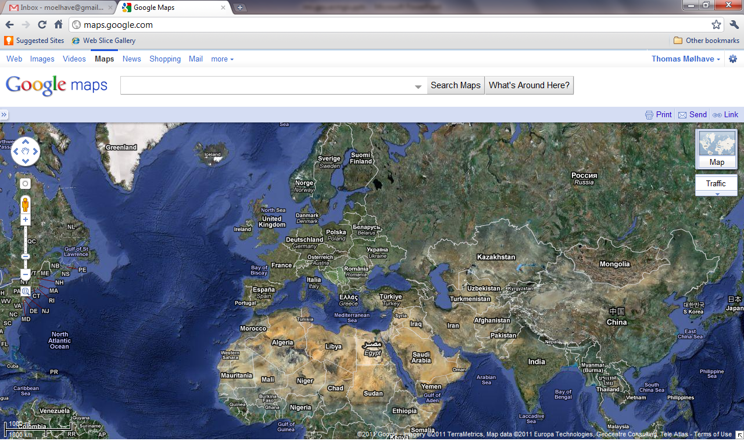
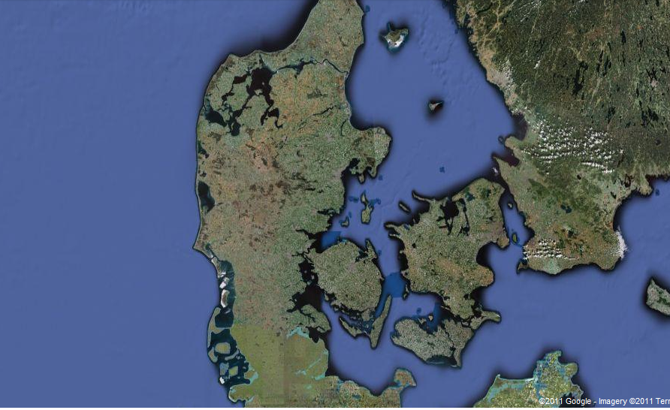
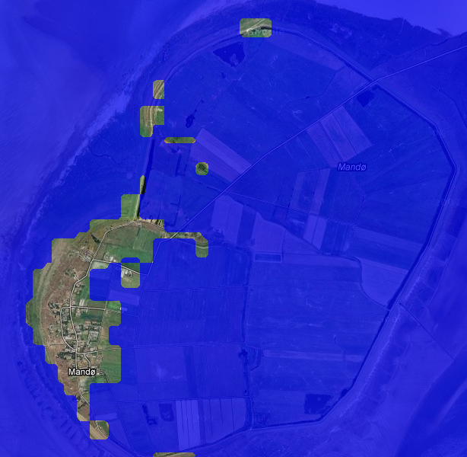
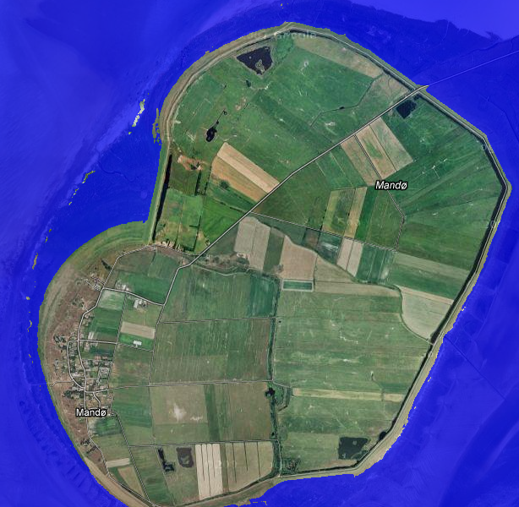
Flood mapping – Mandø, Denmark
90 meter grid resolution
2 meter grid resolution

Slide 4
Digital Elevation Model (DEM)
LiDAR data is just a point cloud
Create simpler models that are easier to process
Modeled as a grid DEM
Grid requires interpolation at grid points
Used in many GIS applications
  Hydrology, contouring, noise computations, line-of sight, city planning

Slide 5
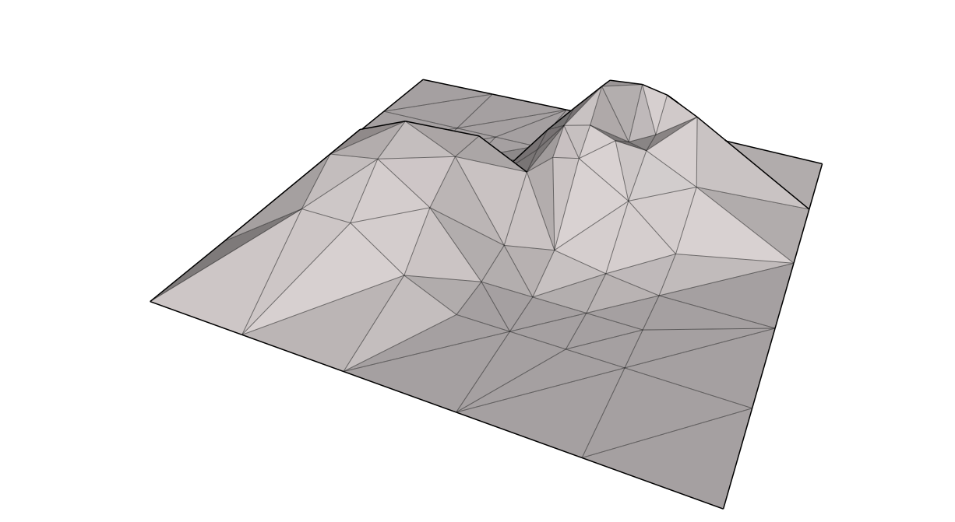
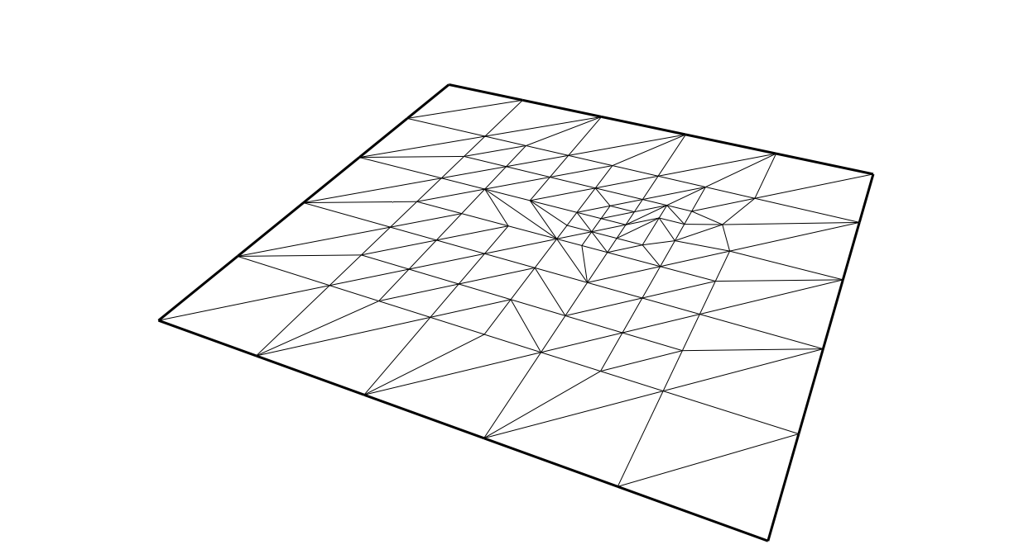

Digital Elevation Models
Triangular Irregular Network (TIN)
4

Slide 6
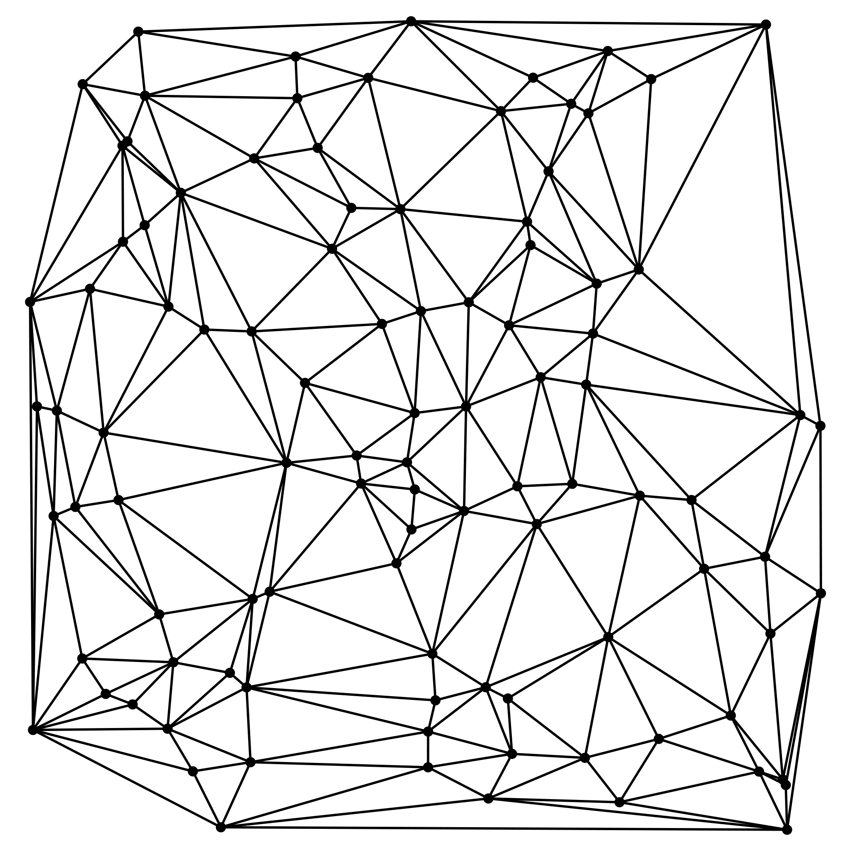
DEM Construction
Must interpolate value at each grid point
Linear interpolation based on Delaunay triangulation [Agarwal et al. 2005]
  Simple but not smooth
  Relatively fast
Regularized spline with tension (RST) [Mitasova et al. 1993]
  Uses high-order polynomials
  Better with sparse data
  Slow

Slide 7
Natural Neighbor Interpolation (NNI)
Voronoi diagram based
Has been used but too slow
Take advantage of general purpose graphics processing unit (GPGPU)
NNI
Linear Interpolation

Slide 8
Contributions
Build high-quality, large-scale grid DEMs with a natural neighbor based interpolation scheme using the GPU
  Handle gaps in data by introducing the idea of region of influence
  Exploit the fact that we only interpolate at grid points using clever blocking. Handle 10⁶ NNI queries in one pass. Previous maximum of ~32 [Fan et al. SIAM, 2005]
  Use CUDA to improve performance of our implementation
  Perform higher dimensional NNI on the GPU to construct grid DEMs in time based on spatial-temporal data

Slide 9
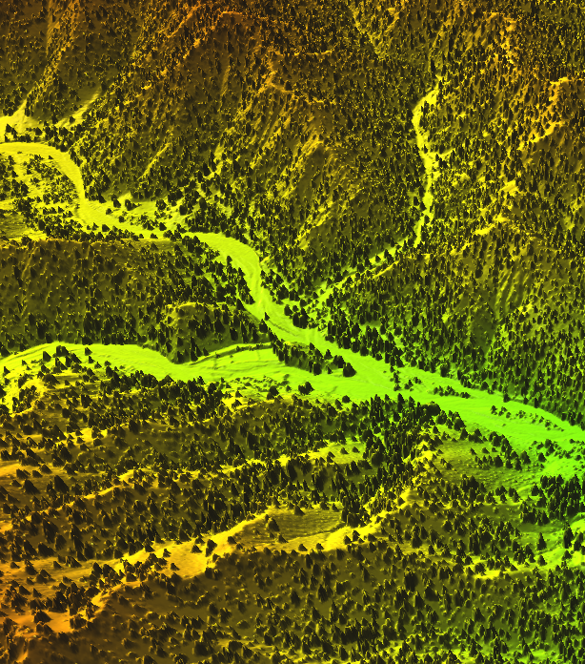
Outline
GPU background
2D
  Voronoi diagrams on the GPU
  Natural neighbor interpolation (NNI)
  Batched NNI
    On grids
  Implementation
  Evaluation
3D
  Voronoi diagrams on the GPU
  NNI
  Memory vs. time tradeoffs for higher dimensional grids
  Evaluation

Slide 10
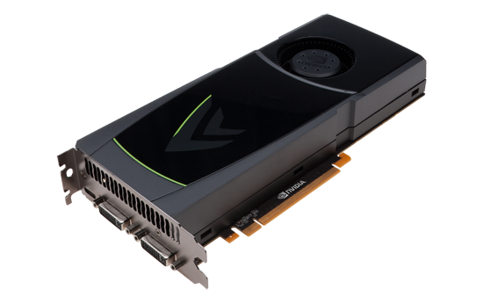
Graphics Processing Unit (GPU)
Specialized hardware for parallel processing
Render 3D objects on 2D plane of pixels Π from a viewpoint o
Used generically in other applications
  Robot collision detection, database systems, fluid dynamics

Slide 11
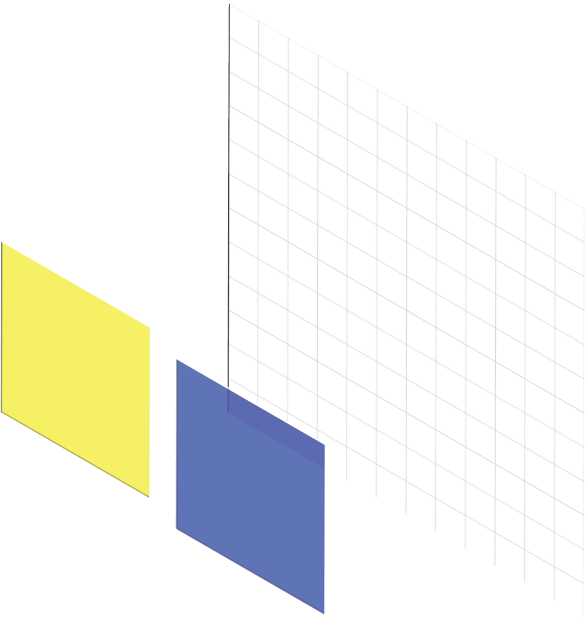
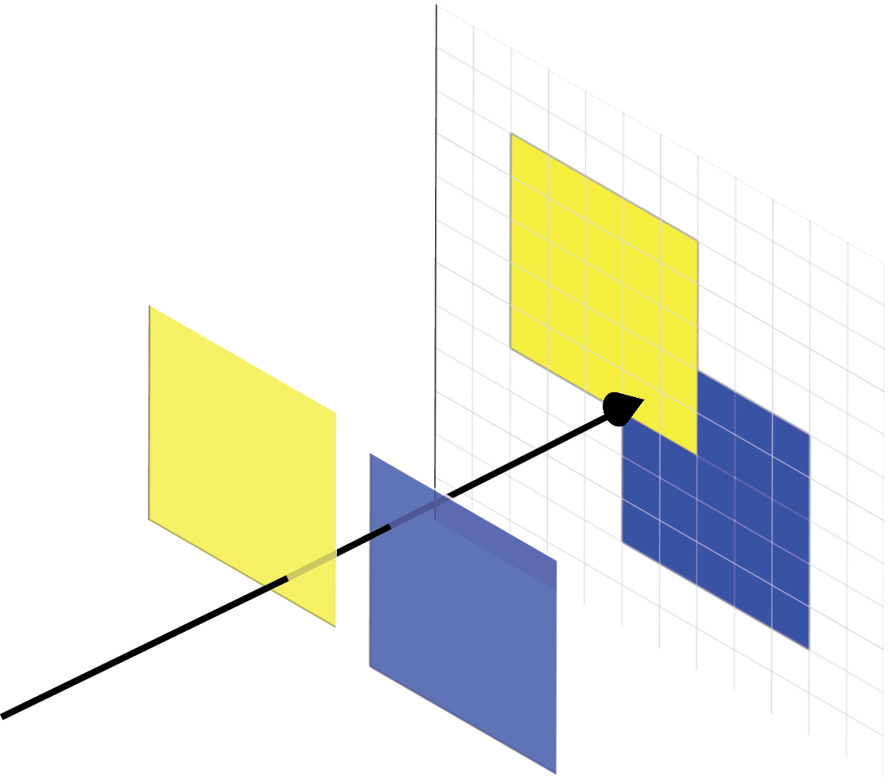
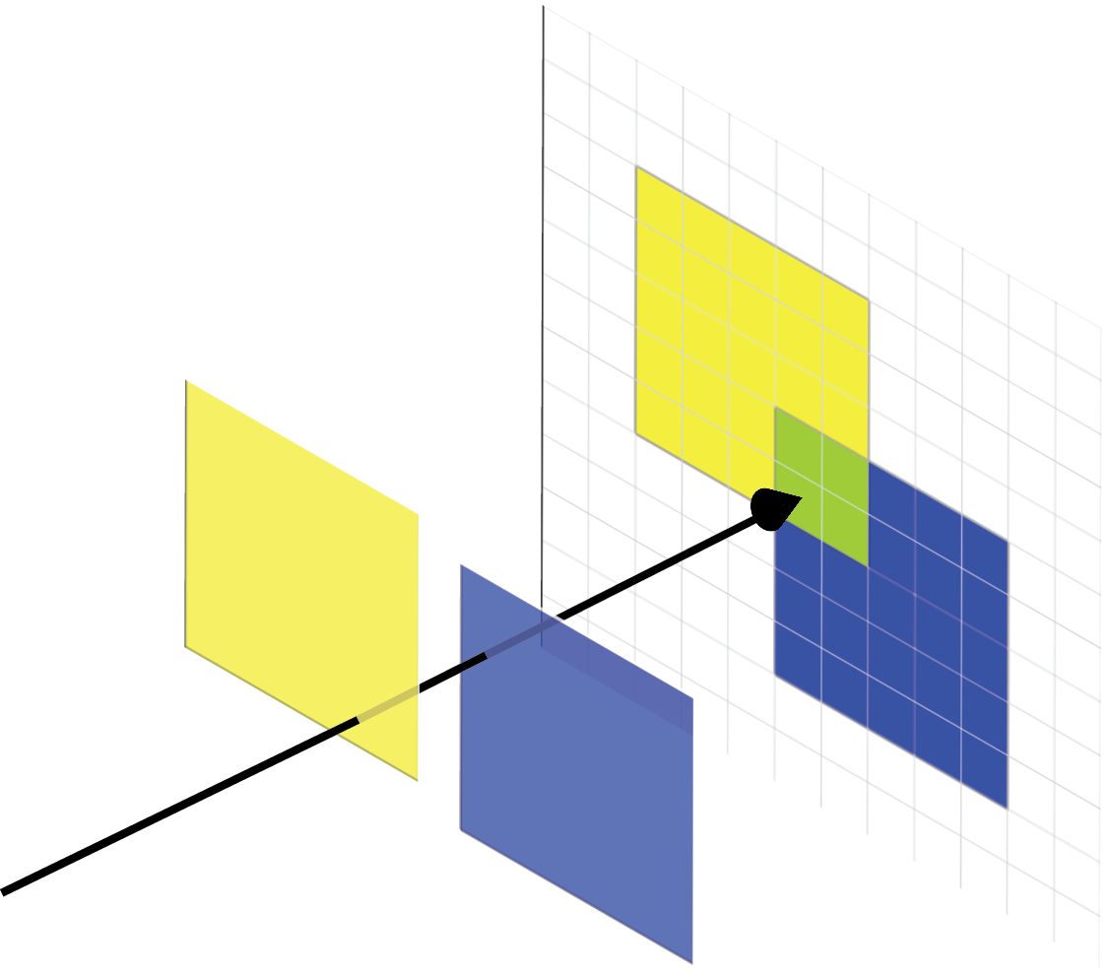
GPU Buffers
Color Buffer
Buffers are 2D array of pixels.
Store unique piece of information about each pixel
Color Buffer
  Stores information about color as seen from a given viewpoint at each pixel
  Can blend objects in line of sight
  Binary options such as bitwise-OR
Depth buffer
  Stores distance to closest object from viewpoint
  Can be set to read-only

Slide 12
GPU Model of Computation
FAST
On card memory for buffers
  Slow read-back to main CPU memory
  Fast, parallel access on card
CUDA for general purpose parallel processing
CPU
Main Memory
SLOW
FAST
GPU
Graphics Card Memory

Slide 13
Computing the Voronoi Diagram
[Hoff, et al. 1999]

Slide 14
Voronoi Diagram
A Voronoi cell Vor(p_{i}) is the region in space for which p_{i} is the closest point (the nearest neighbor) from the set of input points S
Voronoi diagram, Vor(S), is the planar subdivision induced by the Voronoi cells of S
Notes:
As discussed yesterday by sarana nutanong

Slide 15
Voronoi Diagram and Lower Envelopes
For each point p_{i} define function
Lower envelope of {f₁,f₂…f_{n}} is
Lower envelope is distance from x to its nearest neighbor

Slide 16
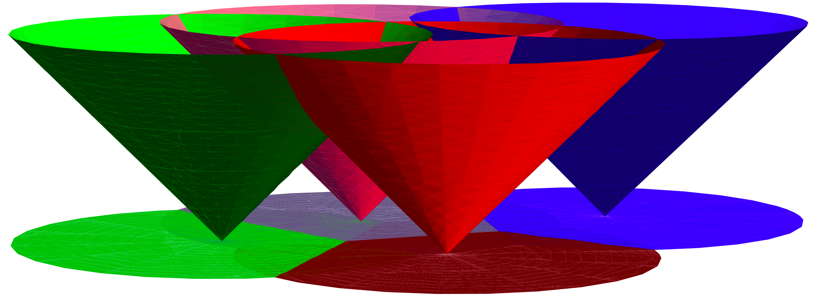
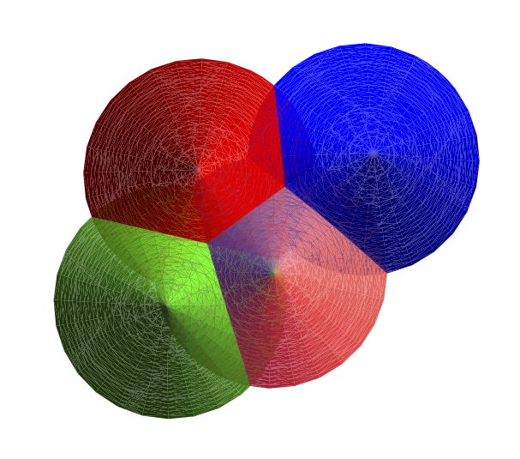
Rendering the Voronoi Diagram
Render on GPU with looking at cones from below
(viewpoint at -∞)

Slide 17
Pixelized Voronoi Diagram
Drawing on GPU discretizes Voronoi diagram. Call this PVor_{S}(p).
Render cone for each input point
Depth buffer stores distance from the pixel to the closest input point (structure of the Voronoi diagram)
Color buffer can store any information specific to the closest input point
Depth Buffer
Color buffer

Slide 18
Generating Pixelized Voronoi Diagrams
Render using truncated polyhedralcones

Slide 19
Truncated Pixelized Voronoi Diagram
TPVor(S)
Radius of cone r defines region of influence
If two points are >2r apart their cones can not overlap and they can not effect each other.

Slide 20
Natural Neighbor Interpolation

Slide 21
Natural Neighbor Interpolation
Vor(q) takes area from neighboring cells (natural neighbors)
Interpolate h(q) based on weighted average of heights of natural neighbors h(p_{i})
Weights are based on:

Slide 22
Natural Neighbor Interpolation
|TPVor(q₁)| = 73
h(q₁)=(33/73)h(p₁)+(12/73)h(p₂)+(28/73)h(p₃)
Call this process BufferAnalysis

Slide 23
NNI Query Processing
Main Memory
Draw TPVor(S)
Save and clear color buffer
Draw Voronoi cell for query q
Save color buffer
BufferAnalysis
GPU Memory

Slide 24
Batching NNI Queries
[Fan, et al. SIAM 2005]

Slide 25
NNI Batch Query Processing
Draw TPVor(S)
Save and clear color buffer
Draw Voronoi cell for query q
Save color buffer
BufferAnalysis
SLOW

Slide 26
Batching NNI Queries
For a given pixel, only need to know if Voronoi cell for q covers it (Y/N)
Only use one bit in color buffer for each query
Color buffer performs bitwise-OR

Slide 27
NNI Batch Query Processing
Draw TPVor(S)
Save and clear color buffer
Draw Voronoi cell for 32 queries
Save color buffer
BufferAnalysis
SLOW

Slide 28
Batching Grids of NNI Queries

Slide 29
NNI for Grid DEM Construction
Grid of queries, M x M grid

Slide 30
Batched NNI on Grids
w is number of bits in color buffer (and number of queries we can handle by previous algorithm)
Break grid into query blocks of size B x B
Could handle each in one pass with previous algorithm
Notes:
Previous algorithm can handle up to w simultaneous queries so we break into query blocks of size <=w

Slide 31
Batched NNI on Grids
Make assumption that cone radius is less than half the width of one query block
Queries in same position in different query blocks are independent
Execute previous algorithm on each query block simultaneously

Slide 32
NNI Grid Query Processing
Draw TPVor(S)
Save and clear color buffer
Draw Voronoi cell for ~10⁶ queries
Save color buffer
BufferAnalysis

Slide 33
Larger Grids
Grids restricted by size of memory on GPU
Developed a I/O efficient partitioning procedure
  Sub-grids that can be handled by GPU
  Separate input data

Slide 34
Putting it together

Slide 35
Implementation
Ran on
  Intel Core2 Duo CPU running Ubuntu 10.4
  NVIDIA GeForce GTX 470 with CUDA 3.0
OpenGL
  Templated Portable I/O Environment (TPIE) for interacting with disk efficiently

Slide 36
NNI Batch Query Processing
Draw TPVor(S)
BufferAnalysis
Draw Voronoi cell for ~10⁶ queries
Save interpolated heights
Optimize GPU to CPU communication
  Transferring color buffers between GPU and CPU memory is slow
  For each query we have a multiple pixels
  Transferring extra data
  Perform BufferAnalysis with CUDA directly on GPU
  Only transfer one value for each query point
Draw TPVor(S)
Save and clear color buffer
Draw Voronoi cell for ~10⁶ queries
Save color buffer
BufferAnalysis
SLOW
SLOW

Slide 37
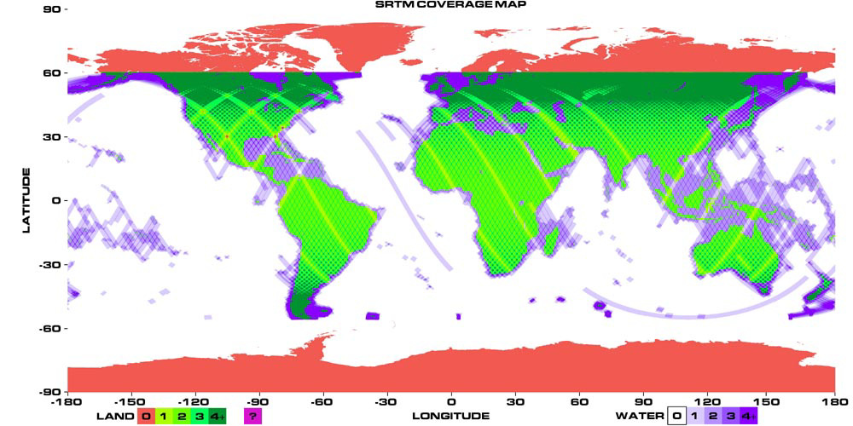
Tests
Denmark (DKPART):
  27 GB
  1 billion data points
  900 km² region
Afghanistan:
  3.5 gigabytes
  186 million data points
  4 km² region
Fort Leonard Wood (Missouri)
  57 GB
  2.2 billion data points
  600 km² region
Source: NASA
Data from COWI A/S and the Army Research Office
Notes:
LiDAR = Light Detection and Ranging

Slide 38
Performance - Efficiency
 | Afghanistan | DKPART | Fort Leonard Wood
Size of input (10⁶) | 186 | 1038 | 2180
Size of output (10⁶) | 9.5 | 213 | 151
RST | 95m | 18.5h | 34h
Linear Interpolation | 16m | 123m | 338m

Slide 39
Performance - Efficiency
 | Afghanistan | DKPART | Fort Leonard Wood
Size of input (10⁶) | 186 | 1038 | 2180
Size of output (10⁶) | 9.5 | 213 | 151
RST | 95m | 18.5h | 34h
Linear Interpolation | 16m | 123m | 338m
NNI without CUDA | 21m | 239m | 186m
Binning Time | 1m 30s | 10m | 17m
Interpolation Time | 19m 30s | 229m | 169m

Slide 40
Performance - Efficiency
 | Afghanistan | DKPART | Fort Leonard Wood
Size of input (10⁶) | 186 | 1038 | 2180
Size of output (10⁶) | 9.5 | 213 | 151
RST | 95m | 18.5h | 34h
Linear Interpolation | 16m | 123m | 338m
NNI without CUDA | 21m | 239m | 186m
NNI with CUDA | 2m 40s | 21m | 36m
Binning Time | 1m 10s | 10m | 17m
Interpolation Time | 1m 30s | 11m | 19m

Slide 41
Performance - Quality
Afghanistan
all ground points
Afghanistan
sparse ground points
NNI
Linear Interpolation

Slide 42
3D Natural Neighbor Interpolation

Slide 43
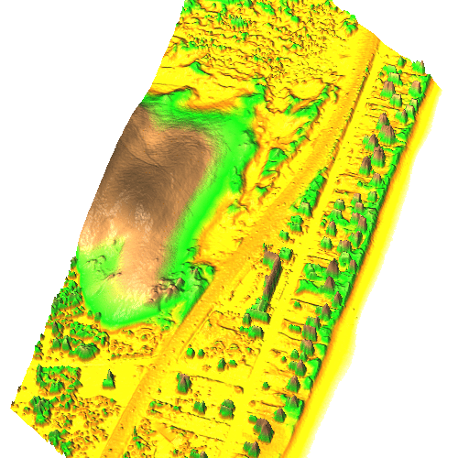
3D Natural Neighbor Interpolation
What if we have spatial-temporal data?
  Planes scan same region different years
Extend previous algorithm
http://skagit.meas.ncsu.edu/~helena/grasswork/NH9908p_anim.gif

Slide 44
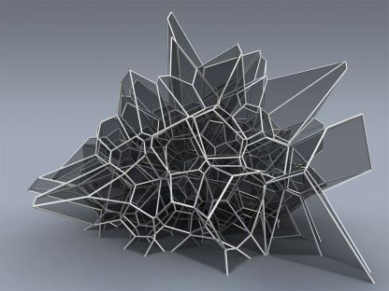
3D Voronoi Diagram
http://www.qhull.org/html/normal_voronoi_knauss_oesterle.jpg

Slide 45
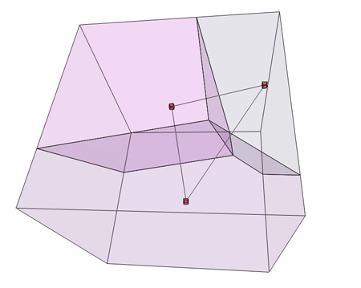
3D Voronoi Diagram
As before – A Voronoi cell Vor(p_{i}) is the region in space for which p_{i} is the near neighbor from the set of input points S
http://www.wblut.com/blog/wp-content/2009/04/voronoi3db2.jpg

Slide 46
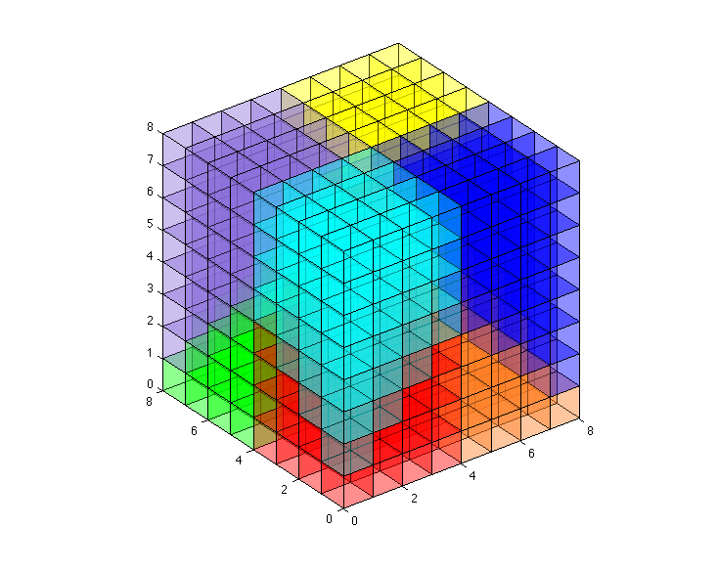
Discretized 3D Voronoi Diagram
Can discretize 3D space into voxels
  Cubes of space
  Sample from center of each voxel
Taking lower envelope would require projecting 4D objects onto 3D hyperplane
  GPU can’t do this

Slide 47
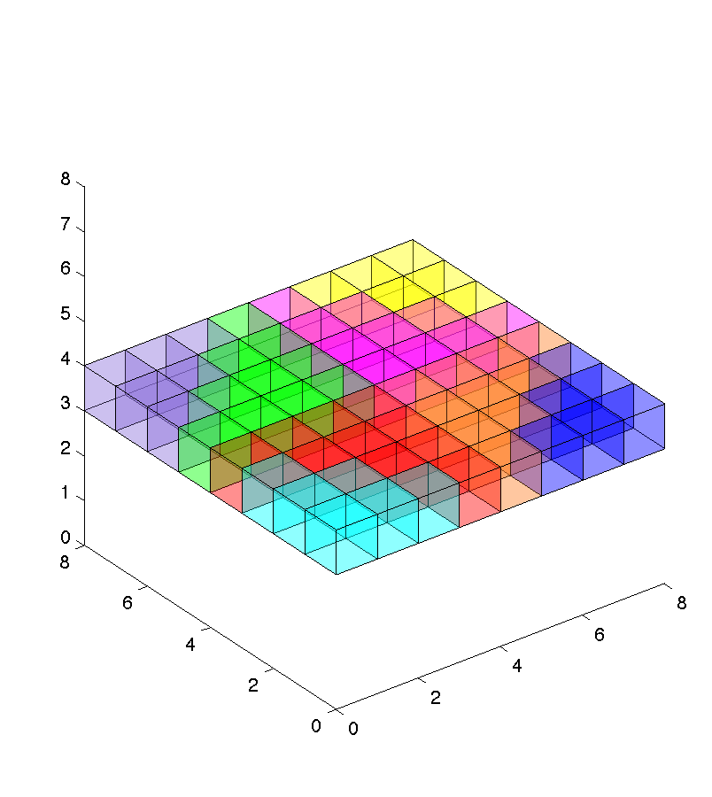
Pixelized Voronoi Diagram
Already discretized, so let’s set time constant
Calculate each time slice separately

Slide 48
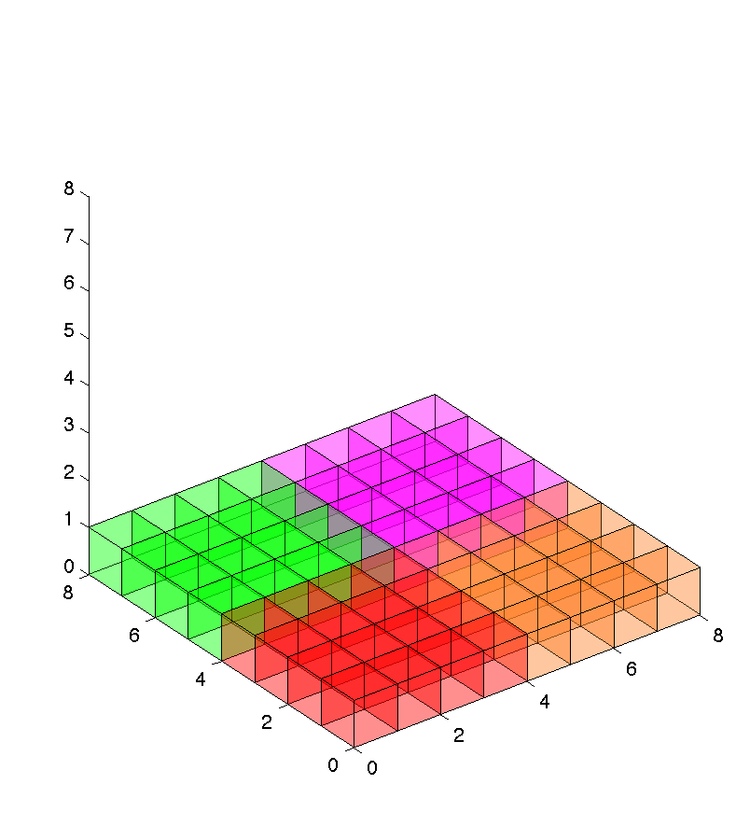
Pixelized Voronoi Diagram

Slide 49
New Lower Envelope
Time is constant so lower envelope changes:

Slide 50
New Lower Envelope

Slide 51
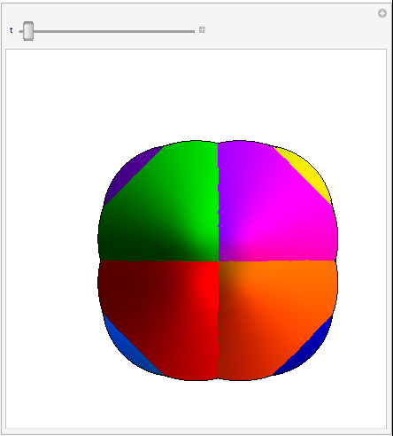
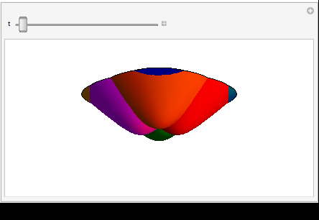
Lower Envelope – Continuous in Time

Slide 52
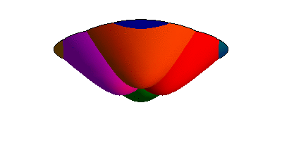
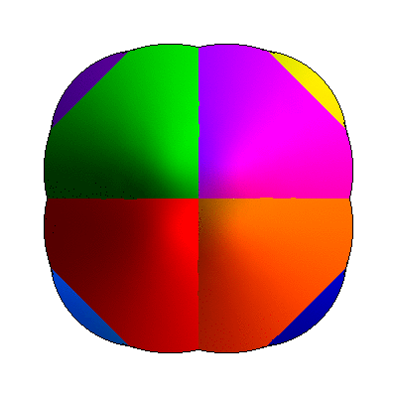
Lower Envelope – Discretized in Time

Slide 53
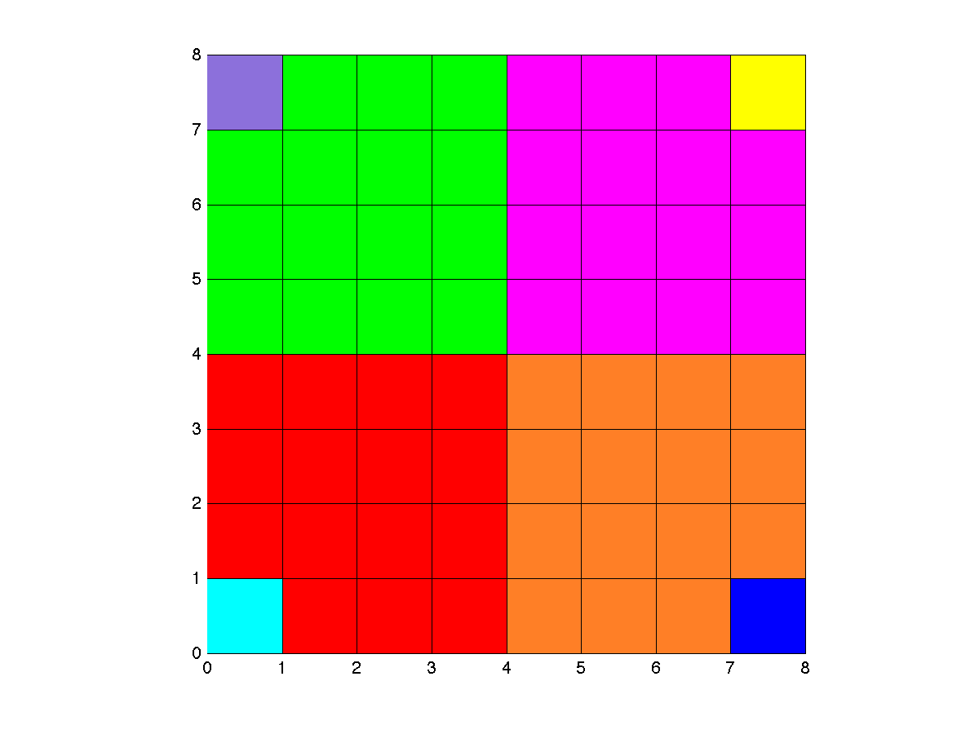
Lower Envelope – Discretized in Time

Slide 54
Truncated Polygonal Hyperboloids

Slide 55
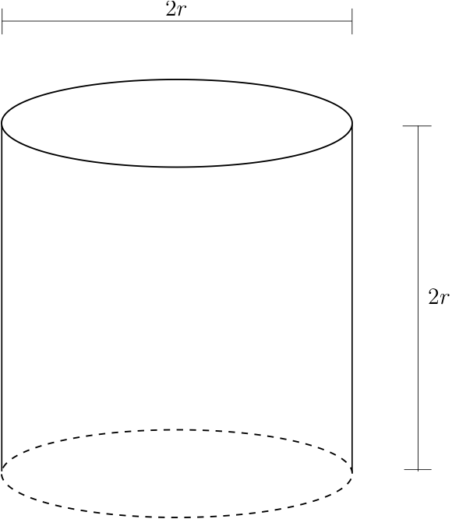
Cylindrical Region of Influence

Slide 56
Natural Neighbor Interpolation on the GPU

Slide 57
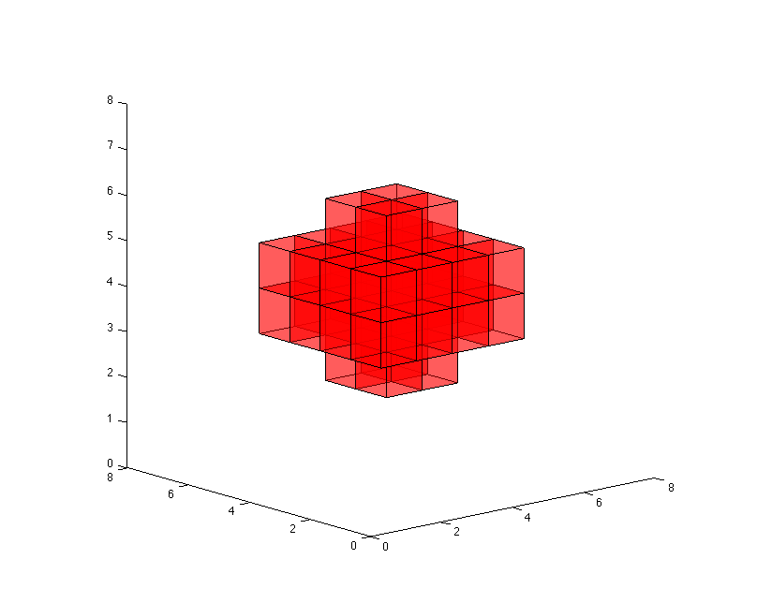
Natural Neighbor Interpolation
Largely the same:

Slide 58
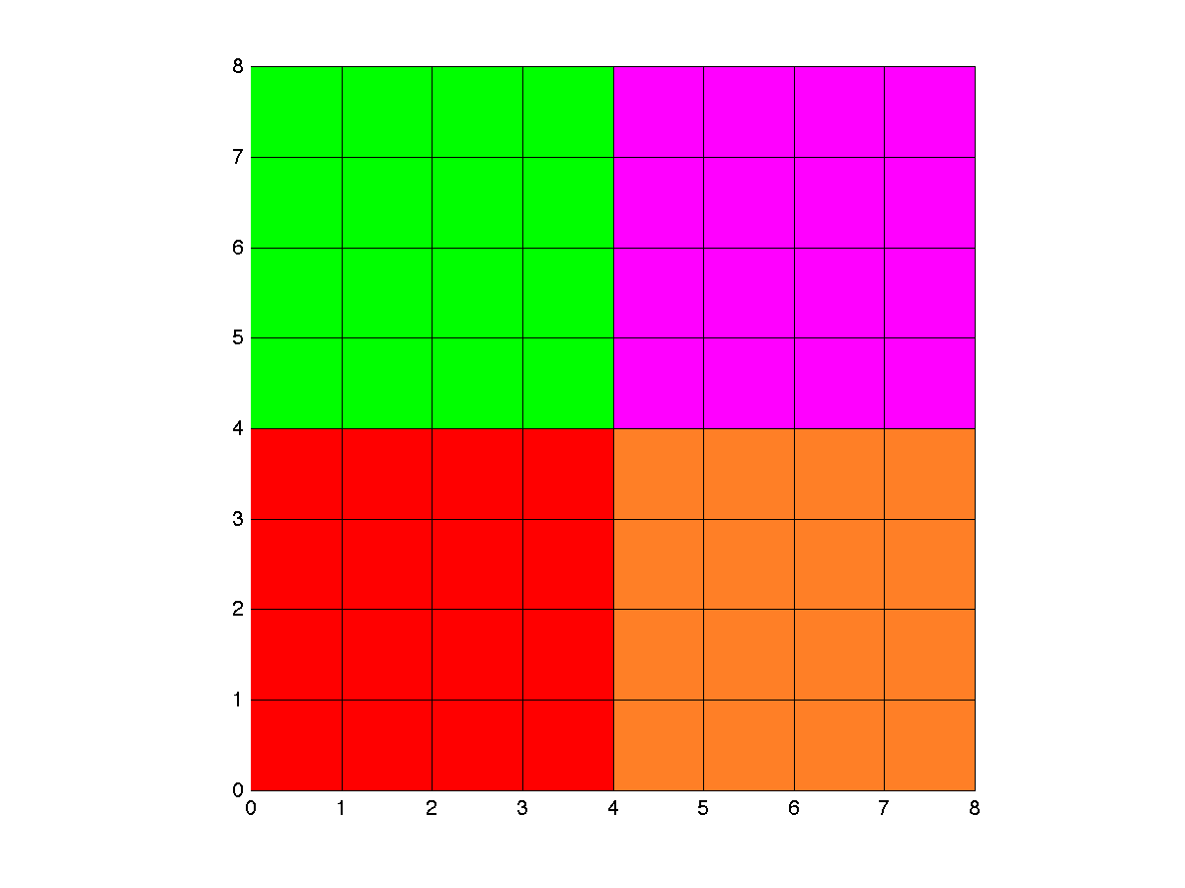
BufferAnalysis
0
0
0
0
Total
0

Slide 59
BufferAnalysis
0
0
0
0
Total
0

Slide 60
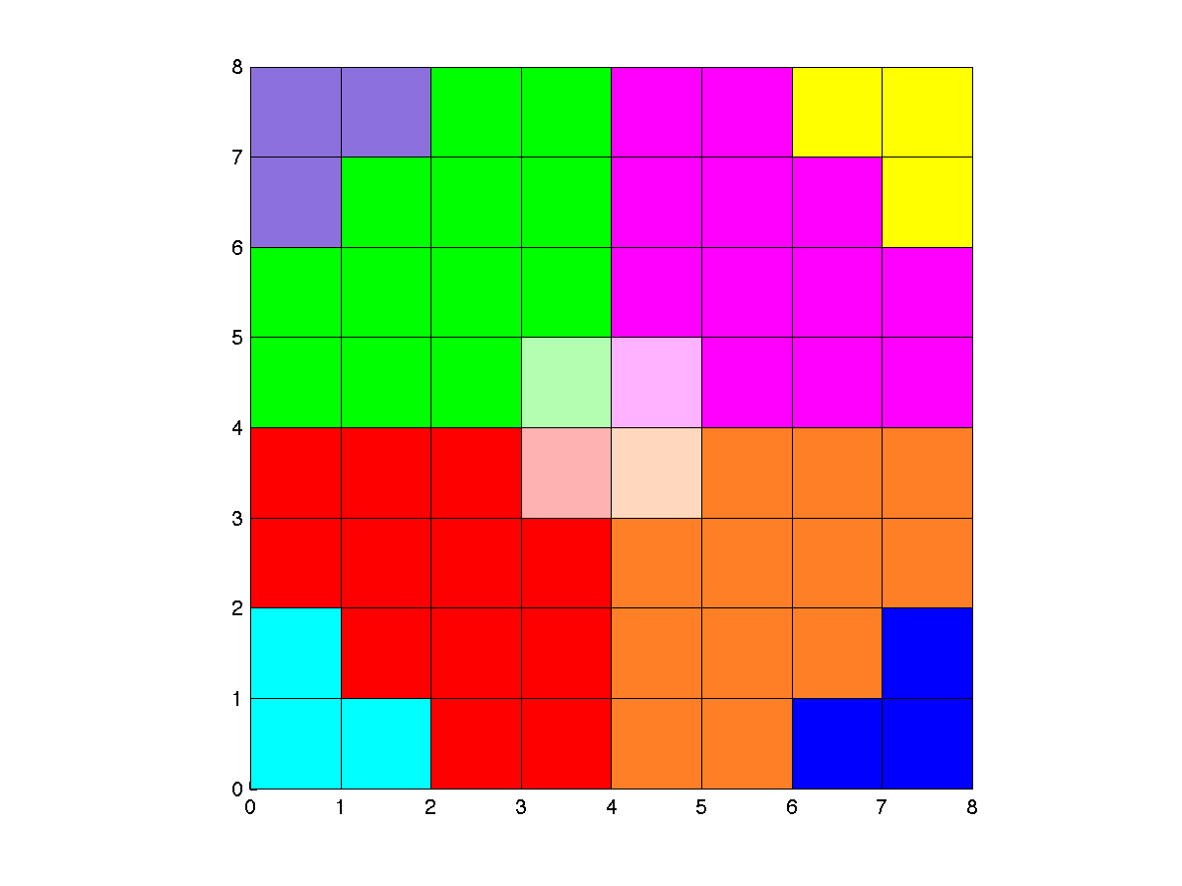
BufferAnalysis
1
1
1
1
Total
4

Slide 61
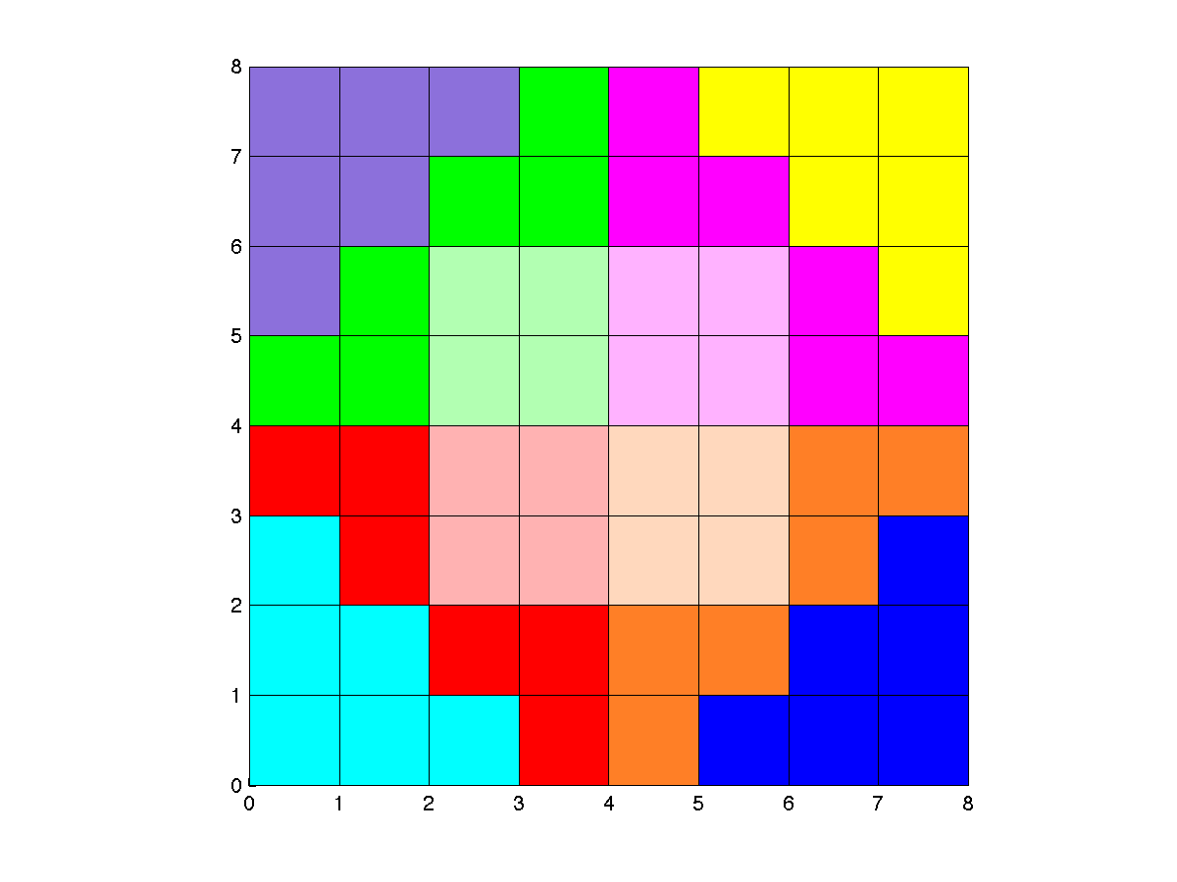
BufferAnalysis
5
5
5
5
Total
20

Slide 62
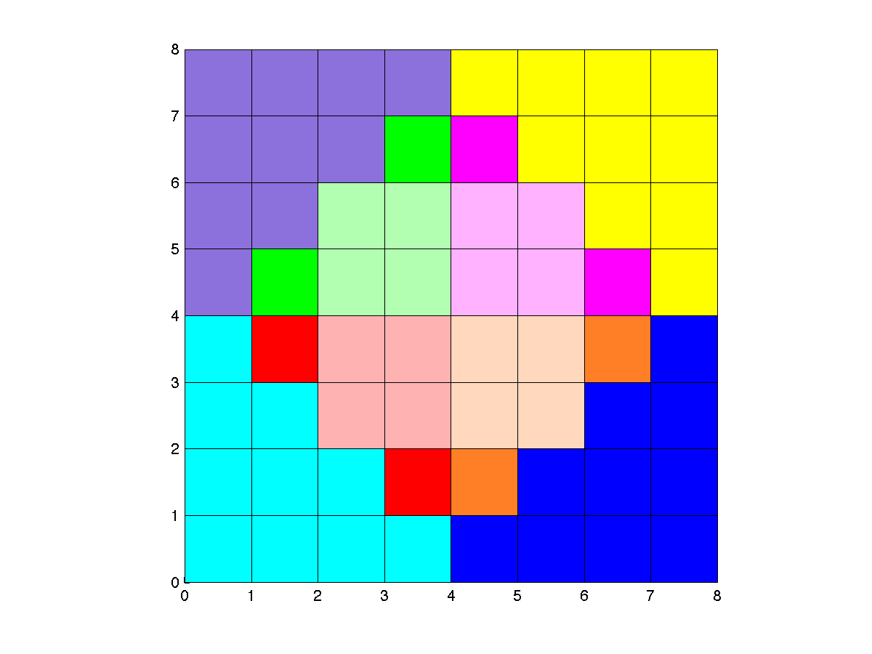
BufferAnalysis
9
9
9
9
Total
36

Slide 63
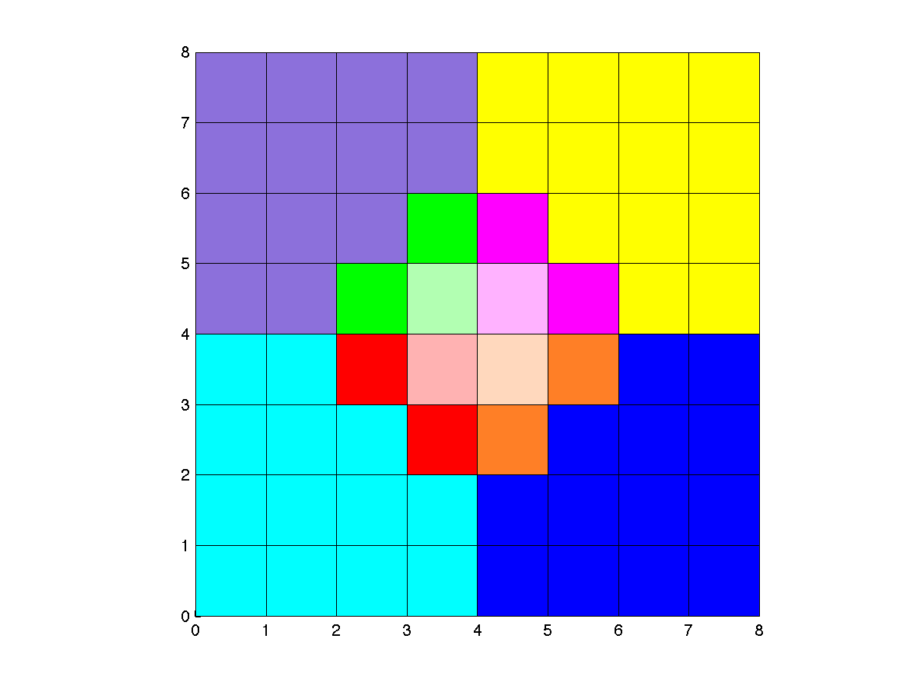
BufferAnalysis
10
10
10
10
Total
40

Slide 64
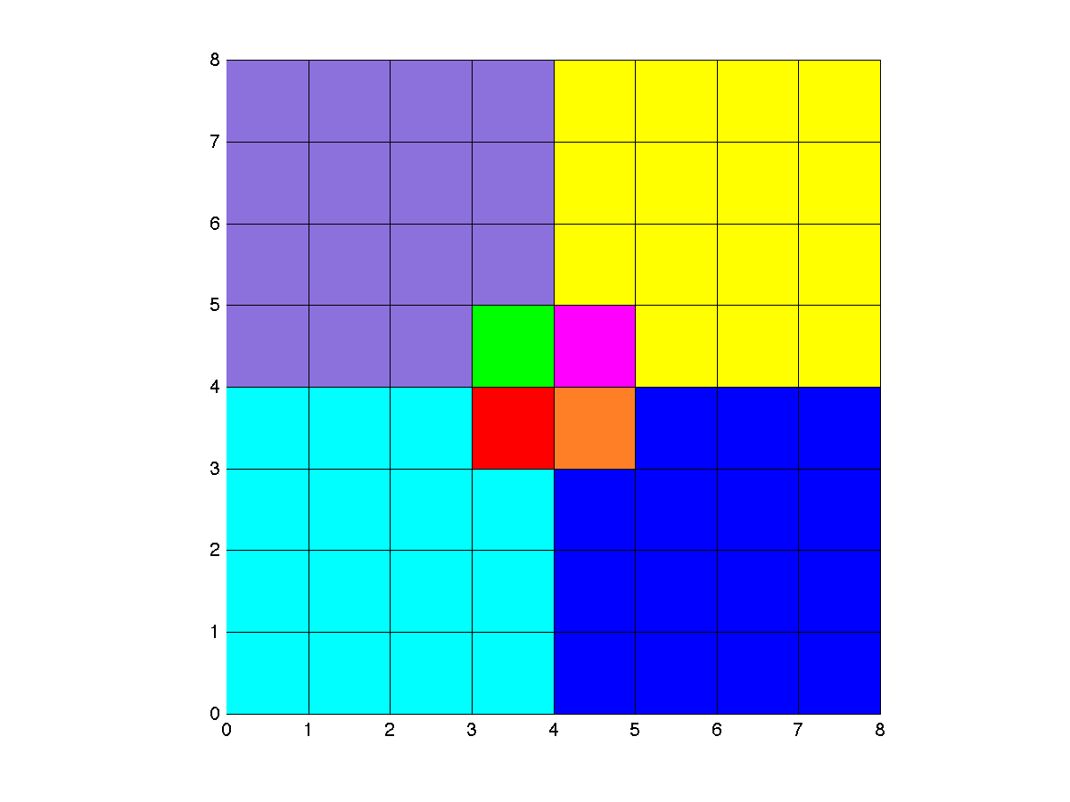
BufferAnalysis
10
10
10
10
Total
40

Slide 65
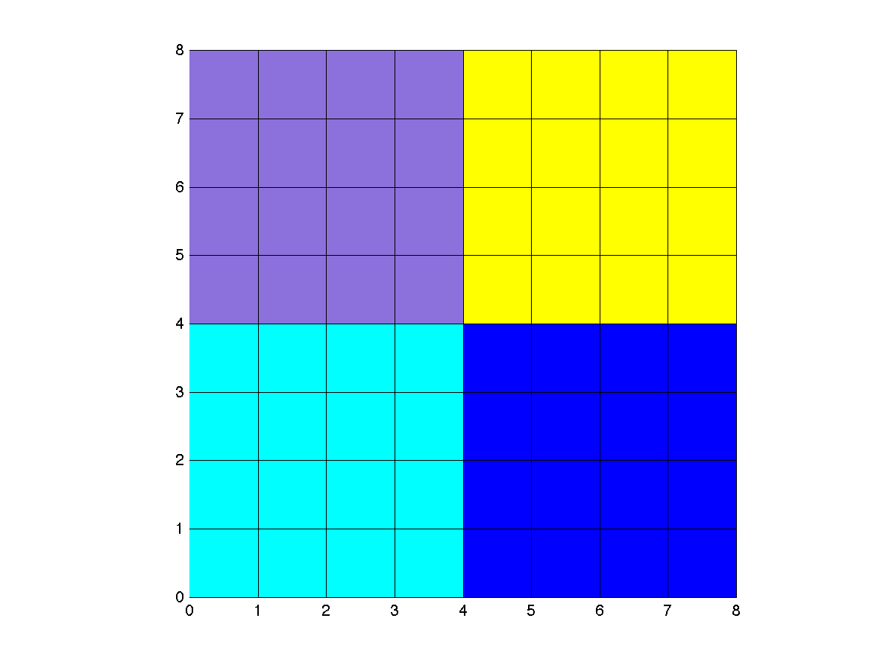
BufferAnalysis
10
10
10
10
Total
40
h(q) = (10/40)h(p₁) + (10/40)h(p₂) +(10/40)h(p₃) +(10/40)h(p₄)

Slide 66
Batching N x N Grids
Within each time slice use same bitwise method
Because radius is limited, we can again do entire grid at once
Handle each time slice separately

Slide 67
NNI on N x N Grid at t_{o}
Draw TPVor(S,τ)
BufferAnalysis
Draw Voronoi cell for ~10⁶ queries
Save interpolated heights
Loop
over τ
for
t_{o}-r ≤ τ ≤ t_{o}+r

Slide 68
Handling N x N x N Grids

Slide 69
NNI on N x N x N Grid
Draw TPVor(S,τ)
BufferAnalysis
Draw Voronoi cell for ~10⁶ queries
Save interpolated heights
Draw TPVor(S,τ)
BufferAnalysis
Draw Voronoi cell for ~10⁶ queries
Save interpolated heights
t_{o}-r ≤ τ ≤ t_{o}+r
t₁-r ≤ τ ≤ t₁+r
…
Interpolate N x N x {t_{o}}
Interpolate N x N x {t₁}

Slide 70
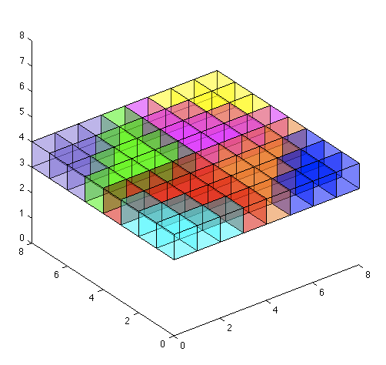
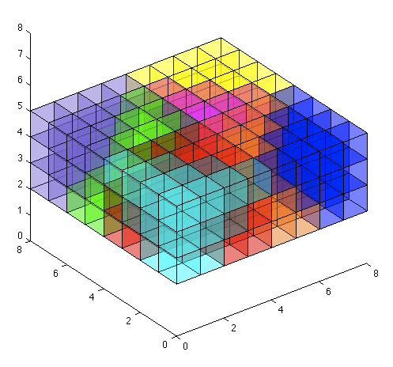
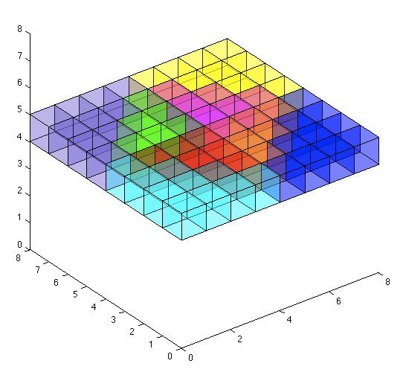
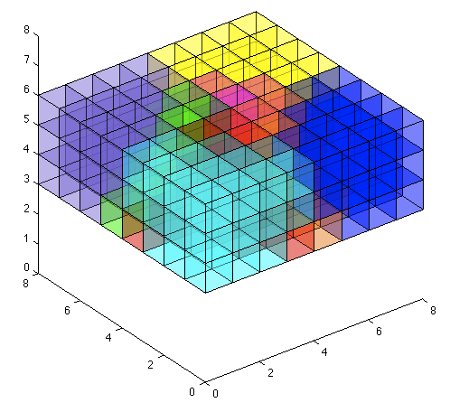
NNI on N x N x N Grids
GPUVoronoi(S)
NNI and BufferAnalysis

Slide 71
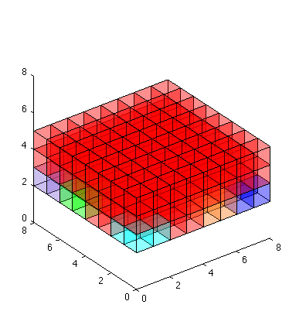
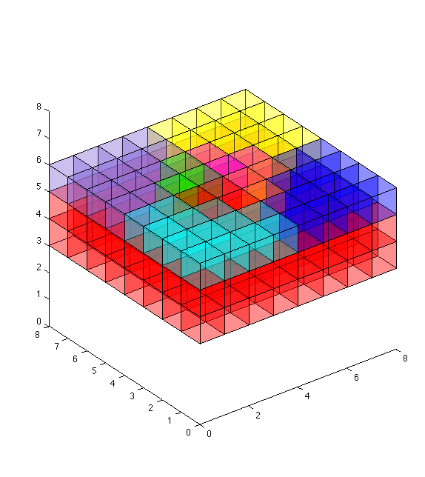
GPUVoronoi(S) Overlap

Slide 72
NNI on N x N x N Grid
Draw TPVor(S,τ)
BufferAnalysis
Draw Voronoi cell for ~10⁶ queries
Save interpolated heights
Draw TPVor(S,τ)
BufferAnalysis
Draw Voronoi cell for ~10⁶ queries
Save interpolated heights
t₁-r ≤ τ ≤ t₁+r
t_{o}-r ≤ τ ≤ t_{o}+r
…
Interpolate N x N x {t_{o}}
Interpolate N x N x {t₁}

Slide 73
O(1) Algorithm
Store each time slice of data in depth buffer once
Use CUDA to modify depth buffer for particular time offset
Combine depth buffers and then perform BufferAnalysis

Slide 74
Evaluation

Slide 75

Performance

Slide 76
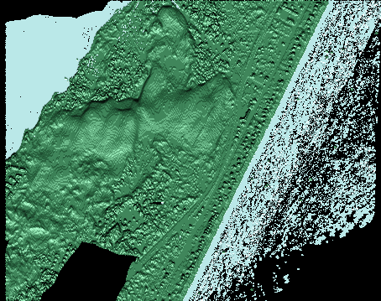
Performance

Slide 77
Performance
 | O(r²) | O(r) | O(r²) | O(r)
Points/Year (10⁶) | 10 | 10 | 50 | 50
Binning Time | 2m 40s | 3m 2s | 15m 55s | 16m 17s
GPUVoronoi(S) | 18m 28s | 4m 58s | 2h 7m | 33m 18s
Draw Query Cones | 1.128s | 1.02s | 1.2s | 0.98s
BufferAnalysis | 8m 36s | 2m 11s | 8m 23s | 2m 21s
Write Points | 0.71s | 0.01s | 1.68s | 1.63 s
Total | 29m 54s | 10m 19s | 2h 31m | 52m 6s
Experiments were run over random large data sets with only 200 by 200 output grid.
Radius in time was 2 such that each Voronoi diagram generally required 50 million or 250 million cones to be drawn
Notes:
50 million – 11GB of data in LAS format
10 million – 2.1GB

Slide 78
Performance
 | O(r²) | O(r) | O(r²) | O(r)
Points/Year (10⁶) | 10 | 10 | 50 | 50
Binning Time | 2m 40s | 3m 2s | 15m 55s | 16m 17s
GPUVoronoi(S) | 18m 28s | 4m 58s | 2h 7m | 33m 18s
Draw Query Cones | 1.128s | 1.02s | 1.2s | 0.98s
BufferAnalysis | 8m 36s | 2m 11s | 8m 23s | 2m 21s
Write Points | 0.71s | 0.01s | 1.68s | 1.63 s
Total | 29m 54s | 10m 19s | 2h 31m | 52m 6s
Notes:
50 million – 11GB of data in LAS format
10 million – 2.1GB

Slide 79
Future Work
Implement O(1) algorithm
Optimize binning procedure for time
Analyze space vs. time trade-offs for d-dimensional grids (N^{d})

Slide 80
Questions?
alex.beutel@cs.duke.edu
http://alexbeutel.com
Special thanks to Pankaj Agarwal and Thomas Mølhave for all their help
Thanks to COWI A/S and the Army Research Office for access to data

Slide 81
Performance - Efficiency
 | Without CUDA |  | With CUDA
Grid Resolution (m.) | 0.8 | 2 | 0.8 | 2
GPUVoronoi(S) | 411 | 73 | 76 | 74
Read C¹ | 814 | 116 | N/A | N/A
Draw Query Cones | 51 | 5.84 | 39 | 6.96
Read C² | 875 | 135 | N/A | N/A
BufferAnalysis | 102 | 9.57 | 183 | 0.46
Write Points | 4.01 | 0.92 | 4.2 | 0.8
Total | 2289 | 371 | 337 | 105
Times in seconds

Slide 82
Performance - Efficiency
 | Afghanistan | DKPART | Fort Leonard Wood
Size of input (10⁶) | 186 | 1038 | 2180
Size of output (10⁶) | 9.5 | 213 | 151
NNI with CUDA | 163 | 1238 | 2190
Binning Time | 67 | 558 | 1030
Interpolation Time | 96 | 680 | 1160
NNI without CUDA | 1252 | 14323 | 11164
Binning Time | 91 | 569 | 1036
Interpolation Time | 1161 | 13754 | 10128
Linear Interpolation | 962 | 7377 | 20307
RST | 5698 | 66729 | 122305
Times in seconds

Slide 83
Performance - Efficiency
 | Without CUDA |  | With CUDA
Grid Resolution (m.) | 0.8 | 2 | 0.8 | 2
GPUVoronoi(S) | 411 | 73 | 76 | 74
Read C¹ | 814 | 116 | N/A | N/A
Draw Query Cones | 51 | 5.84 | 39 | 6.96
Read C² | 875 | 135 | N/A | N/A
BufferAnalysis | 102 | 9.57 | 183 | 0.46
Write Points | 4.01 | 0.92 | 4.2 | 0.8
Total | 2289 | 371 | 337 | 105
Times in seconds

Slide 84
Future Work
NNI for grid DEMs on GPU
  Scalable
  Much faster
Make region of influence more flexible
Extend algorithm to 3D
  Spatial-temporal data

Slide 85
Lower Envelope in 3D
For each point p_{i} we define the function
Again lower envelope of {f₁,f₂,…f_{n}} is
Lower envelope is distance from q to is nearest neighbor

Slide 86
Voronoi Generation Redundancy
F_{τ} – Framebuffer with Voronoi at time τ
Δ = 3
F₀ F₁ F₂ F₃ F₄ F₅ F₆ F₇ F₈
F₀ F₁ F₂ F₃ F₄ F₅ F₆ F₇ F₈
F₀ F₁ F₂ F₃ F₄ F₅ F₆ F₇ F₈
F₀ F₁ F₂ F₃ F₄ F₅ F₆ F₇ F₈
But regenerating is F₂ F₃ unnecessary
Interpolate grid for τ = 3
Interpolate grid for τ = 2

Slide 87
O(Δ) Algorithm
Save framebuffers to GPU memory for reuse
Interpolate grid for τ=2
Interpolate grid for τ=3
F₁
F₁
F₃
F₃
F₂
F₂
GPUVoronoi
BufferAnalysis
F₂
F₄
F₄
GPU Memory

Slide 88
Flood mapping – Mandø, Denmark
90 meter grid resolution
2 meter grid resolution

Slide 89
Performance - Efficiency
 | Afghanistan | DKPART | Fort Leonard Wood
Size of input (10⁶) | 186 | 1038 | 2180
Size of output (10⁶) | 9.5 | 213 | 151
RST | 5698 | 66729 | 122305
Times in seconds

Slide 90
Performance - Efficiency
 | Afghanistan | DKPART | Fort Leonard Wood
Size of input (10⁶) | 186 | 1038 | 2180
Size of output (10⁶) | 9.5 | 213 | 151
RST | 5698 | 66729 | 122305
Linear Interpolation | 962 | 7377 | 20307
Times in seconds

Slide 91
Performance - Efficiency
 | Afghanistan | DKPART | Fort Leonard Wood
Size of input (10⁶) | 186 | 1038 | 2180
Size of output (10⁶) | 9.5 | 213 | 151
RST | 5698 | 66729 | 122305
Linear Interpolation | 962 | 7377 | 20307
NNI without CUDA | 1252 | 14323 | 11164
Binning Time | 91 | 569 | 1036
Interpolation Time | 1161 | 13754 | 10128
Times in seconds

Slide 92
Performance - Efficiency
 | Afghanistan | DKPART | Fort Leonard Wood
Size of input (10⁶) | 186 | 1038 | 2180
Size of output (10⁶) | 9.5 | 213 | 151
RST | 5698 | 66729 | 122305
Linear Interpolation | 962 | 7377 | 20307
NNI without CUDA | 1252 | 14323 | 11164
NNI with CUDA | 163 | 1238 | 2190
Binning Time | 67 | 558 | 1030
Interpolation Time | 96 | 680 | 1160
Times in seconds

Slide 93
Performance - Efficiency
 | Afghanistan | DKPART | Fort Leonard Wood
Size of input (10⁶) | 186 | 1038 | 2180
Size of output (10⁶) | 9.5 | 213 | 151
RST | 5698 | 66729 | 122305
Linear Interpolation | 962 | 7377 | 20307
NNI without CUDA | 1252 | 14323 | 11164
NNI with CUDA | 163 | 1238 | 2190
Binning Time | 67 | 558 | 1030
Interpolation Time | 96 | 680 | 1160
Times in seconds

Slide 94
Voronoi Diagram
Voronoi diagram, Vor(S), is the planar subdivision induced by the Voronoi cells of S

Slide 95
Natural Neighbor Interpolation

Slide 96
Natural Neighbor Interpolation

Slide 97
Truncated Pixelized Voronoi Diagram
TPVor(S)
Radius of cone r defines region of influence
If two points are >2r apart their cones can not overlap and they can not effect each other.

Slide 98
Tests
Compared against linear interpolation based on Delaunay triangulation and RST
Used w=32, 6-sided polyhedralcones, r=~20 m.
Data sets
  DKPART – 1 billion data points over 10 x 90 km of Denmark data set (courtesy of COWI A/S). 27GB
  Afghanistan – 186 million data points over 4 km² in Paktika province (provided by ARO). 3.5 GB
  Fort Leonard Wood – 2.2 billion points over 600 km² in Missouri (provided by ARO). 57 GB

Slide 99
Handling Larger Grids
Algorithm is limited by size of GPU memory
Maximum size grid in one pass is μ x μ
Divide grid into sub-grids of necessary size
Using binning procedure for optimal I/O efficiency

Slide 100
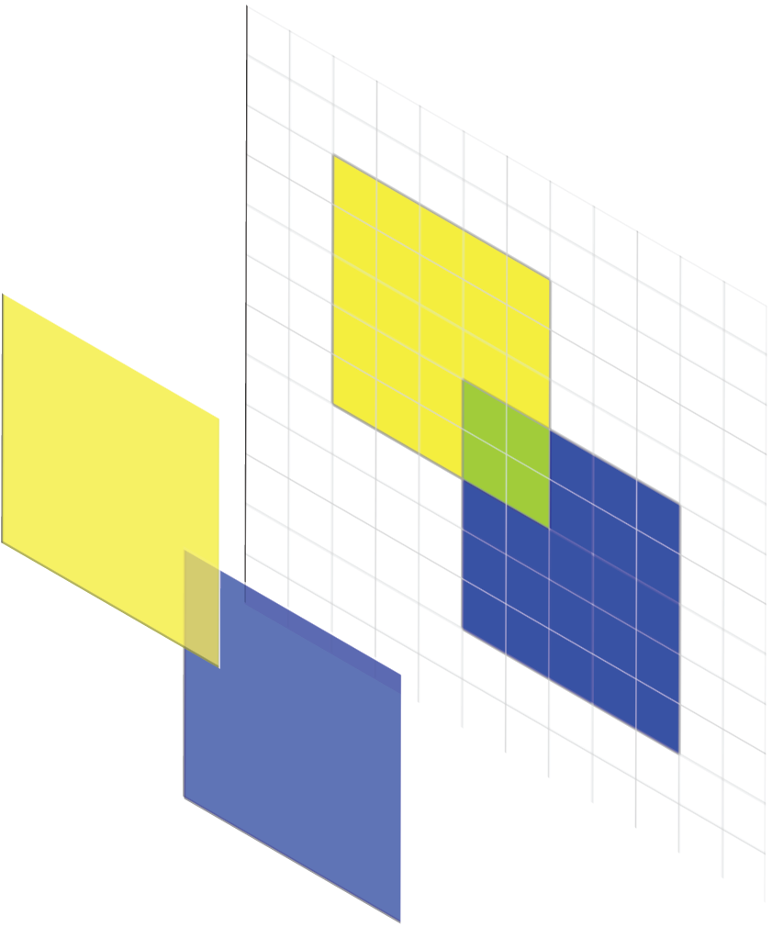
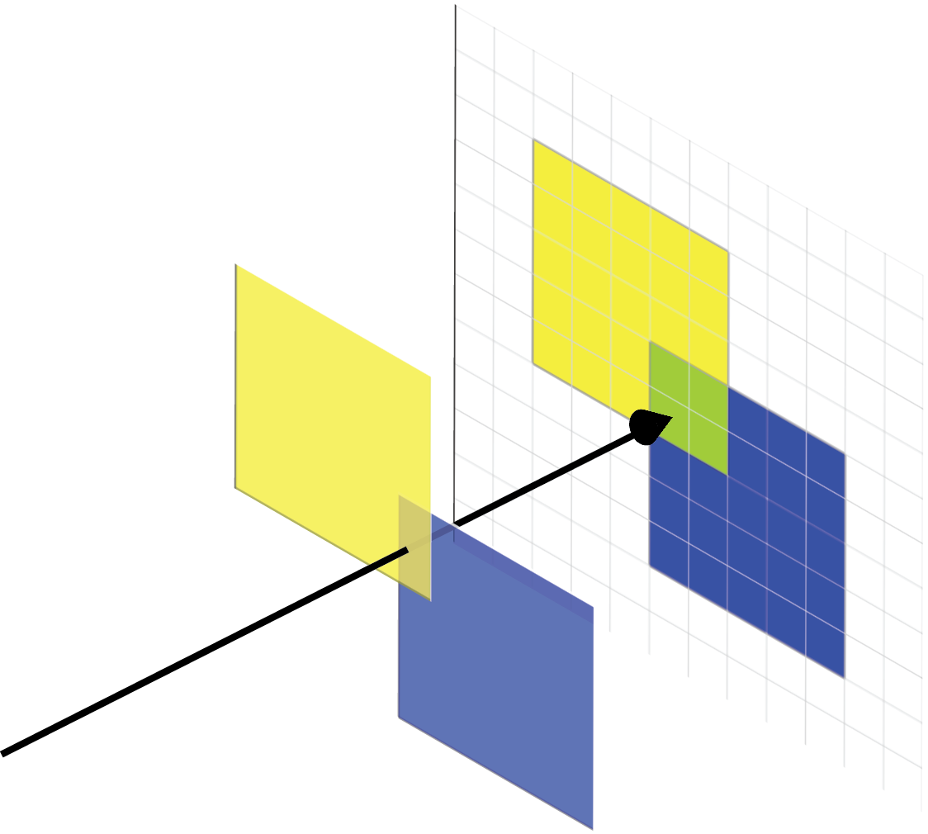

GPU Buffers
Color Buffer C
Depth buffer
  p_{j} is intersection of ray oπ and ω_{j}
  Can set to read-only
Color Buffer
  α_{j} is blending parameter
  χ_{j} is color of ω_{j}
  Binary options such as bitwise-OR

Slide 101
Handling Larger Grids
Algorithm is limited by size of GPU memory
Maximum sized grid in one pass is N x N
Divide grid into sub-grids Q of necessary size μ x μ with μ=(N-4r/ρ)/s
Using binning procedure for optimal I/O efficiency

Slide 102
I/O Efficient Binning
Have memory of size M and we write to disk with blocks of size B
If μ>M then m=M/μ and we need m² sub-grids
Can hold at most M/B streams in memory (holding B points per stream in memory at a time)
Partition into groups P of Q of size n=m/(M/B)^{1/2}
Recurse on P
Depth of recursion is
O(log_{M/B}M/μ)

Slide 103
Handling Larger Grids
Create point stream for each sub-grid
Iterate through points
Add points to each sub-grid which the point’s cone could effect
  Within r of the sub-grid
If necessary, recurse
Run algorithm on each sub-grid Q independently

Slide 104
BufferAnalysis
Iterate over pixels
Check if pixel is part of query point q’s Voronoi cell (color is set)
For each pixel reference C¹ for height of natural neighbor from which q stole area
Set of pixels Π

Slide 105
NNI Batch Query Processing
Save and clear color buffer C¹
Draw TPVor(S)
SLOW
Draw Voronoi cell for query
Save and clear color buffer C²
BufferAnalysis

Slide 106
NNI Query Processing
Draw TPVor(S)
Save and clear color buffer
Draw Voronoi cell for query q
Save color buffer
BufferAnalysis

Slide 107
Updated BufferAnalysis
Iterate over pixels
Check if pixel π is colored
  For each bit in C²[π] that is 1 find corresponding query point q_{i}
  Reference C¹ for height
  Update interpolated height

Slide 108
NNI Batch Query Processing
Save and clear color buffer C¹
Draw TPVor(S)
SLOW
Draw Voronoi cells for 32 queries
Save and clear color buffer C²
BufferAnalysis

Slide 109
NNI on Grids
M x M grid of query points
Spaced by ρs

Slide 110
Batched NNI on Grids
w is number of bits in color buffer (and number of queries we can handle by previous algorithm)
Break grid into query blocks of size B x B
Could handle each in one pass with previous algorithm
Notes:
Previous algorithm can handle up to w simultaneous queries so we break into query blocks of size <=w

Slide 111
Independence
Cones can only color pixels within a radius of r
If regions of influence are disjoint (independent) can use the same color for both cones
For a given red colored pixel must be able to determine which query colored it from set {q₁,q₂,q₃,q₄}
If the queries are independent then the closest query colored it

Slide 112
Batched NNI on Grids
Make assumption that cone radius is less than half the width of one query block
Queries in same position in different query blocks are independent
Execute previous algorithm on each query block simultaneously

Slide 113
Updated BufferAnalysis
Iterate over pixels
Check if pixel π is colored
  For each bit in C²[π] that is 1 find corresponding set of query points Q_{j} that used this bit as their color
  Find q_{i} in Q_{j} that is closest to π and update interpolated height for this query point
For red bit, Q_{j} = {q₁,q₂,q₃,…}
For blue bit, Q_{k} = {q₄,q₅,q₆,…}

Slide 114
Implementation Optimizations
Reduce disk-transfer
  I/O efficient binning of data for large grids
  Use Templated Portable I/O Environment (TPIE)

Slide 115
GPU Buffers
Buffers are 2D array of pixels.
Store unique piece of information about each pixel
Depth buffer
  Stores distance to closest object from viewpoint
  Can be set to read-only
Color Buffer
  Stores information about color as seen from a given viewpiont at each pixel
  Can blend objects in line of sight
  Binary options such as bitwise-OR
Color Buffer C

Slide 116
Performing an NNI query
|TPVor(q₁)| = 73
h(q₁)=(33/73)h(p₁)+(12/73)h(p₂)+(28/73)h(p₃)
Call this process BufferAnalysis

