Slide 1






SCALING SGD to
Big dATA
& Huge Models
Alex Beutel
Based on work done with Abhimanu Kumar, Vagelis Papalexakis, Partha Talukdar, Qirong Ho, Christos Faloutsos, and Eric Xing

Slide 2
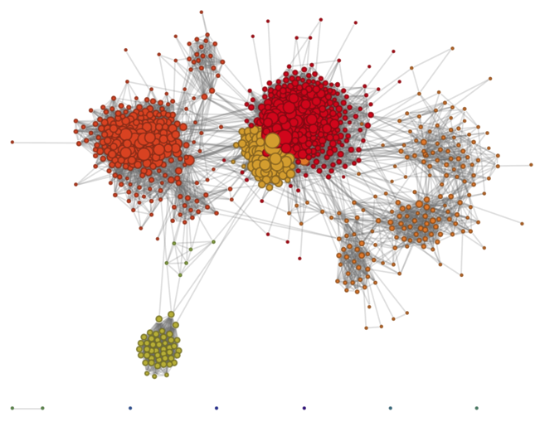





Big Learning Challenges
1 Billion users on Facebook
Collaborative Filtering
Predict movie preferences
Tensor Decomposition
Find communities in temporal graphs
300 Million Photos uploaded
to Facebook per day!
400 million tweets per day
Topic Modeling
What are the topics of webpages, tweets, or status updates
Dictionary Learning
Remove noise or missing pixels from images

Slide 3
Big Data & Huge Model Challenge
2 Billion Tweets covering 300,000 words
Break into 1000 Topics
More than 2 Trillion parameters to learn
  Over 7 Terabytes of model
400 million tweets per day
Topic Modeling
What are the topics of webpages, tweets, or status updates

Slide 4
Outline
Background
Optimization
  Partitioning
  Constraints & Projections
System Design
  General algorithm
  How to use Hadoop
  Distributed normalization
  “Always-On SGD” – Dealing with stragglers
Experiments
Future questions

Slide 5
Background

Slide 6
Stochastic Gradient Descent (SGD)

Slide 7
Stochastic Gradient Descent (SGD)

Slide 8
SGD for Matrix Factorization
Movies
V
Users
X
U
≈
Genres

Slide 9
SGD for Matrix Factorization
V
U
X
≈
Independent!

Slide 10
The Rise of SGD
Hogwild! (Niu et al, 2011)
  Noticed independence
  If matrix is sparse, there will be little contention
  Ignore locks
DSGD (Gemulla et al, 2011)
  Noticed independence
  Broke matrix into blocks

Slide 11
DSGD for Matrix Factorization (Gemulla, 2011)
Independent Blocks

Slide 12
DSGD for Matrix Factorization (Gemulla, 2011)
Partition your data & model into d × d blocks
Results in d=3 strata
Process strata sequentially,
process blocks in each stratum in parallel

Slide 13
Other Big Learning Platforms
GraphLab (Low et al, 2010) – Find independence in graphs
PSGD (Zinkevich et al, 2010) – Average independent runs on convex problems
Parameter Servers (Li et al, 2014; Ho et al, 2014)
  Distributed cache of parameters
  Allow a little “staleness”

Slide 14
Tensor Decomposition

Slide 15
What is a tensor?
Tensors are used for structured data > 2 dimensions
Think of as a 3D-matrix
For example:
Derek Jeter plays baseball
Subject
Object
Verb

Slide 16
Tensor Decomposition
Derek Jeter plays baseball
W
V
Subject
X
≈
U
Object
Verb

Slide 17
Tensor Decomposition
W
V
X
≈
U

Slide 18
Tensor Decomposition
Independent
W
V
X
≈
U
Not Independent

Slide 19
Tensor Decomposition

Slide 20
For d=3 blocks per stratum, we require d²=9 strata

Slide 21
Coupled Matrix + Tensor Decomposition
Subject
Y
X
Object
Document
Verb

Slide 22
Coupled Matrix + Tensor Decomposition
W
A
V
Y
X
≈
U

Slide 23
Coupled Matrix + Tensor Decomposition

Slide 24
Constraints & Projections

Slide 25
Example: Topic Modeling
Words
Topics
Documents

Slide 26
Constraints
Sometimes we want to restrict response:
  Non-negative
  Sparsity
  Simplex (so vectors become probabilities)
  Keep inside unit ball

Slide 27
How to enforce? Projections
Example: Non-negative

Slide 28
More projections
Sparsity (soft thresholding):
Simplex
Unit ball

Slide 29
Sparse Non-Negative
Tensor Factorization
Sparse encoding
Non-negativity:
More interpretable results

Slide 30
Dictionary Learning
Learn a dictionary of concepts and a sparse reconstruction
Useful for fixing noise and missing pixels of images
Sparse encoding
Within unit ball

Slide 31
Mixed Membership Network Decomp.
Used for modeling communities in graphs (e.g. a social network)
Simplex
Non-negative

Slide 32
Proof Sketch of Convergence
[Details]
Regenerative process – each point is used once/epoch
Projections are not too big and don’t “wander off”
(Lipschitz continuous)
Step sizes are bounded:
Noise from SGD
Projection
Normal Gradient Descent Update
SGD Constraint error

Slide 33
System design

Slide 34
High level algorithm
Stratum 1
Stratum 2
Stratum 3
…
for Epoch e = 1 … T do
for Subepoch s = 1 … d² do
Let be the set of blocks in stratum s
for block b = 1 … d in parallel do
Run SGD on all points in block
end
end
end

Slide 35
Bad Hadoop Algorithm: Subepoch 1
Mappers
Reducers
Run SGD on
Update:
Run SGD on
Update:
U₂
V₁
W₃
U₃
V₂
W₁
Run SGD on
Update:
U₁
V₃
W₂

Slide 36
Bad Hadoop Algorithm: Subepoch 2
Mappers
Reducers
Run SGD on
Update:
Run SGD on
Update:
U₂
V₁
W₂
U₃
V₂
W₃
Run SGD on
Update:
U₁
V₃
W₁

Slide 37
Hadoop Challenges
MapReduce is typically very bad for iterative algorithms
  T × d² iterations
Sizable overhead per Hadoop job
Little flexibility

Slide 38

High Level Algorithm
W₃
W₃
W₂
W₂
W₁
V₁
W₁
V₁
V₂
V₂
V₃
V₃
U₁
U₂
U₁
U₂
U₃
U₃
U₁
V₁
W₁
U₂
V₂
W₂
U₃
V₃
W₃

Slide 39
High Level Algorithm
W₃
W₃
W₂
W₂
W₁
V₁
W₁
V₁
V₂
V₂
V₃
V₃
U₁
U₂
U₁
U₂
U₃
U₃
U₁
V₁
W₃
U₂
V₂
W₁
U₃
V₃
W₂

Slide 40
High Level Algorithm
W₃
W₃
W₂
W₂
W₁
V₁
W₁
V₁
V₂
V₂
V₃
V₃
U₁
U₂
U₁
U₂
U₃
U₃
U₁
V₁
W₂
U₂
V₂
W₃
U₃
V₃
W₁

Slide 41
Hadoop Algorithm
Reducers
Mappers
Run SGD on
Update:
Process points:
…
U₁
V₁
W₁
HDFS
Map each point
Partition &
Sort
Run SGD on
Update:
to its block
U₂
V₂
W₂
HDFS
with necessary info to order
Run SGD on
Update:
…
U₃
V₃
W₃

Slide 42
Hadoop Algorithm
Reducers
Mappers
Process points:
Map each point
Partition &
Sort
to its block
with necessary info to order

Slide 43
Hadoop Algorithm
Reducers
Mappers
Process points:
…
Map each point
Partition &
Sort
to its block
with necessary info to order
…

Slide 44
Hadoop Algorithm
Reducers
Mappers
Run SGD on
Update:
Process points:
…
U₁
V₁
W₁
Map each point
Partition &
Sort
Run SGD on
Update:
to its block
U₂
V₂
W₂
with necessary info to order
Run SGD on
Update:
…
U₃
V₃
W₃

Slide 45
Hadoop Algorithm
Reducers
Mappers
Run SGD on
Update:
Process points:
…
U₁
V₁
W₁
Map each point
Partition &
Sort
Run SGD on
Update:
to its block
U₂
V₂
W₂
with necessary info to order
Run SGD on
Update:
…
U₃
V₃
W₃

Slide 46
Hadoop Algorithm
Reducers
Mappers
Run SGD on
Update:
Process points:
…
U₁
V₁
W₁
HDFS
Map each point
Partition &
Sort
Run SGD on
Update:
to its block
U₂
V₂
W₂
HDFS
with necessary info to order
Run SGD on
Update:
…
U₃
V₃
W₃

Slide 47
System Summary
Limit storage and transfer of data and model
Stock Hadoop can be used with HDFS for communication
Hadoop makes the implementation highly portable
Alternatively, could also implement on top of MPI or even a parameter server

Slide 48
Distributed Normalization
Words
Topics
π₁
β₁
Documents
π₂
β₂
π₃
β₃

Slide 49
Distributed Normalization
Transfer σ^{(b)} to all machines
Each machine calculates σ:
σ^{(b)} is a k-dimensional vector,
summing the terms of β_{b}
π₁
β₁
σ⁽²⁾
σ⁽²⁾
σ⁽²⁾
Normalize:
σ⁽¹⁾
σ⁽³⁾
π₂
β₂
π₃
β₃
σ⁽¹⁾
σ⁽¹⁾
σ⁽³⁾
σ⁽³⁾

Slide 50
Barriers & Stragglers
Reducers
Mappers
Run SGD on
Update:
Process points:
…
U₁
V₁
W₁
HDFS
Partition &
Sort
Wasting time
waiting!
Map each point
Run SGD on
Update:
to its block
U₂
V₂
W₂
HDFS
with necessary info to order
Run SGD on
Update:
…
U₃
V₃
W₃

Slide 51
Solution: “Always-On SGD”
For each reducer:
Run SGD on all points in current block Z
Shuffle points in Z and decrease step size
Check if other reducers are ready to sync
Wait
Run SGD on points in Z again
If not ready to sync
If not ready to sync
Sync parameters
and get new block Z

Slide 52
“Always-On SGD”
Reducers
Run SGD on old points again!
Run SGD on
Update:
Process points:
…
U₁
V₁
W₁
HDFS
Map each point
Partition &
Sort
Run SGD on
Update:
to its block
U₂
V₂
W₂
HDFS
with necessary info to order
Run SGD on
Update:
…
U₃
V₃
W₃

Slide 53
Proof Sketch
[Details]
Martingale Difference Sequence: At the beginning of each epoch, the expected number of times each point will be processed is equal

Slide 54
Proof Sketch
[Details]
Martingale Difference Sequence: At the beginning of each epoch, the expected number of times each point will be processed is equal
Can use properties of SGD and MDS to show variance decreases with more points used
Extra updates are valuable

Slide 55
“Always-On SGD”
Reducer 1
Reducer2
Reducer 3
Reducer 4
First SGD pass of block Z
Read Parameters from HDFS
Extra SGD Updates
Write Parameters to HDFS
Notes:
Use on paramater server
Gibbs sampling

Slide 56
Experiments

Slide 57
FlexiFaCT (Tensor Decomposition)
Convergence

Slide 58
FlexiFaCT (Tensor Decomposition)
Scalability in Data Size

Slide 59
FlexiFaCT (Tensor Decomposition)
Scalability in Tensor Dimension
Handles up to 2 billion parameters!
Notes:
Rank=50

Slide 60
FlexiFaCT (Tensor Decomposition)
Scalability in Rank of Decomposition
Handles up to 4 billion parameters!

Slide 61
Fugue (Using “Always-On SGD”)
Dictionary Learning: Convergence

Slide 62
Fugue (Using “Always-On SGD”)
Community Detection: Convergence

Slide 63
Fugue (Using “Always-On SGD”)
Topic Modeling: Convergence

Slide 64
Fugue (Using “Always-On SGD”)
Topic Modeling: Scalability in Data Size
GraphLab cannot spill to disk

Slide 65
Fugue (Using “Always-On SGD”)
Topic Modeling: Scalability in Rank

Slide 66
Fugue (Using “Always-On SGD”)
Topic Modeling: Scalability over Machines

Slide 67
Fugue (Using “Always-On SGD”)
Topic Modeling: Number of Machines

Slide 68
Fugue (Using “Always-On SGD”)

Slide 69
Looking forward

Slide 70
Future Questions
Do “extra updates” work on other techniques, e.g. Gibbs sampling? Other iterative algorithms?
What other problems can be partitioned well? (Model & Data)
Can we better choose certain data for extra updates?
How can we store large models on disk for I/O efficient updates?

Slide 71
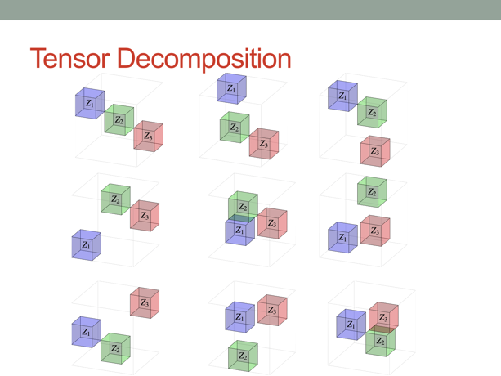
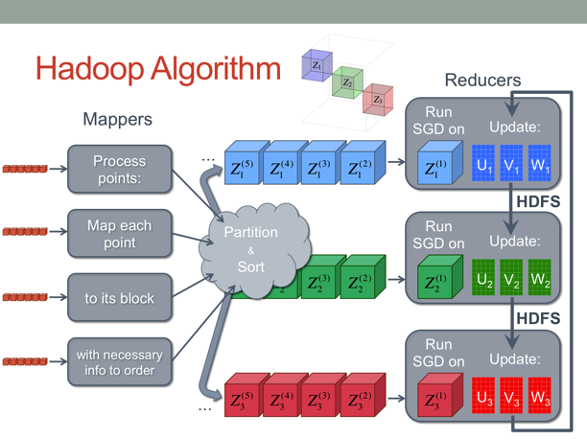
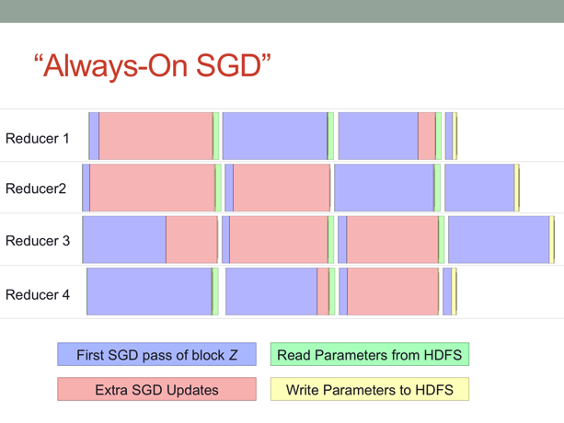
Key Points
Flexible method for tensors & ML models
Partition both data and model together for efficiency and scalability
When waiting for slower machines, run extra updates on old data again
Algorithmic & systems challenges in scaling ML can be addressed through statistical innovation

Slide 72

Questions?
Alex Beutel
abeutel@cs.cmu.edu
http://alexbeutel.com
Source code available at http://beu.tl/flexifact

